Slide 1
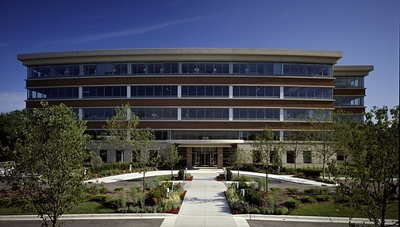
Weltman Bernfield LLC
Certified Public Accountants and Business Consultants

Slide 2
Since 1925 Weltman Bernfield LLC has remained strongly tied to the ethics and philosophy of its founders. Though we’re rooted in tradition, we’re committed to the future of our clients and out employees. We will continue to build the staff and capabilities you’ve come to expect, and offer a wide range of personalized services to both individuals and business clients. How can we help you?
Weltman Bernfield LLC
Our Services Include:
Audits, Reviews, and Compilations of Financial
Statements
Business Start-up and Entity Selection
Succession Planning
Business Valuations
Cash Flow and Budgeting Analysis
Senior Advisory Services
Estate and Gift Tax Preparation and Planning
Family Business Consulting
Financial Forecasts and Projections
Financial and Retirement Planning
Healthcare Financial Management Solutions
Individual and Business Tax Planning and Preparation
IRS Representation
Mergers & Acquisitions Consulting
Not for Profit Accounting and Tax Services
Public Company Reporting and Compliance
QuickBooks and other Accounting Software Design and
Implementation
Real Estate Accounting and Tax Services
Restructuring and Turnaround Solutions

Slide 3
Weltman Bernfield LLC
Introducing…
Partner Insights
with WB

Slide 4
Partner Insights with WB
Weltman Bernfield LLC
Come discuss topics on information that will help you in your business and personal life.
Income and Estate Tax Planning
Starting a Business
Healthcare Management
Personal Investment and Credit
Strategies
Retirement Planning
Business Succession Planning
Facts About Your Next IRS Audit
Business Valuation Process and
Strategies
Business Fraud Detection and
Prevention
Sarbanes-Oxley (Sox) Implementation
and Compliance
Equity Funding Strategies
Alternative Investment Strategies

