Slide 1
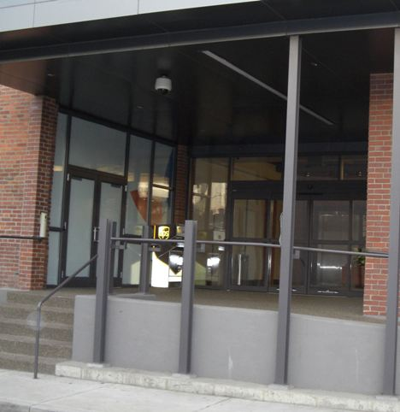
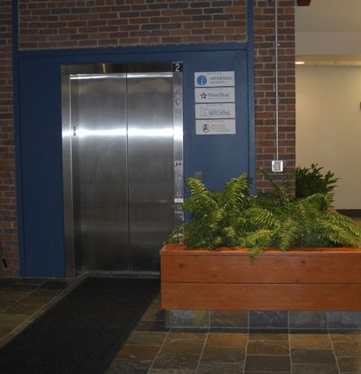



Welcomes our New National Call Center
High Security Entrance with Key Code Access and Over-head Camera Detection
Easy Accessibility to small parts storage facility

Slide 2
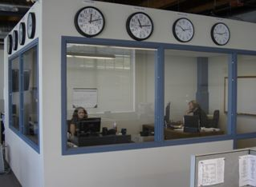
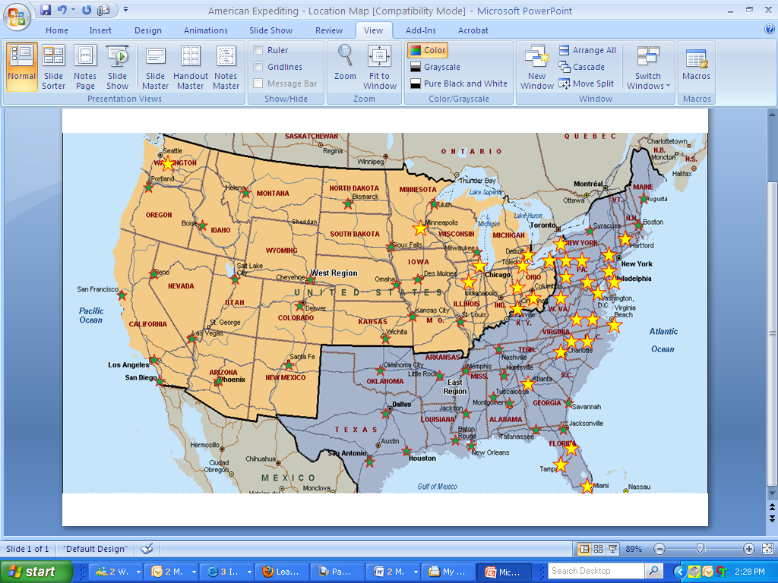
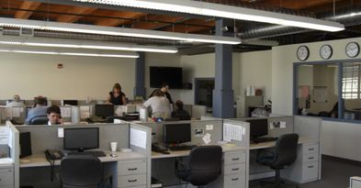
Mission Control – 24/7/365
*Over 200 top U.S. Cities Covered
*Forty Company Owned Distribution Centers
*Established 1983

Slide 3
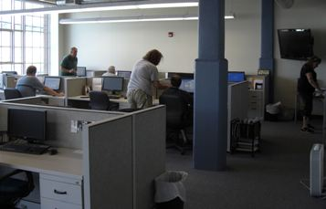
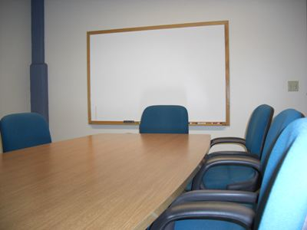
Operations Central
Daily Coordination Meetings - Review Standard Operational
Procedures, New Clients, On-Time Reports, etc.,
Customer Service and Dispatch – 36 work stations

Slide 4
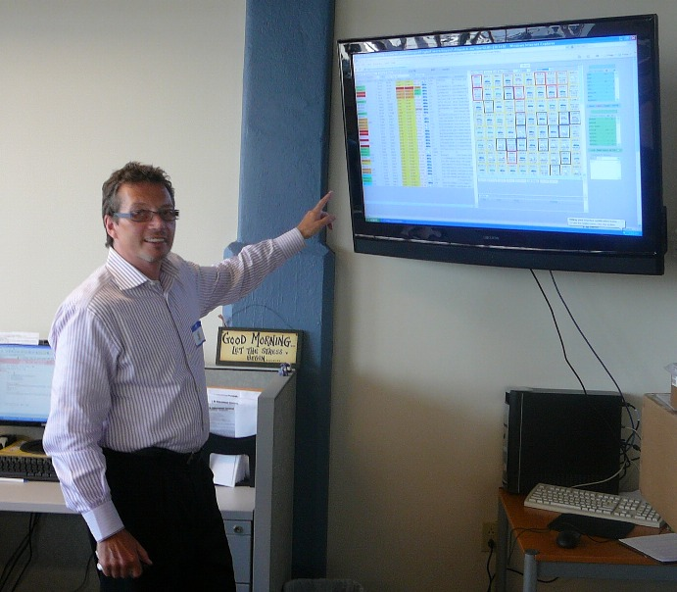
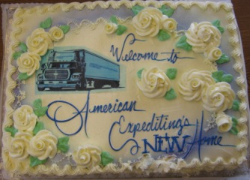
“HELPING TO SAVE LIVES”

