Slide 1
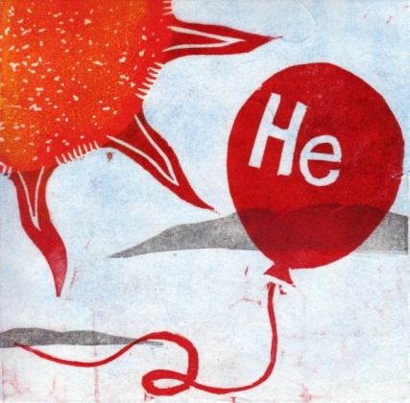
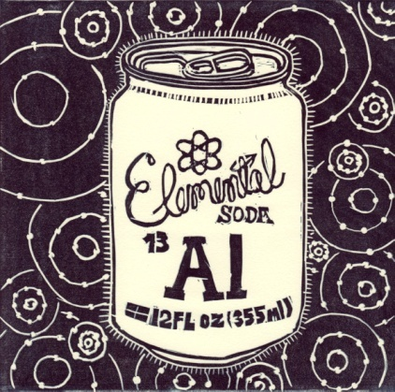
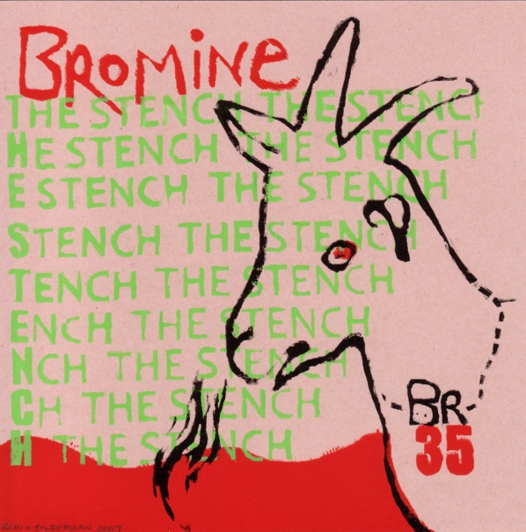
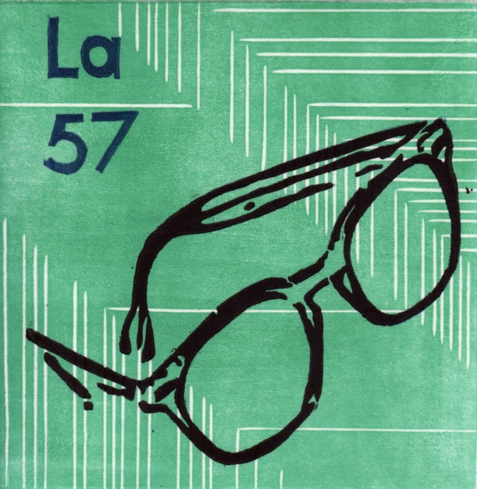
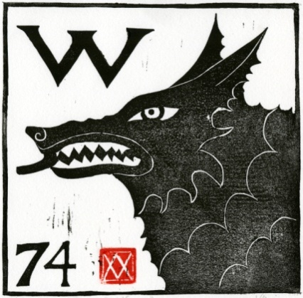
Periodic Table Printmaking Project, 2007 118 prints by 97 artists woodcut, linocut, monotype, etching, lithograph, silkscreen, or in combination Jennifer Schmitt, Curator, Concord, Massachusetts
Helium: Jennifer Schmitt Aluminum: Ellen Brooks
Bromine, Robin Lookability
Lanthanum: Jennifer Schmitt
Tungsten: Viza Arlington

