Slide 1

Collaborative Energy Bitrix Intranet 10.0 uniting the energies of each employee to achieve efficiency at all levels

Slide 2
Bitrix Intranet
spectrum of services
Vertical Communications
Tasks with reports
Company news
Employee directory
Records management
Photo and video galleries
Absence chart
Enterprise search with suggestions
Online training
Horizontal Communications
Workgroups
Document sharing
Wiki
Calendaring and event planning
Instant messenger
Online indicator
Extranet
Send&Save SMTP server
much more

Slide 3
Bitrix Intranet
spectrum of services
Automation of Operations
Business processes
Visual business process modeler
Lists (Records Management)
Resource scheduling
Web forms
Helpdesk
Social Networking
Rich user profiles
Forums
Photo galleries with commentary
Personal blogs
Microblogging
Bulletin boards and much more

Slide 4
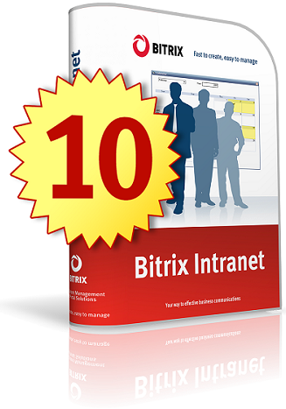
Bitrix Intranet 10.0 – new horizons
Time management 2.0
Department intranets
Web cluster
Document management
CRM
Integration with Microsoft, Apple, Google products
MS SharePoint
Microblogs
Live Feed
MS Office
Task management 2.0
Mobile apps
MS Exchange

Slide 5

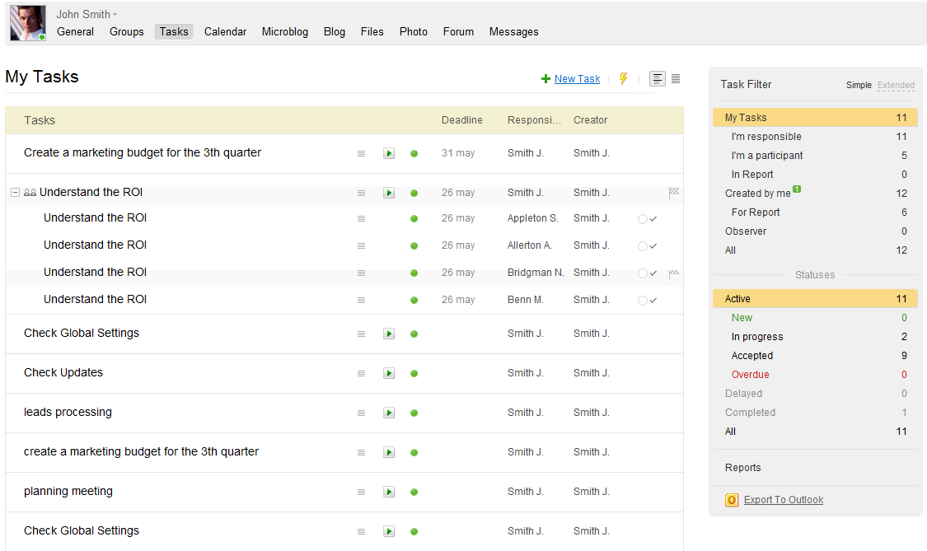
Task Management 2.0
Tasks assigned by a direct superior are automatically accepted.
Tasks from peers or different departments must be approved.
Filtering of tasks by status, tags and dates.
Integration with Microsoft Outlook and Exchange
Option for mandatory approval
Efficiency reports
All parties involved can leave commentary at any time

Slide 6
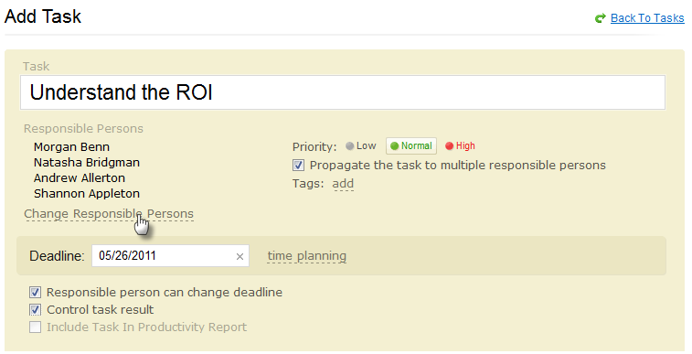
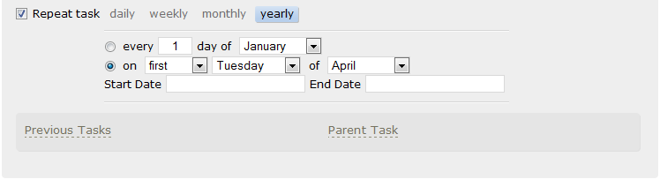
Task Management 2.0
Periodic tasks with flexible renewal times
Tasks listed by due dates or priority
Quick assignment with notification
Subtasks with unlimited nesting
Assignment of responsible persons, participants, and observers
Duplication of tasks to multiple assignees
Attach files
Add links and tags

Slide 7
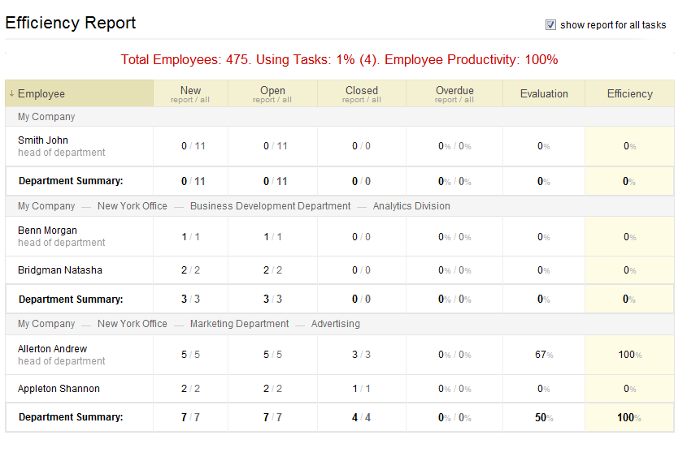
Efficiency Reports
Built using tasks marked to be included in the report. Include evaluation of immediate superior.
All employees can see a personal efficiency report and the report of their corresponding department and the company.
Managers can see subordinates’ reports
Report includes:
workload (current and completed tasks for the time period)
KPIs (percentage of completed and overdue tasks, evaluation by supervisor)
efficiency (percentage of approved tasks finished in the period)

Slide 8

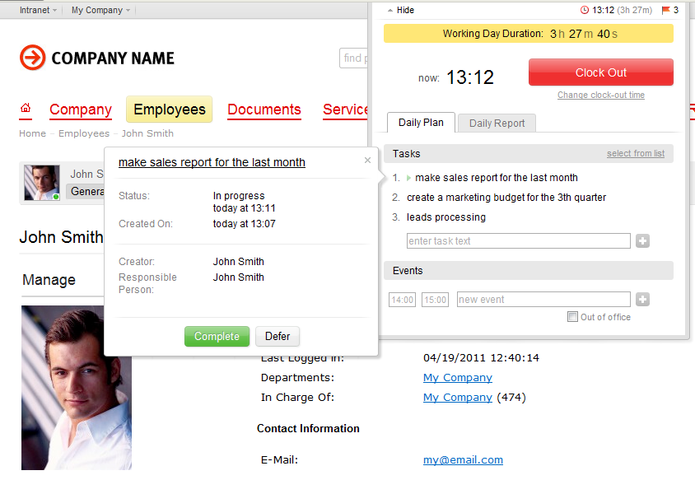
Time Management 2.0
Clocking in and out:
work day begins with login to the intranet
system allows for breaks
Quick daily plan choosing tasks from the task list or adding other duties manually
Daily reports as the day progresses or just before clocking out

Slide 9
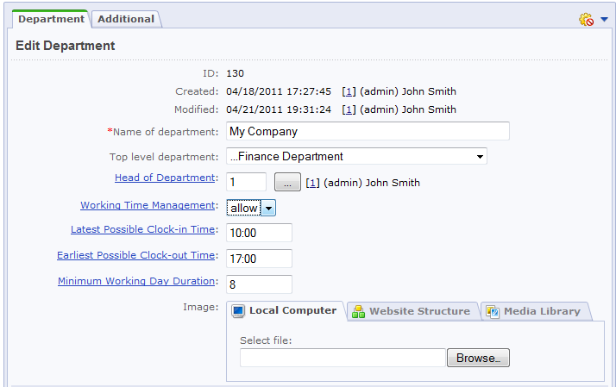
Time Management 2.0
Work day settings include:
start and finish of working hours
permitted lateness (in minutes)
total amount of break time in a working day
minimal length of a working day
Settings can be applied throughout the company, to a specific department or to an individual employee.

Slide 10
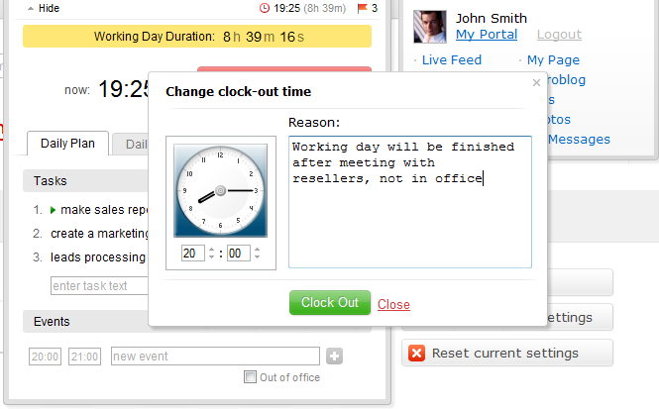
What if I forgot to…?
Clock in or Start working day – a time other than the current time can be marked with a brief explanation of the discrepancy.
Clock out or End working day- a time other than the current time can be marked with a brief explanation of the discrepancy.
The employee’s supervisor approves exceptions before the work day can appear in the working time report.

Slide 11
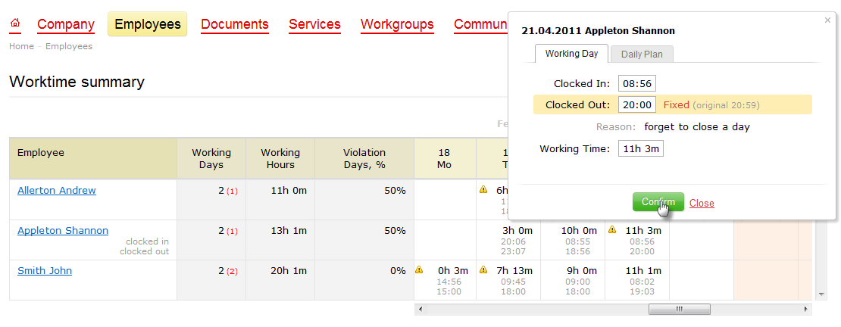
Working Time Report
A supervisor can view daily information about employees, their daily plans, and the report from the previous day or days.
The report is integrated with the Absence Chart.
The HR department or accounting can use the report to calculate pay for the payment period.

Slide 12
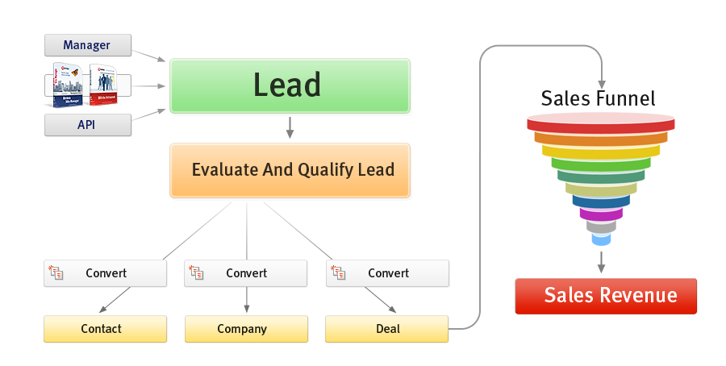
CRM
CRM (Customer Relationship Management) – a system for managing interaction with customers and contacts.

Slide 13
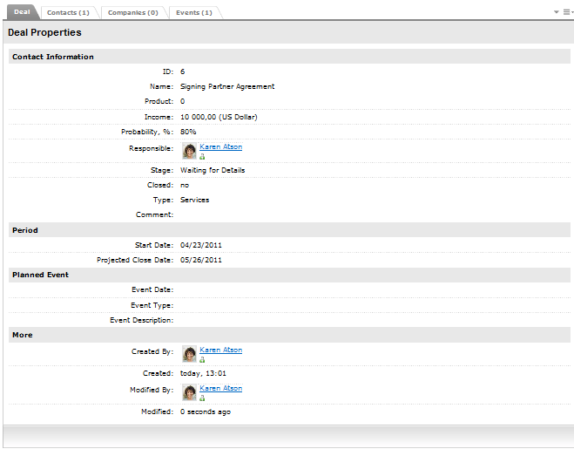
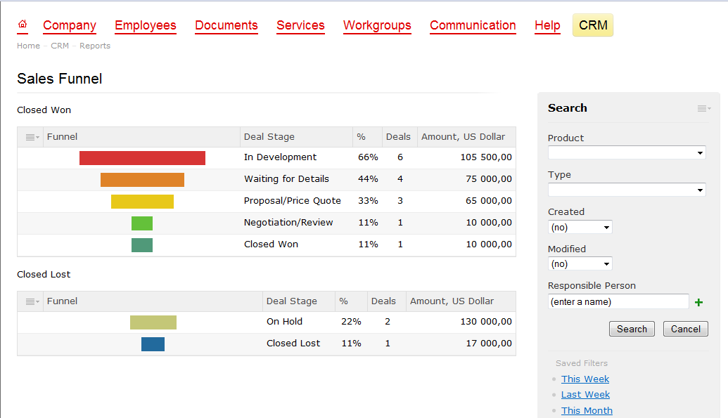
CRM
Lead management
leads can be added from a website, imported in bulk, or added manually.
leads are converted into Contacts or Companies.
Contact and Company management
Deal management
Event logging
Integration with Outlook for Contacts
Adaptive interface for viewing of records, convenient filtering system
Settings
Settings for all directories
Customizable fields for Leads, Contacts, Companies, and Deals.
Reports for all events
Sales funnel
Personalized desktop

Slide 14
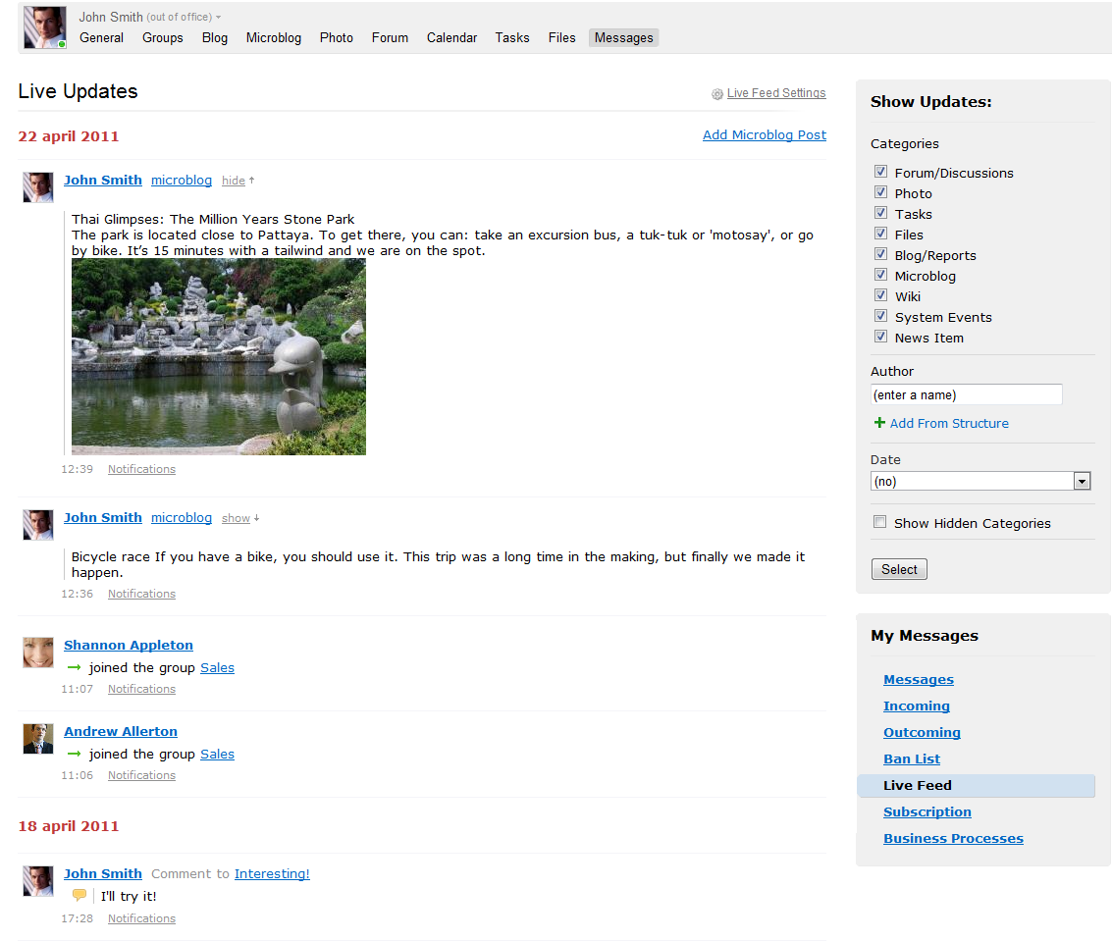
Live Feed
United feed for all intranet events, keeping everyone in tune with the pace of the company.
Updates are access-sensitive; users can choose to turn off categories of updates.
Notification of changes in top task bar.
Viewing and posting from mobile devices.

Slide 15
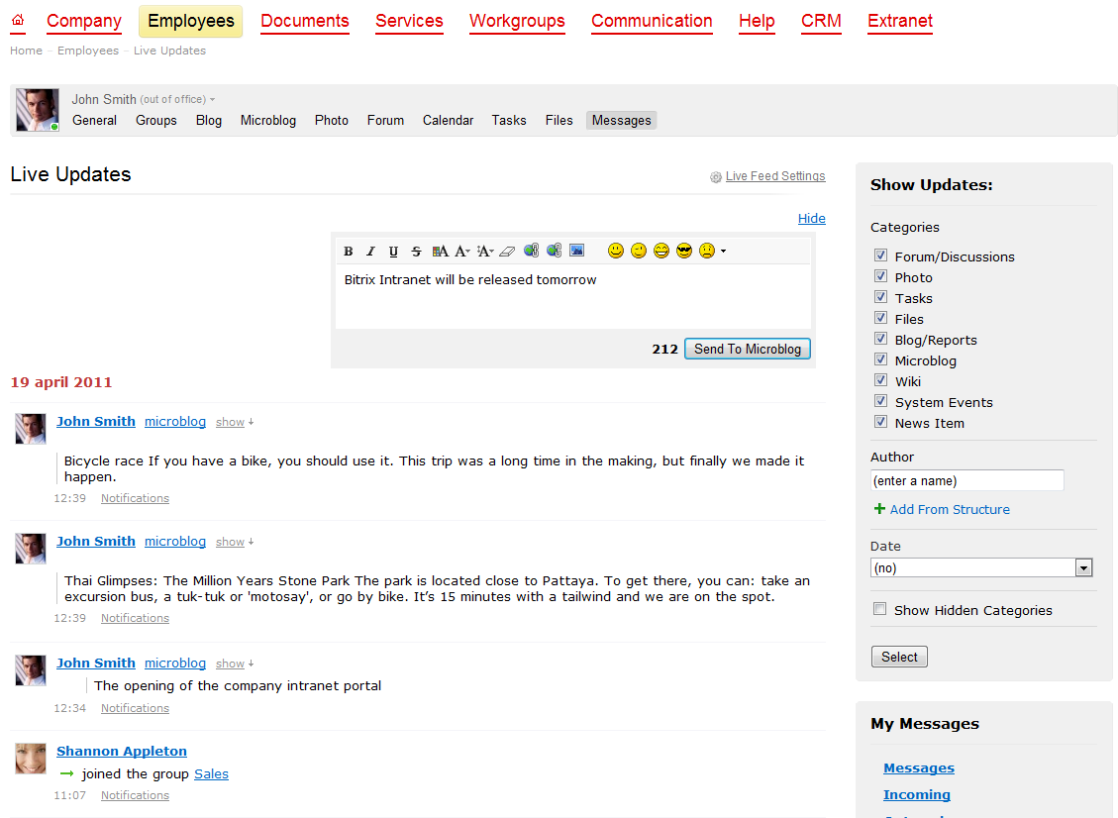
Microblog
Exchange of messages among users for quick information and updates, comments, or whatever they are doing at the time.
Microblogs for each user and workgroup
Posts appear in the Live Feed
Posting from mobile devices

Slide 16
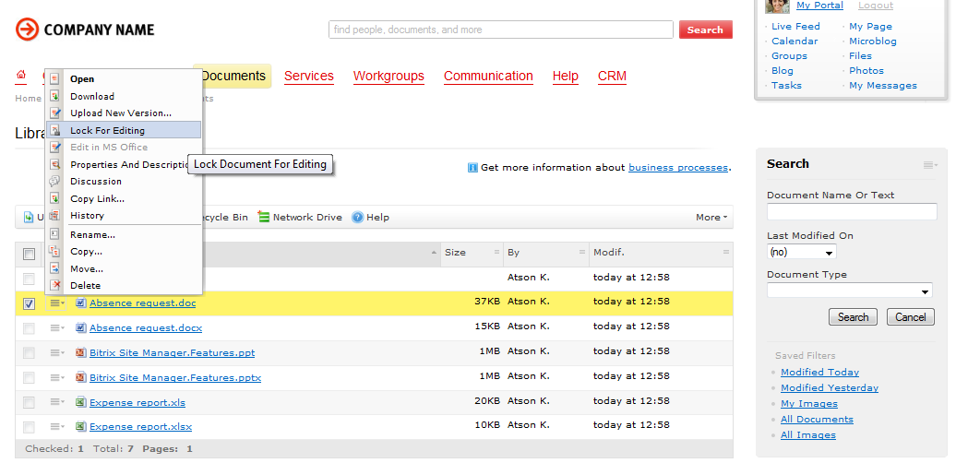
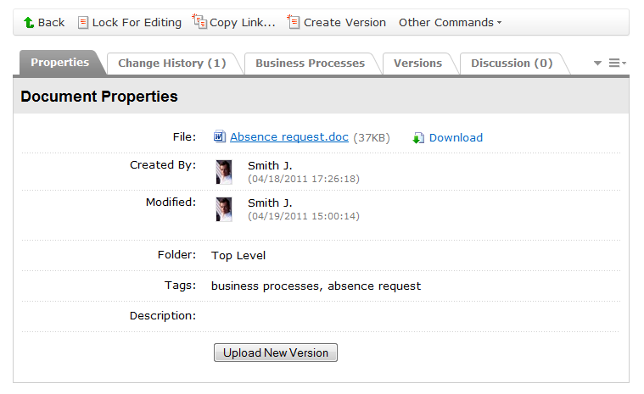
Document Management
New interface
Version history
Recycle bin
Detail page for each document
Bulk upload
Indexed by enterprise search and search suggestions
Full two-way integration with Microsoft

Slide 17
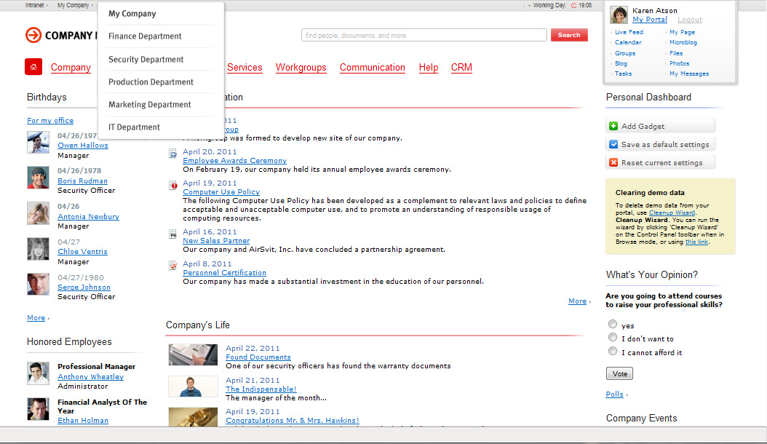
Department Intranets
Each department or division can now have a partitioned intranet with integration into the global intranet to the degree desired.

Slide 18
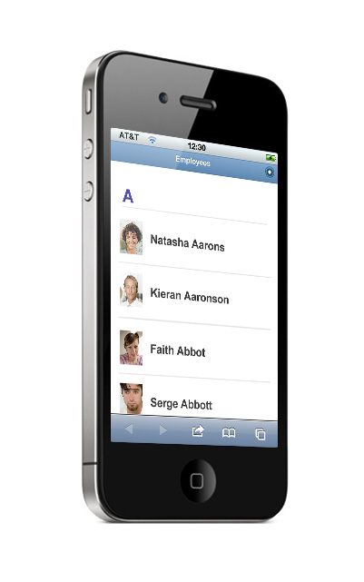
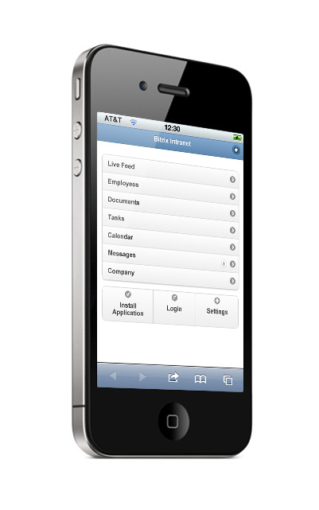
Mobile apps
Mobile web apps, created on the basis of BitrixMobile technology, allow mobile access to the intranet. Custom apps can be developed using BitrixMobile.

Slide 19
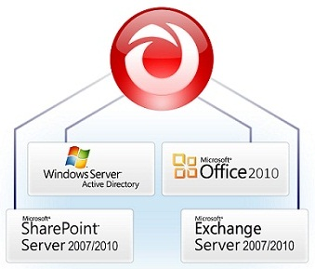
Integration with Microsoft
Connector with MS Exchange Server 2007/2010
Connector with MS SharePoint
Integration with MS Exchange Web Mail
Improved integration with Active Directory and MS Office
Connector with MS Exchange Server 2007/2010 provides two-way integration of calendars and tasks with import of contacts.

Slide 20
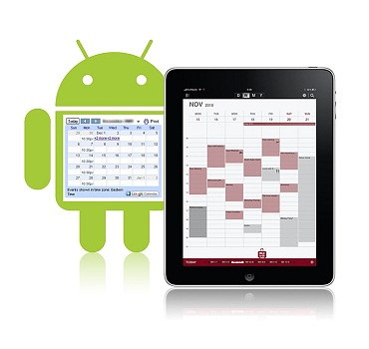
Integration with Apple and Google
With the newly-developed support for CalDAV formats, Google calendars can now be shared in the intranet and accessed and modified from Android devices with synchronization.
Support of CardDAV and CalDAV allows calendar sharing with devices using Mac OS X, iPad, and iPhone with two-way data exchange and contact export from the intranet

Slide 21

Bitrix Web-cluster Both existing and new web projects based on applicable editions of Bitrix Site Manager can be distributed among several interchangeable servers using Bitrix Web-cluster.
Bitrix Web-cluster enables:
High availability clusters. Redundancy in clusters maintains site availability during a server fail event.
High performance clusters. Traffic spikes or other load peaks are countered by the addition of more server resources.
Balancing of load, traffic, and data storage among several servers.

Slide 22

Bitrix Intranet: BizPace Enterprise
The new edition of Bitrix Intranet contains 2 modules that are not included in regular BizPace. The modules do not contain user-related functionality, but rather provide much-needed features for high-value intranets.
Department Intranets
Web Cluster
Pricing starts at $9990
Clients currently using BizPace with an active subscription to updates can upgrade to BizPace Enterprise at no charge for a limited time.

Slide 23
Bitrix Intranet Portal Homepage: http://www.bitrixsoft.com/products/intranet/
Download the newest 90-day trial:
http://www.bitrixsoft.com/products/intranet/demo.php
Online demo:
http://www.bitrixsoft.com/download/intranet/index.php

Slide 24


Contact us
website: http://www.bitrixsoft.com
partner directory: http://www.bitrixsoft.com/partners/
bitrixsoft
consult.bitrixsoft
general: info@bitrixsoft.com partners: partners@bitrixsoft.com
Stephen Ankenman Regional Director, US & Canada
stephen@bitrixsoft.com
Nikolay Shulgin Regional Director, D-A-CH
shulgin@bitrixsoft.com

