Slide 1
Time on Page – Images versus no images
Notes:
No disparity between visits….

Slide 2
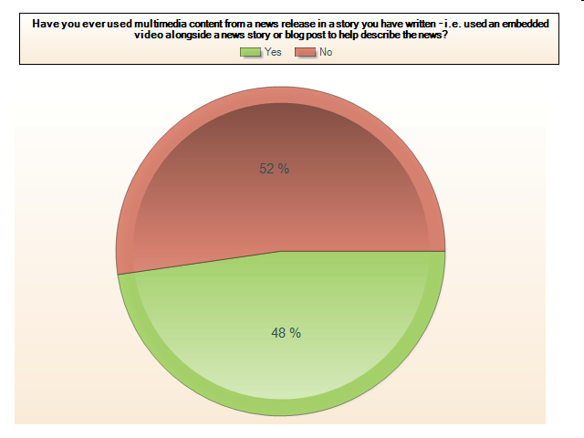
Usage of multimedia by journalists

Slide 3
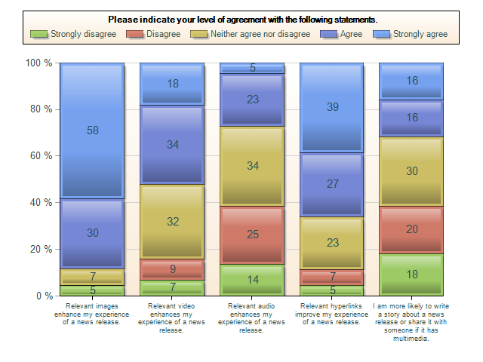
Value of multimedia for journalists

Slide 4
Qualitative feedback from journalists
“Photos of new products are essential for us to write about those products. We like to show our readers the product as well as write about it. “
“Multimedia is useful when it is fully relevant--throwing it in just to be "multimedia" can be irritating to the reader. For video and audio, a brief lead-in to explain why I would take the time to watch/listen is always helpful.”
The speaker in an online video needs to be engaging -- not boring! Plus the video needs to be interesting -- not just a person talking. Further, make sure the person is saying something valuable to journalists, not just a "come to our website for more" soundbite or worse a bite that says, "we value consumers."

