Slide 1
Beautiful & Affordable Wedding Dresses
www.DressesShop.com

Slide 2
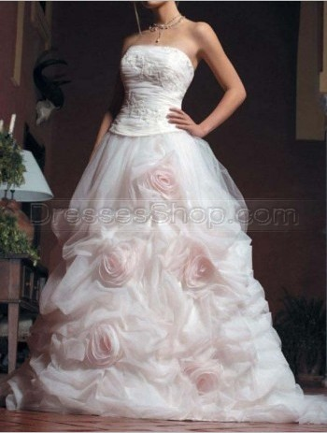
Classic Fashion Off-the Shoulder Pink Organza A-Line/Princess Line Dress Ruched Beading Flower/Rosette Sleeveless Chest Wrap Lace up Mid Back Court Train Wedding Dresses (Weddingdresses4757)

Slide 3
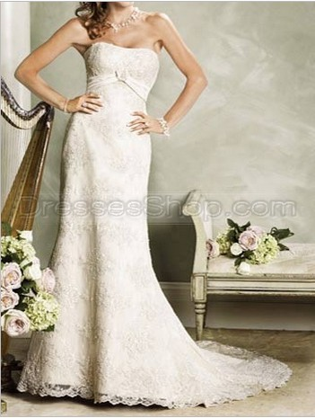
Chic Elegant Luxury Glamorous Off-the Shoulder Champagne Hot Lace Mermaid/Trumpet Applique Beading Pleated Lace Sleeveless Chest Wrap Lace up Mid Back Court Train Wedding Dresses (Weddingdresses5082)

Slide 4
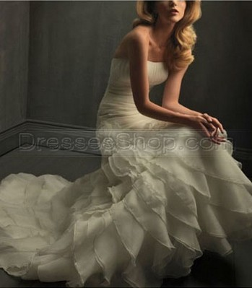
2011 Holy White Mermaid Pleated Buttons Flower Organza Wedding Dress Bridal Dresses Item No. : weddingdress2481

Slide 5
2011 Style Elegant Empire Strapless Court Train Soft Transparency Wedding Dress Item No. : empirewd0005

Slide 6
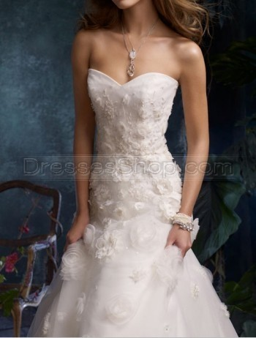
Noble A-Line Ivory Organza Sweet-Heart Ruched Beading Rosette Low Back Off-the Shoulder Package Hip Wedding Dresses Item No. : Weddingdresses5889

Slide 7
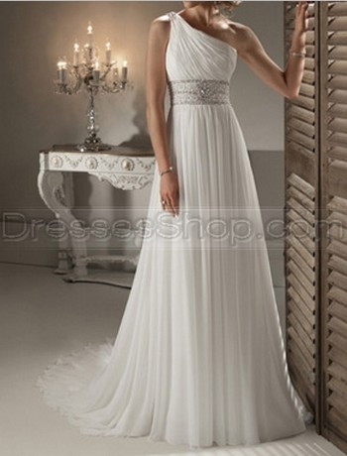
Chic Luxury Sexy One-Shoulder White Chiffon Sheath/Column Ruched Beading Sleeveless Chest Wrap Lace up Mid Back Court Train Wedding Dresses (weddingdress5558)

Slide 8
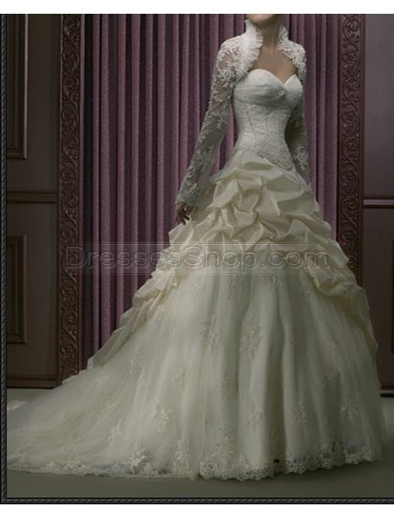
Modern Ball Gown Ivory Long Sleeves Asymmetrical Taffeta Organza Applique Pleated Beading Wedding Dress Item No. : Weddingdresses3738

Slide 9
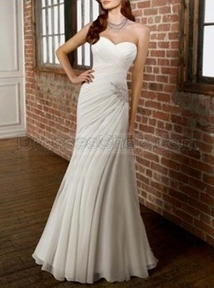
Delicate Bust Corset Ivory Chiffon Applique Beading Ruched Lace up Mid Back Court Train Wedding Dresses(Weddingdresses3577)

Slide 10
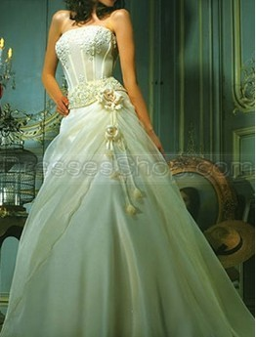
Modern Glamorous Vintage Off-the Shoulder Asymmetrical Champagne Satin Organza A-Line/Princess Line Dress Applique Beading Pleated Flower Sleeveless Chest Wrap Lace up Mid Back Chapel Train Wedding Dresses (Weddingdresses5126)

Slide 11
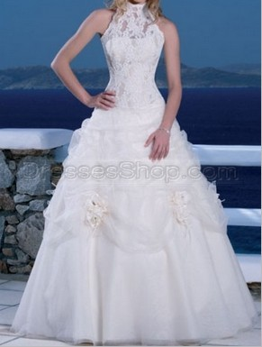
Chic Luxury Fashion Bust Corset White Satin Organza Ball Gown Beading Flower/Rosette Ruched Sleeveless High-Neck Zip up High/Covered Back Wedding Dresses (Weddingdresses4804)

Slide 12
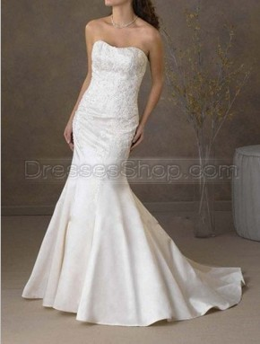
Modern Fantasy Strapless Package Hip Ivory Satin Mermaid/Trumpet Applique Beading Pleated Sleeveless Sweet-Heart Lace up Mid Back Court Train Wedding Dresses (Weddingdresses4859)

Slide 13
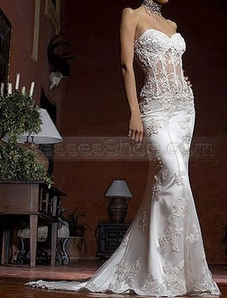
Sweetheart Romantic Off-the Shoulder Package Hip Ivory Satin Lace Mermaid/Trumpet Applique Beading Pleated Lace Sleeveless Sweet-Heart Lace up Mid Back Sweep Train Wedding Dresses (Weddingdresses5147)

Slide 14
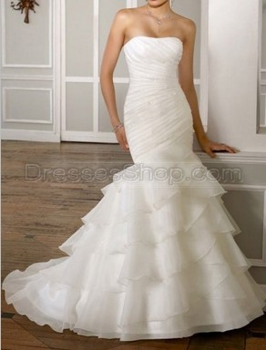
Timeless Gorgeous Package Hip Asymmetrical White Satin Organza Mermaid/Trumpet Beading Ruffles Sleeveless Chest Wrap Lace up Mid Back Court Train Wedding Dresses (weddingdress5616)

Slide 15
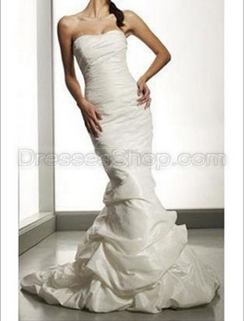
Empire Mermaid/Trumpet Court Train Buttons Ruched Satin White Wedding Dress for Bride Item No. : tmwd0036

Slide 16
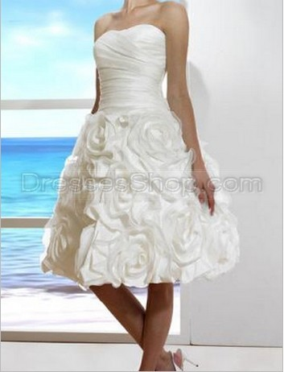
Luxurious A-Line Off-the Shoulder Bust Corset Pleated Flower/Rosette Organza Wedding Dress Item No. : Weddingdresses2365

Slide 17
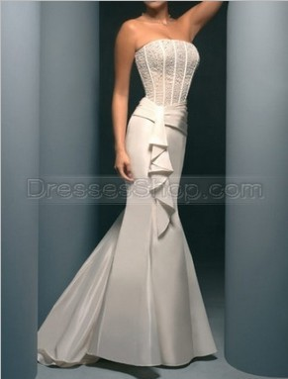
Fantasy Mermaid Strapless Floor Length Ruched Ruffles Beading Wedding Dress Item No. : Weddingdresses4201

Slide 18
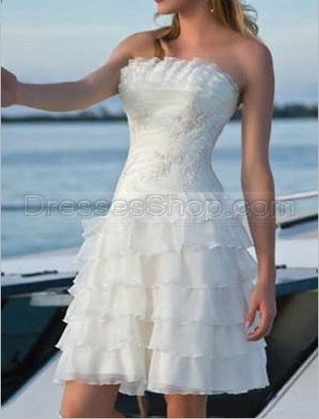
Sheath/Column Off-the Shoulder Romantic Flounce Applique Pleated Beading Organza Wedding Dress Item No. : Weddingdresses2379

Slide 19
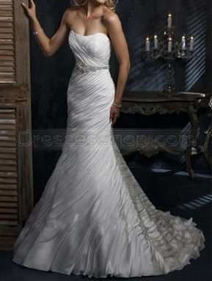
Modern Elegant Refined Strapless Package Hip White Satin Mermaid/Trumpet Rhinestones Ruched Beading Sleeveless Chest Wrap Lace up Mid Back Court Train Wedding Dresses (weddingdress5521)

Slide 20
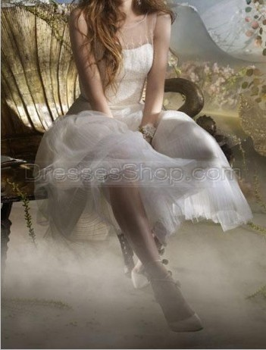
Fashion Full Skirt White Organza Beading Sequins Sheer Back Sling Bust Corset Intermission Wedding Dresses Item No. : Weddingdresses5886

Slide 21
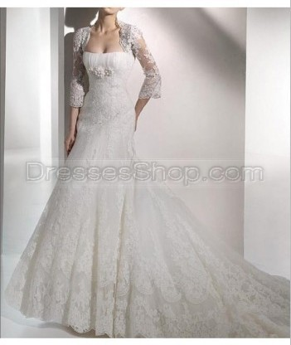
Posh Trumpet Ivory Hot Lace Beading Sequins Lace Off-the Shoulder Package Hip Long Sleeves Wedding Dresses Item No. : Weddingdresses5728

