Slide 1
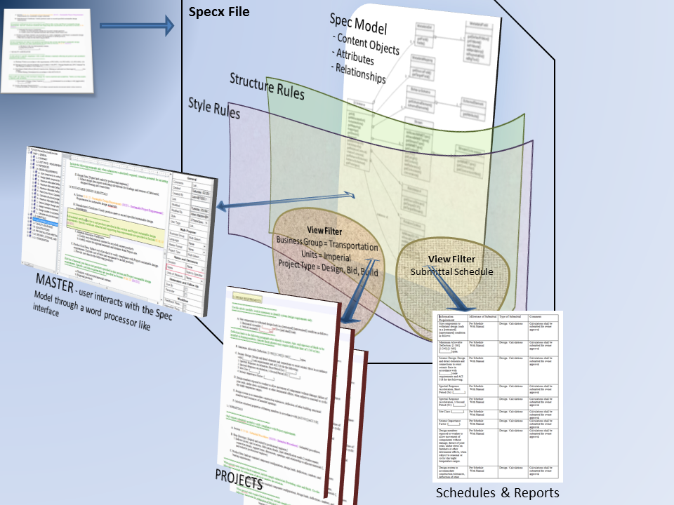
Spec Modeling
- Migrate
User customizable
Style & Structure Rules
Attributes
View Filters
Once modeled, spec managers can
continue to create more rules
and filters to
Update Existing Projects
Provision New Projects

Slide 2

- Migrate
Spec-driven
Processes
Drive processes directly from the Spec Model ensuring compliance to the governing documents
Design
Cost Estimating
Requisitions
Bidding
Purchasing
Quality Assurance
Receiving
Construction
Operations
User customizable
Style & Structure Rules
Attributes
View Filters
Once modeled, spec managers can
continue to create more rules
and filters to
Update Existing Projects
Provision New Projects

Slide 3

- Migrate
- Lessons Learned
- Updates
Spec-driven
Processes
Drive processes directly from the Spec Model ensuring compliance to the governing documents
Design
Cost Estimating
Requisitions
Bidding
Purchasing
Quality Assurance
Receiving
Construction
Operations
User customizable
Style & Structure Rules
Attributes
View Filters
Once modeled, spec managers can
continue to create more rules
and filters to
Update Existing Projects
Provision New Projects

