Slide 1
Australia, why wait for your refund?
Media Kit
mrtaxrefund.com.au
1300 829 227

Slide 2
who
Commencing trading in February 2012, Mr Tax Refund is a Registered Tax Agent with a difference.
The company offers its clients combined over-the-phone and online tax consulting services and annual tax return lodgement.
Cost savings from not having physical offices are passed onto clients in the form of much lower fees, extended hours and additional services.
The company offers a 24 hour ‘instant’ refund option to clients who can’t wait for their refund from the tax office, and a ‘Double your Fee’s Back’ maximum refund guarantee.
We are a young and vibrant new entrant in an industry that needs us.
In FY 2015 it’s conservatively estimated the Company will have serviced over 40,000 customers.
2

Slide 3
releases
REFER TO ATTACHMENTS SENT WITH THIS PRESENTATION
June 14, 2012. “New Kid on the Block set to Shake-Up Tax Agent Market”
3

Slide 4
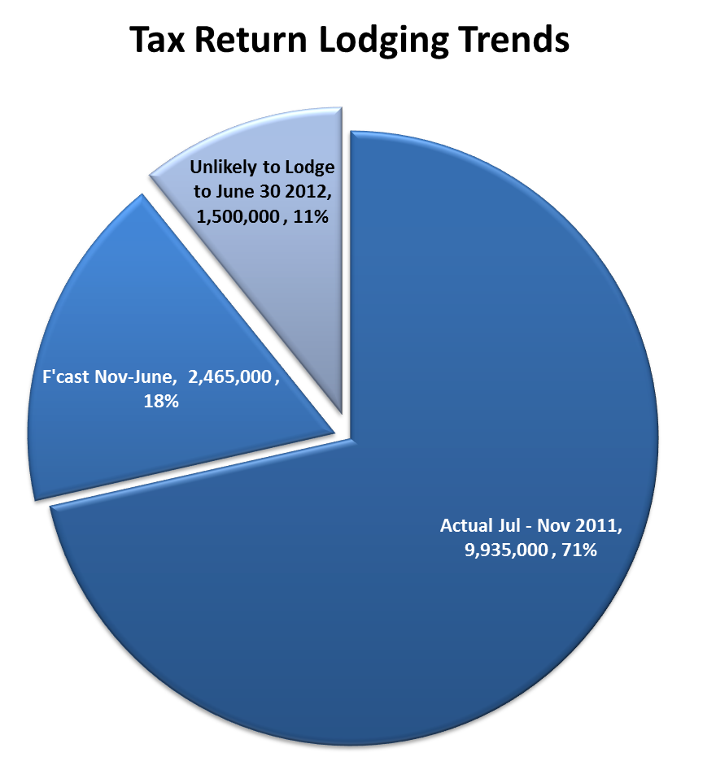
facts & figs
Approximately 12.4 million tax returns are lodged in Australia yearly. The bulk of these are sent in the ‘official’ tax season which in between July and Nov.
This fiscal year approximately 9.94 million tax returns received by the ATO of which 9.54 million were finalised and 7.8 million refunds sent totalling $19.2 billion (an average of $2010 per refund).
Up to 1.5 million fail to lodge a return yearly or almost 11% of those who should.
Sources: Estimates to June 30 2012 based Inspector-General of Taxation, 'Review into the non-lodgement of individual tax returns', June 11 2009
ATO Progress Report 20
FACT: 11% OF AUSTRALIA’S WHO SHOULD LODGE A TAX RETURN DON’T.
4

Slide 5
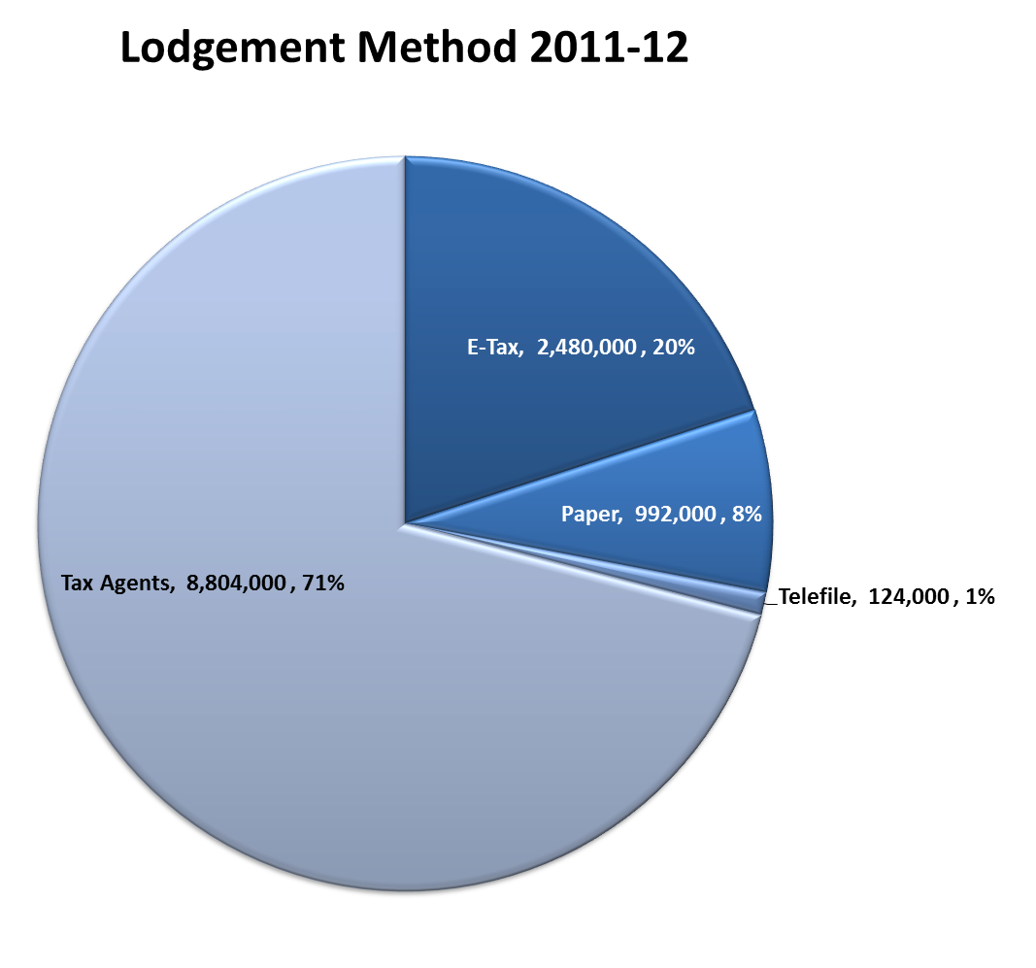
facts & figs
Assisted tax preparation is still the most popular method of lodgement in Australia with 71% or 8.8 millions returns being lodged through the 37,000 Registered Tax Agents in Australia. More than 95% of businesses get their returns done by a Tax Agent.
55% of these Tax Agents are 50 years old +.
Though lodgement by Tax Agents remains the dominant method, the use of self-complete tax portals have been growing steadily over the past few years.
Sources:
ATO Compliance Program 2011
Tax Practitioners Board Annual Report 2010-11
FACT: TAX AGENT LODGEMENTS REMAIN BY FAR THE MOST POPULAR METHOD
5

Slide 6
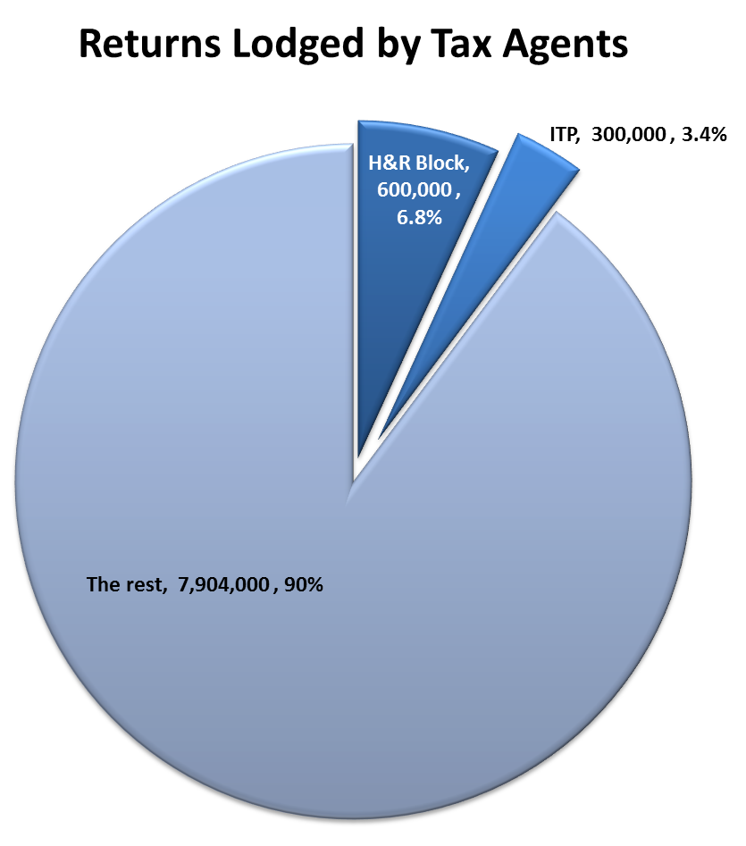
facts & figs
Of the 8.8 million or 10% of tax returns lodged by Tax Agents yearly about 900,000 are done by 2 large retail chains; H&R Block (400+ stores) and ITP (250+ stores).
Source: H&R Block & ITP website as of May 11 2012
FACT: 10% OF AUSTRALIA’S RETURNS PREPARED BY TAX AGENTS ARE DONE BY H&R BLOCK OR ITP

Slide 7
competition
H&R Block and ITP are generally located at high street locations with ITP sometimes setting up shopping centre pods in the tax season. Both have online and phone tax return services but do not offer an instant tax refund option.
The rest of the market is characterised by very small chains (3-10 locations) and individual accountancy practices.
Only a tiny number (.01%) of Australian tax agents offer instant refund services – the largest being Tax Today, Tax Tips and AllTAX.
Through strategic partnerships, clever marketing and highly competitive pricing Mr Tax Refund will quickly become the dominant provider of instant tax refund services in Australia by the end of the third year of operation.
FACT: LESS THAN 0.01% OF AUSTRALIAN TAX AGENTS OFFER INSTANT TAX REFUNDS

Slide 8
the brand
Provide customers with Australia’s best value tax preparation services, while offering market leading levels of customer service, expertise and professionalism…

Slide 9
brand
While Mr Tax Refund will be experts in tax and accounting the Company is equally focussed on building a National brand.
The Company’s core branding statement is that it will provide customers with Australia’s best value tax preparation services, while offering market leading levels of customer service, expertise and professionalism. At their option customers can also have their tax refunds in 24 hours as opposed to waiting for weeks.
Mr Tax Refund aims to service the low to medium socioeconomic bracket of taxpayers, which represents a very large segment of the Australian market. As the Company will be Australia’s first specialist national instant tax refund brand it will establish a defensible position in this profitable segment of the market.
The Company has developed an animation family led by the matriarch character “Stevo” that is designed to be used in humorous animation clips that are aimed at spreading the brand virally. This is a cost-effective way to market and gain significant exposure. Stevo, along with Mrs Tax Refund “Deb” will also be used in all marketing material to help expand brand awareness and engage with customers on a fun level.

Slide 10
demand
1 in 3 H&R Block US clients opt for instant refunds
In the US, instant tax refunds (or Rapid Anticipating Loans as they are known there) are very popular among low to medium socio-demographic consumer groups. Notably, in the 2008/9 tax season almost 1 in 3 H&R Block customers opted for the instant tax refund. In annual reports, H&R Block management stated that the introduction of this valued service contributed a very large increase in overall customers since introduction.
Source: H&R Block Annual Report , June 2009.

Slide 11
clients
Mr Tax Refund will target male and female working taxpayers between 18 to 49 years old who earn between $18,000 to $60,000 pa.
Generally, the Company’s target market will want their tax returns prepared efficiently, at a convenient time that suits them and in the first four months of the financial year.
A large majority will prefer to have their fees deducted from their tax refund rather than paying the accountant up front. Experience and overseas trends have shown that this target demographic will be most likely to switch from their current tax agent due to the attractiveness of the instant refund option.
The target market are the taxpayers of the future. As Australia’s population ages, less workers are in the system to support the growing age pension. The tax office continues to focus on taxing workers as they earn their wages. Only at year end do they have an opportunity to get their refunds. Mr Tax Refund will target this sector by offering a professional service in a way that suits them with the option of an instant refund.
EVERYDAY AUSTRALIANS SEEKING GOOD VALUE AND SERVICE

Slide 12
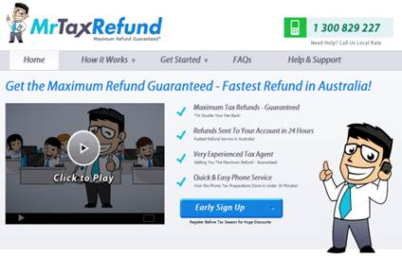
website
mrtaxrefund.com.au features include:
Corporate video: Customers can quickly and easily be made aware of our value proposition and how it works online via a soon to be produced corporate video.
Multiple platforms: Access mrtaxrefund.com.au across a wide variety of platforms including desktop, mobile and next generation devices including the Apple iPad and other tablet PCs;
Expert Advice : mrtaxrefund.com.au will also include a resource base of valuable current tax tips and advice and links to relevant information on changes to tax law that may effect them;
Facebook connectivity: Facebook users will have the option of using the ‘Facebook connect’ tool when setting up their Mr Tax Refund account. This enables user data to be automatically imported from their Facebook account allowing for quick and easy setup. This provides information about the consumer which can then be used by Mr Tax Refund to target certain user groups specifically;
Database Management: Allows for detailed customer segmentation, which will lead to more targeted, efficient and effective direct marketing campaigns;
Incentives for repeat use: New members will be offered discounts and value add products via a range of Mr Tax Refund affiliates including cash advances if required;
mrtaxrefund.com.au
OVER THE PHONE TAX RETURN PREPARED THE EASY WAY

Slide 13
management
Stephen Burns B.Com (Hons) MBA. GAICD.
CEO & Media Contact
Recently Stephen was CEO of City Finance, Australia's largest specialist
small loans provider.
Greg Armstrong B. Com M.ACC. Dip Fin Serv. Registered Tax Agent.
Tax Manager
Greg has many years’ experience as an Accountant, both in public practice and in Management roles.
Michael Stratman B.Econ (Accnt). CPA. FAICS.
Secretary & CFO
Michael has over 15 years experience as CFO of large public and private companies,
He is a previous Director of The National Financial Services Federation and prior to City Finance spent 7 years as Chief Operating Officer of OzEmail Ltd (first Australian company to NASDAQ list) where he was responsible for the US$150M operation in Australia.
Stephen holds a Bachelor’s Degree in Commerce (Economics & Marketing) and an MBA. He is a Director of corporate advisory company Citycorp Group, is an ASSOB Accredited Advisor and is a Graduate and Member of the Institute of Company Directors and Australian Institute of Management.
Stephen has twenty years experience in service based industries and has particular expertise in operations management, marketing strategy, advertising, public relations and business development across a variety of sectors including telecommunications, IT, media, property and franchising.
Stephen enjoys most water sports including surfing and in his younger years was a triathlete and personal trainer.
His passion for all things financial started as a teenager at high school. He completed his Bachelor of Commerce straight out of high school while working in numerous Management roles in Retail Administration. Following a role in the country in his early twenties, he moved back to Perth to take a position as State Administration Manager for a well-known WA Retailer. He then completed his Master of Accounting part-time while in this role and on its completion, moved into public practice. It is here where he gained his experience in preparing Tax returns and also in many other areas of Taxation.
He has a special interest in preparing Individual Tax Returns and has prepared thousands of returns. It is this experience that has allowed him to gain his registration as a Tax Agent. It is his passion for Accounting that has led him to his current role with Mr Tax Refund.
Greg’s interests extend to all facets of finance and he also holds a Diploma of Financial Services.
Greg enjoys spending time with his wife and two young children. He enjoys watching cricket and football and is a mad Sydney Swans supporter.
including ASX listed Auspine Limited - Australia’s largest public listed, vertically integrated plantation softwood forester, manufacturer and distributor.
Michael took direct control of statutory reporting, development of group financial policies and reporting systems, group taxation, control of group cashflows and banking facilities. In 1989 Michael was appointed as Company Secretary, maintaining the statutory registers for the group and assisting the Group Secretary and in 1995 was promoted to Chief Financial Officer and Group Secretary with responsibility for the Accounting and Finance, Credit Control and Company Secretarial functions.
Michael left Auspine to join Sylvatech Limited (formerly Australian Plantation Group Limited) in September 1999 as Chief Financial Officer/Company Secretary.
Michael is a proud father of two, and in his spare time enjoys cycling, listening to music and a good Coonawarra red.
Interesting Fact:
‘Stevo’ (Mr Tax Refund) was initially a caricaturised likeness of Stephen Burns

Slide 14
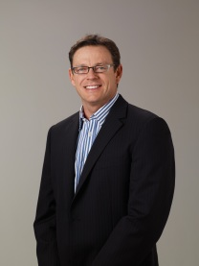
media contact
Stephen Burns, CEO
M. +61 449 611 000
P. 1300 829 227
F. 1800 329 829
E. stephen.burns@mrtaxrefund.com.au
W. www.mrtaxrefund.com.au
An explainer video is available at www.mrtaxrefund.com.au and www.youtube.com/MrTaxRefundAustralia and further information on company history can be found at http://www.mrtaxrefund.com.au/about-us.php
For more and higher res logos or graphics feel free to contact Stephen directly.
Follow us at
www.facebook.com/mrtaxrefund
www.twitter.com/mrtaxrefund
14

