Slide 1

Introducing
FailSafeSolutions
Online Backup Software

Slide 2
Agenda
Your Online Data Backup Requirements
Tape vs Online Backup
Underlying technologies of FSS Online
Peace of mind services and supports

Slide 3
Your Online Data Backup Requirements

Slide 4
Online Backup Requirements
Short RPO* and Fast RTO**
*Definition RPO (Recovery Point Objective)
**Definition RTO (Recovery Time Objective)

Slide 5
To Avoid this….

Slide 6
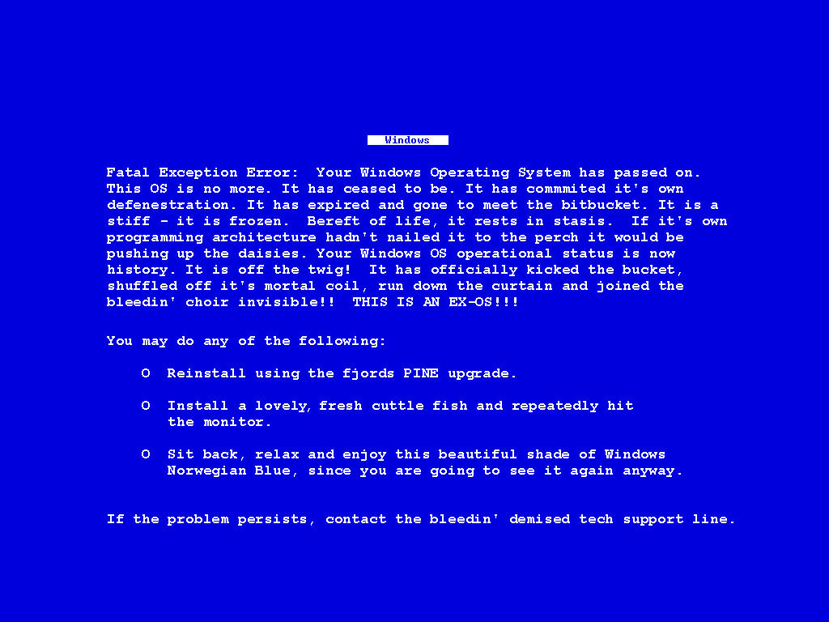
BSOD

Slide 7



Short RPO Fast RTO
Short RPO and Fast RTO
RPO: the shorter the more expensive
RTO: the faster the more expensive
Critical factors in the latest IT auditing standard
Disaster happens
Recovery Point
Data Loss
Recovery Time
Down Time

Slide 8
Requirements
On-Site and Off-site Protection

Slide 9
Requirements
2. Backup all Server, Desktops and Laptops

Slide 10
Requirements
3. Easy to use , manage and troubleshoot

Slide 11
Requirements
4. Affordable

Slide 12
Tape vs FFS Online Backup

Slide 13
Tape vs FSS Online Backup
Advantages of tape
Fast for sequential full backup
Convenient when one-cartridge is enough for backup
An easy media rotation method for preserving multiple full-system backups in one-cartridge scenario
Virtually unlimited in storage size
Perceptually inexpensive for the relatively low cost of backup tape
Perceptually easy for off-site storage

Slide 14
Tape vs FSS Online Backup
Disadvantages of tape
Cannot fulfill short RPO and fast RTO
Prone to human and mechanical errors
High failure rate on restoration when using multiple tapes
Need to have tape loader and backup program at DR site
Sequential access of backup data makes restoration not flexible
Lack of routine data integrity checking
Costly for off-site storage
No feasible for backing up desktop / laptop computers
Not easy to use and manage for non-IT staffs
High total cost of ownership

Slide 15

Tape vs FSS Online Backup
TAPE
FSS-ONLINE

Slide 16
Tape vs FSS Online Backup
TAPE
FSS-ONLINE
Fast for sequential full backup
Convenient when one-cartridge is enough for backup
An easy media rotation method for preserving multiple full-system backups in one-cartridge scenario
Virtually unlimited in storage size
Perceptually inexpensive for the relatively low cost of backup tape
Perceptually easy for off-site storage
Cannot fulfill short RPO and fast RTO
Prone to human and mechanical errors
High failure rate on restoration when using multiple tapes
Need to have tape loader and backup program at DR site
Sequential access of backup data makes restoration not flexible
Lack of routine data integrity checking
Costly for off-site storage
Not feasible for backing up desktop / laptop computers
Not easy to use and manage for non-IT staffs
High total cost of ownership
Fast for both full and incremental backup
Convenient for backing up data of any sizes
Preserving multiple full-system backups is natively supported
Unlimited in storage size
Inexpensive than tape (to be explained later)
Primarily designed for easy off-site backup
Able to fulfill short RPO and fast RTO
Immune to human and mechanical errors
Nearly 100% successful rate on restoration with routine integrity checking
No need to have backup program at DR site
Random access of backup data makes restoration extremely easy and flexible
With routine data integrity checking
Cost for secure off-site backup is extremely low
Backup all servers, desktops and laptops
Easy to use and manage for all staffs
Low total cost of ownership

Slide 17


Tape vs FSS Online Backup
Your needs in data backup
Tape
FSS
1. Short RPO and fast RTO
2. On-site and off-site protection
3. Backup all servers, desktops and laptops
4. Easy to use , manage and trouble-shoot
5. Affordable

Slide 18
Tape vs FSS Online Backup
FSS can meet short RPO by :
Block level incremental / differential backup
Continuous Data Protection
Flexible backup scheduling

Slide 19
Tape vs FSS Online Backup
FSS-Online can meet fast RTO by :
Advanced D2D2D architecture
Bare metal backup and restore
Local restore from seeded data
Point in time restoration

Slide 20
Tape vs FSS Online Backup
FSS-Online offers better off-site protection by:
Secure 256-bit AES encryption and 128-bit SSL transmission channel
Bandwidth throttling capability on backup and replication
Restoration through the Internet

Slide 21
Tape vs FSS Online Backup
Protect all servers and computers with:
Common operating systems, applications, files support
OS : Windows, Linux, Mac, etc
Applications : Exchange, SQL, Oracle, MySQL, Lotus Domino etc
Files : jpg, doc, xls, ppt, html ,mp3, etc
Heterogeneous environment support

Slide 22
Tape vs FSS Online Backup Easy to use, manage and trouble-shoot with:
Centralized web management console
Restore anytime and anywhere
Triggering backup from server side
Comprehensive backup logs and reports
Email report to user and administrator
Support Windows Active Directory
Support proxy server
Auto software upgrade
Seed-load utility for importing large data
Command line tool
Flexible retention policy
Multiple backup sets
Logout reminder
Offline backup reminder
Filter files by extensions
Filter files / folders by user defined patterns
Keep a local copy of the backup data
31 languages support

Slide 23
FailSafeSolution Online Backup
Features

Slide 24
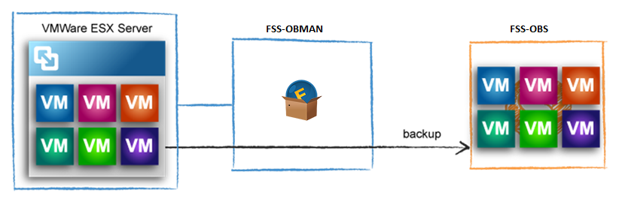
FSS-Online Features
Virtual Machine Backup

Slide 25
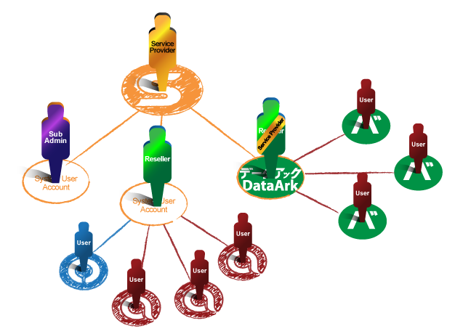
FSS-Online Features
Multi-Level Systems User Management

Slide 26
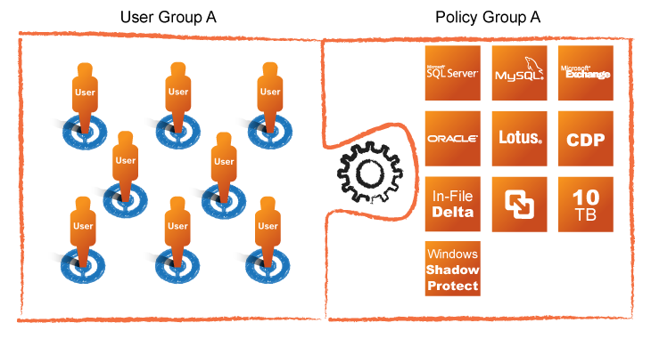
FSS-Online Features
Group Policy

Slide 27
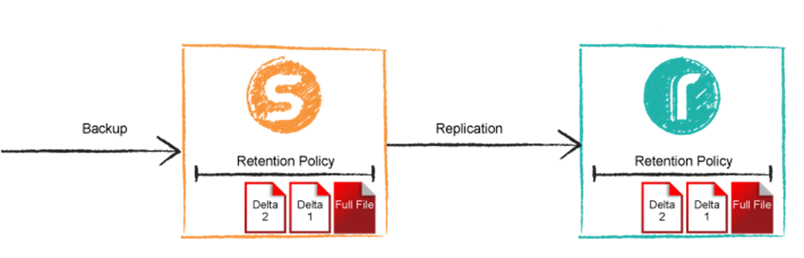
FSS-Online Features
Retention Policy

Slide 28
FailSafeSolutions
Underlying technologies of FSS-Online

Slide 29
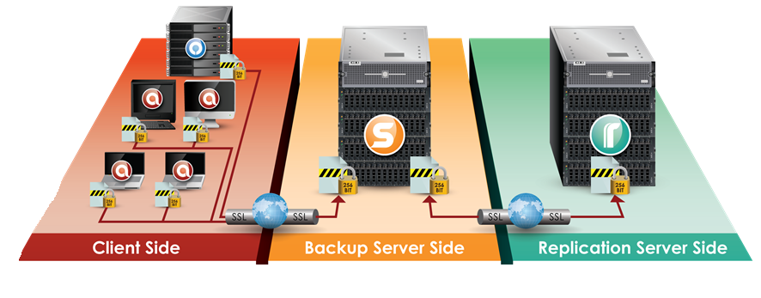
Underlying technologies of FSS-Online
D2D2D architecture
A computer hard disk is backed up to another hard disk instead of other media ( e.g. tape, CDR), and then replicated to a third one for additional protection.

Slide 30
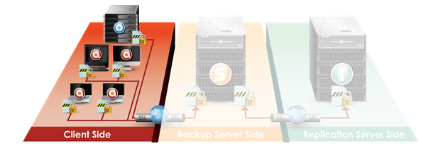
Underlying technologies of FSS-Online
Client Side Applications
 |  | FSS One Click Backup
 | Easy to use backup application
 | Simple and clean interface
 | Designed for desktops and laptops
 |  | FSS Online Backup Manager
 | Fully featured backup application
 | Equipped with various backup modules
 | Designed for database, email and file servers

Slide 31
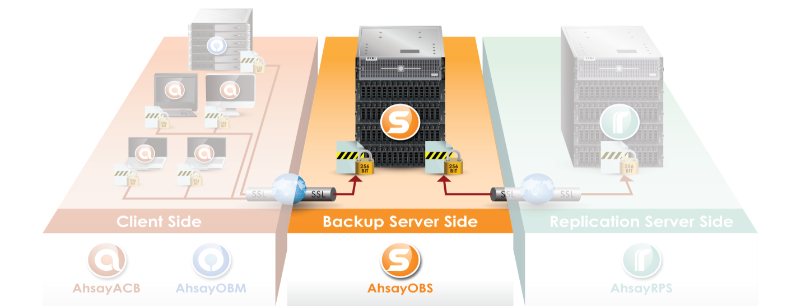
Underlying technologies of FSS-Online
Backup Server Side Application
FSS Offsite Backup Server
Centralized management of backup accounts and data
Equipped with web management console
Comprehensive reports available

Slide 32
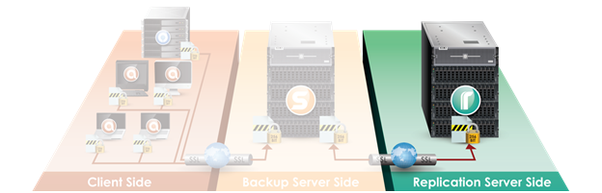
Underlying technologies of FSS-Online
Replication Server Side Application
Ahsay Replication Server
Backup of the backup server
Close to real time off-site replication
Able to rebuild AhsayOBS in case of disaster
Additional protection for backed up data

Slide 33
FailSafeSolutions Online Backup
Peace of Mind Service and Support

Slide 34








FSS-Online
Professional Backup Consultation
On-site Software Installation and Configuration
First Time Seed Backup
On-site System Restore and Application Recovery
Application Server Loan Service
24 x 7 Customer Support
Knowledgebase
Online Blog Discussion

Slide 35
FailSafeSolutions Online Backup
About FailSafeSolutions

Slide 36
About Us
FailSafeSolutions offers comprehensive online backup and disaster recovery services. Our clients range from small medium sized businesses to large enterprise public companies.
“Always Ready” Online Backup and Disaster Recovery

