Slide 1


The Quest for Well Being
Begins…

Slide 2
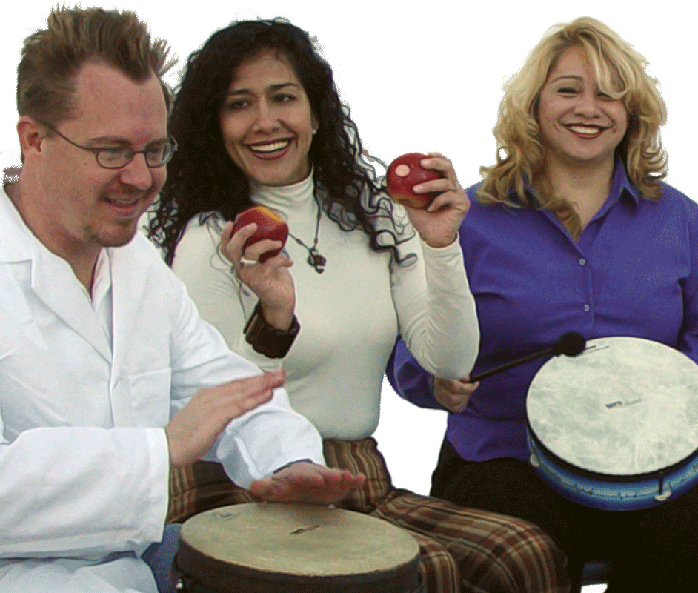
…by discovering your own personal rhythm

Slide 3

pulse
…the pulse that unites us.

Slide 4
What is HealthRHYTHMS?
an evidence-based program
being utilized as a cost-effective strategy for:
clinical outcome-based programs for individuals facing the challenges of many common diseases
employee wellness initiatives
building cohesive and supportive teams
stress management
more…

Slide 5

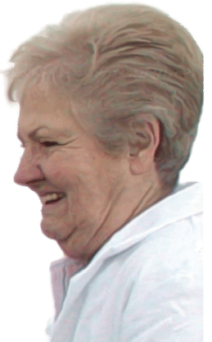

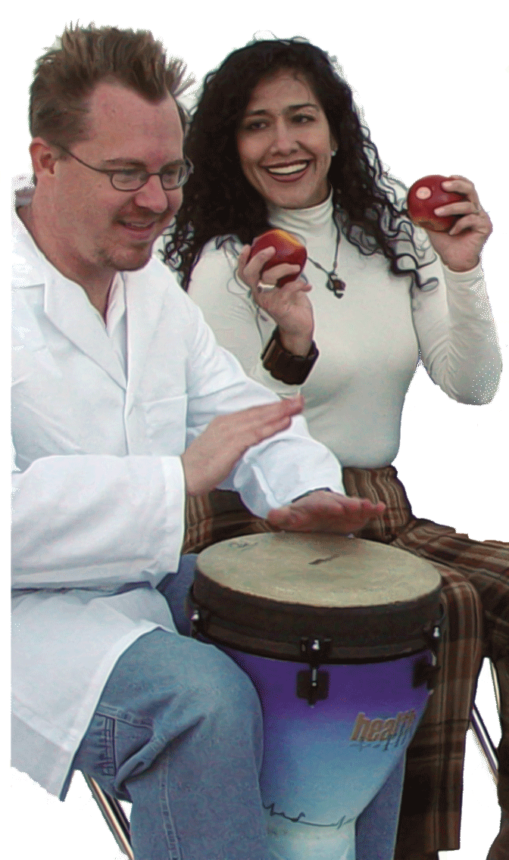
Our Philosophy
HealthRHYTHMS… is not about inspiring successful drumming
it’s about inspiring successful living.
…is not about exceptional performance
it’s about exceptional support and personal expression.
…is not about teaching people to play
it’s about giving people permission to play.
…best facilitators are not only talented musicians
they are caring, compassionate and intuitive guides.
…is not about acquiring technique
it’s about sharing for the sake of personal EMPOWERMENT.

Slide 6
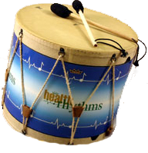
inspires successful living
offers exceptional support and personal expression
gives people permission to play
trains facilitators to be caring, compassionate and intuitive guides
allows people to share for the sake of personal
EMPOWERMENT

Slide 7

What are the Personal Benefits?
Stress Reduction & Relaxation
Interpersonal Support and Bonding
Creative Musical Expression
Strengthened Immune System
Spiritual Connection
Exercise

Slide 8
Why should I get involved?
Create a health promoting environment
Empower people to move beyond their
perceived boundaries
Bring to the surface what is difficult to express
in words alone
Draw people together
Enhance communication & morale

Slide 9

Don’t take our word for it… Get a second opinion.
Barry Bittman, MD, CEO, Mind-Body Wellness Center "Group drumming from a HealthRHYTHMS perspective is transcendent ... it empowers people to more effectively express themselves, while enabling them to move beyond their perceived limitations and put back into their lives what is missing."
Bernie S. Siegel, MD, Author of Love, Medicine and Miracles and Prescriptions For Living. “Every group drumming experience I’ve participated in with EcaP (Exceptional Cancer Patients) brings to the surface remarkably deep heartfelt, healing emotions that are difficult to express with words alone."
Jeffrey Ritterman, MD, Kaiser Permanente – "Many of our patients are socially isolated and the drumming sessions help them feel connected with each other. In a short period of time they develop a mutually supportive, caring, healing community. I would recommend the HealthRHYTHMS protocol to health care providers working with patients in a variety of settings. One of the key challenges facing health care providers today is to help create a truly health promoting environment. Group drumming sessions using the HealthRHYTHMS protocol can help this process tremendously."

Slide 10

This all sounds great…
but, how can I be sure that this works?

Slide 11

Consider the Scientific Evidence
- 9 Years of Research - 7 Peer-Reviewed Published Research Studies - Demonstrated biological and/or psycho-social benefits
and did we mention…
no known negative side-effects

Slide 12

Research Summary
IMPACT ON IMMUNE SYSTEM STUDY Strengthens the Immune System (2001)
EMPLOYEE BURNOUT & TURNOVER STUDY
Improves Mood, Reduces Burnout & Turnover (2003)
REDUCING STUDENT DROP-OUT RATE STUDY
Retains Students: Mood Improvement & Burnout Reduction (2004)
CREATIVITY & BONDING IN SENIORS STUDY
Inspires Creativity & Bonding in Long-Term Care Residents (2004)
GENOMIC IMPACT STUDY
Reverses Stress on the Genomic Level (2005)
CORPORATE EMPLOYEE WELLNESS BENEFITS STUDY
Strengthens the Immune System of Corporate Employees (2007)
QUALITY OF LIFE IMPROVEMENTS IN AT-RISK ADOLESCENTS STUDY
Adolescent Protocol is a Catalyst for Quality of Life Improvement (2009)
Research Abstracts Available at: www.remo.com/health

Slide 13
Research-Based Benefits Summary
Strengthens the Immune System – Natural killer (NK) cell activity was significantly boosted in subjects who participated in the HealthRHYTHMS protocol compared to controls. Natural killer cells play a major role in the destruction of cancer and cells infected by viruses.
Reduces Burnout – Total Mood Disturbance (TMD) in employees after 6 sessions was improved by 46%. 6 weeks after the intervention TMD was improved 62%, suggesting that the benefits continue long afterward.
Reduces Employee Turnover – Mood improvements experienced by study participants resulted in a projected 18.3% reduction in employee turnover. (Actual reduction was greater)
Saves Money - The study of HealthRHYTHMS conducted at a long-term care facility, resulted in projected cost savings averaging $89,100 per year at a typical 100-bed long-term care facility.
Reduces Stress - HealthRHYTHMS protocol actually reverses biological responses at the DNA level that can lead to the development of a host of common diseases.
Cost-Effective – Health benefits & reduction in burnout suggest increased work-force stability, lower employee turnover costs, and significant return on investment for HealthRHYTHMS® Group Empowerment Drumming.

Slide 14

Creating the Perfect Fit
HealthRHYTHMS Group Empowerment Drumming is supported by research that demonstrates
significant benefits in a variety of applications with one simplified solution. Here’s a sampling of
potential applications for this cost-effective, evidence-based strategy:
Stress Management & Morale
Teambuilding
Support Groups
Employee Wellness Initiatives
Patient Groups
Schools & Universities
Senior Citizen Groups
At-Risk Adolescents
HealthRHYTHMS Facilitation training is a tool that complements the skills of your facilitator. It is not
intended to be a substitute for a credentialed counseling or healthcare professional where advisable.

Slide 15
Drum Up Wellness
Talk to Your HealthRHYTHMS® Trained Facilitator
about offering this exciting strategy.
REMO, Inc. in no way certifies the qualifications of any HealthRHYTHMS Trained Facilitator.
REMO/HealthRHYTHMS offers materials, training, instruments and research and can only verify the training status of its trainees. For more information visit www.remo.com/health

