Slide 1
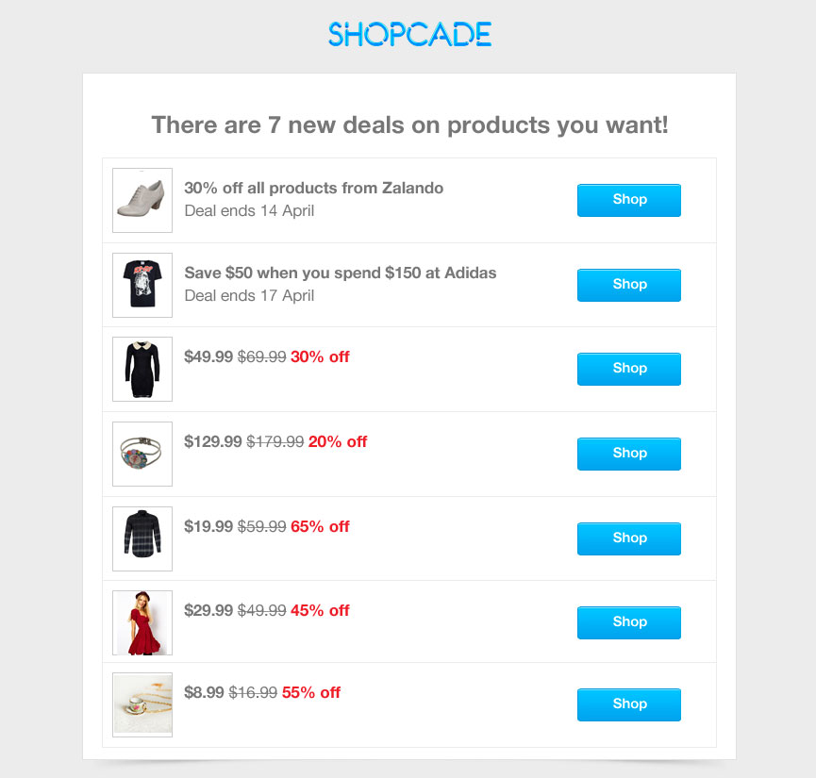
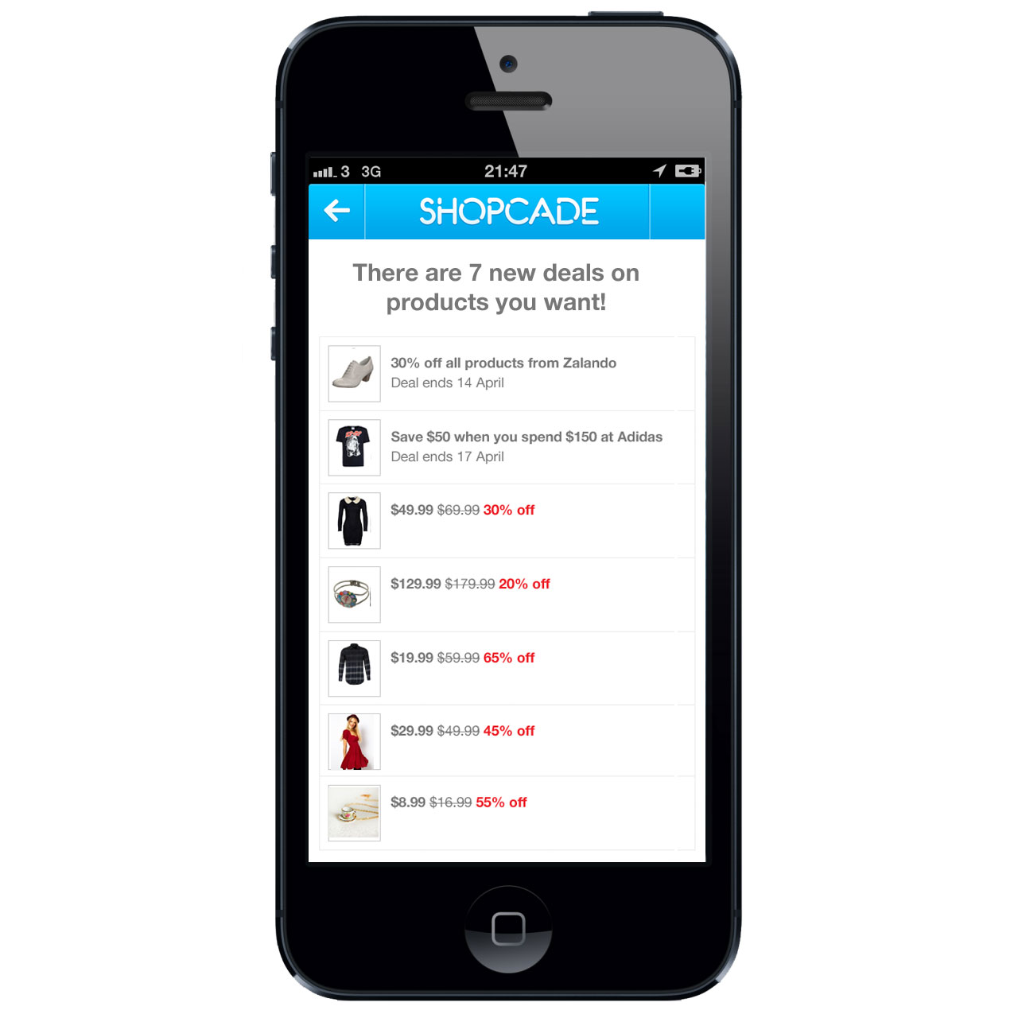
Get alerts when the things you want go on deal
When products or brands you want go on deals, you’ll be notified immediately, so you can save money on the things you want.

Slide 2
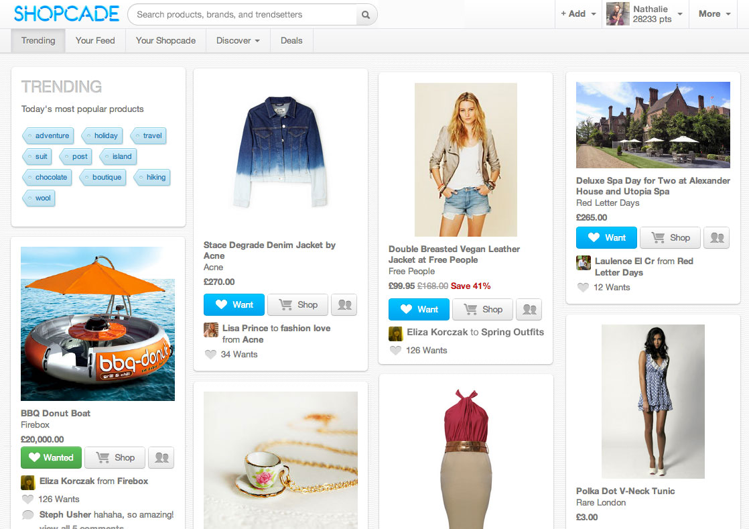
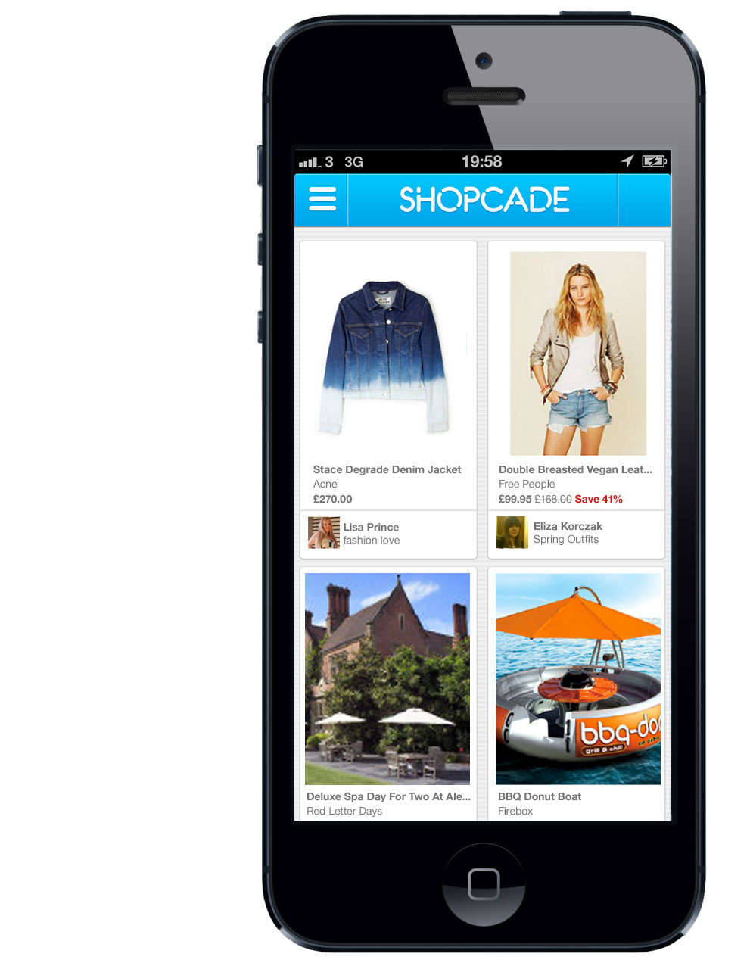
See new trending products and deals
picked just for you based on what you want
Discover the best products and deals everyday, hand-picked for you by Shopcade from over 300,000 affiliated brands. You can also see what your friends and people you follow want.

Slide 3
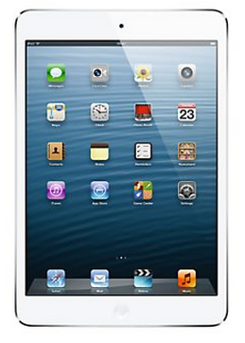
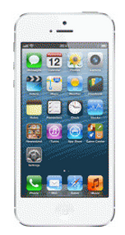
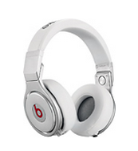
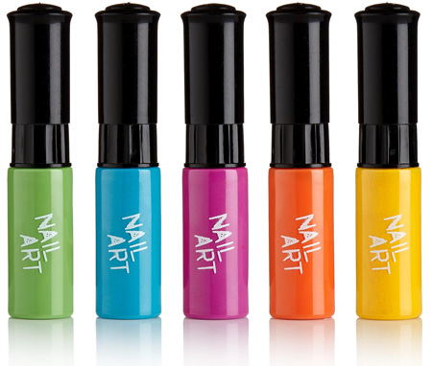
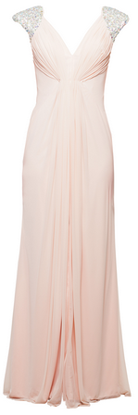
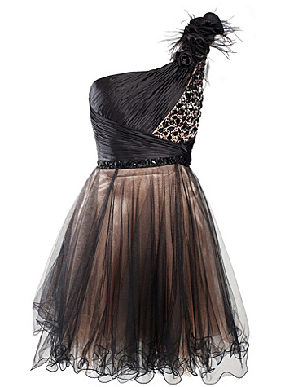
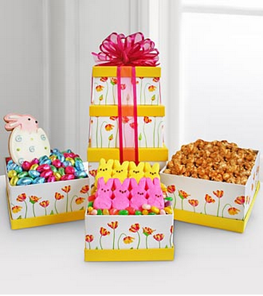
Most wanted deals from Shopcaders’ so far
Electronics
Fashion & Beauty
iPad mini
iPhone 5:
Dr Dre Beats
Cosmetics
Swimsuit
Food & Home
Dresses
Easter hampers
Home Products

Slide 4
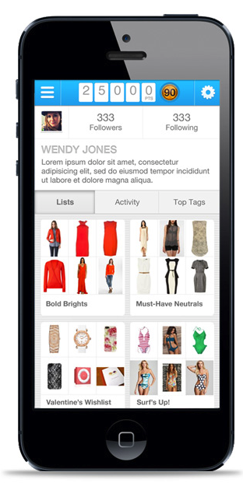
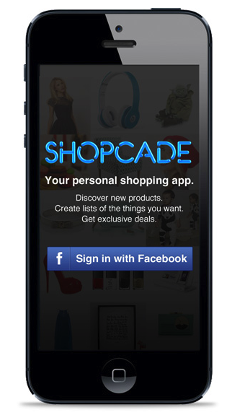
Shopcade on Mobile iOS

Slide 5
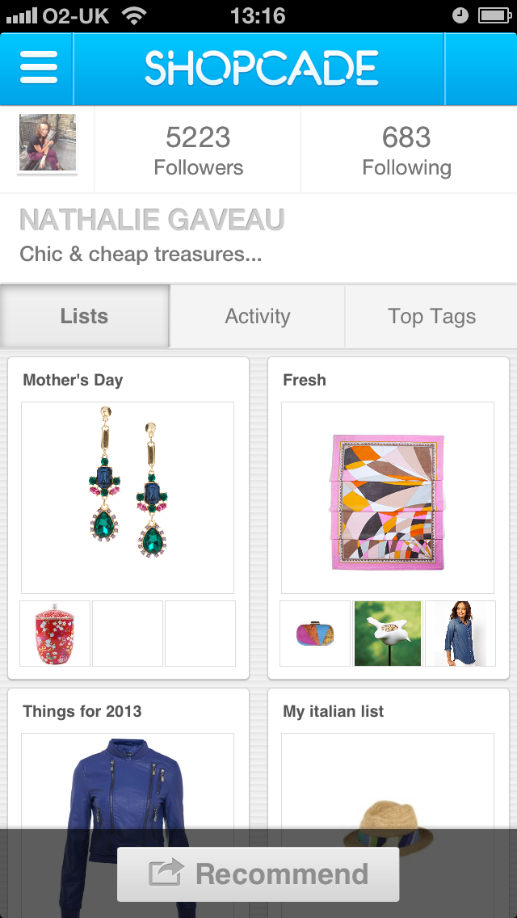
Nathalie Gaveau CEO of Shopcade

