Slide 1
Grub Hub Camp Kitchen
“Spend your outdoor vacation time pursuing sports and enjoying family and friends - not packing, unpacking, and organizing camp.”

Slide 2
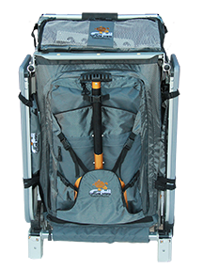
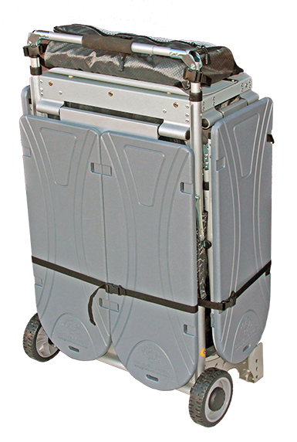
“In the same single, compact unit, needed to store all camping gear,
the Grub Hub provides the world’s most complete and efficient camping HUB.”
Rugged,
Compact
Ultra Portable

Slide 3
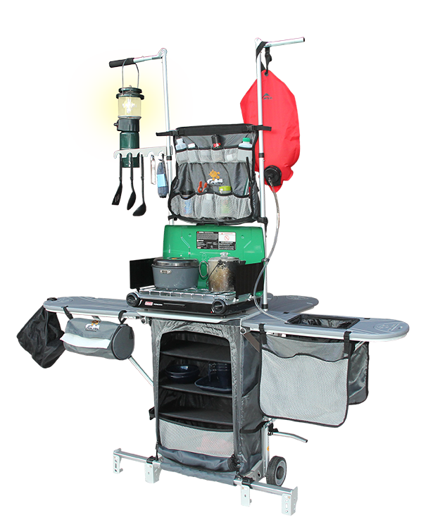
The Grub Hub stores and transports all camp kitchen gear then sets up in 3 minutes to provide tables, stove support, lantern support and organization needed for a complete camp “HUB”.
It makes getting outdoors easy, fun and highly sustainable.

Slide 4
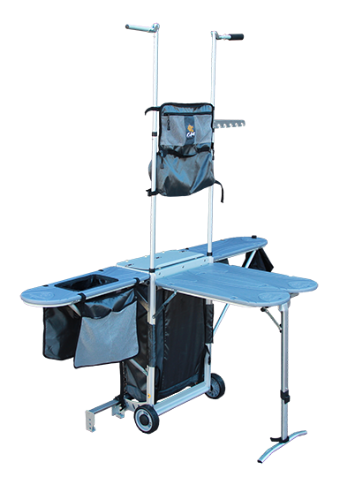
Grub Hub includes:
Main organizer
Tower organizer
Lantern Support
2 Air dry bags
Litter Bag
Utensil Rack
Collapsible Sink

Slide 5
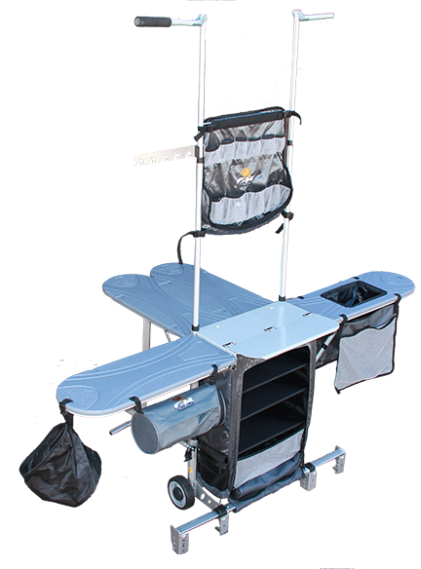
The Grub Hub camp kitchen supports and promotes a very sustainable camping methodology by providing highly portable and organized cooking and working space, as well as support for lighting and water and other features such as air dry bags for cleaning solid dishes.
The product's features and functionalities assist campers in working much more efficiently outdoors and help reduce convenience packaging and other wasteful methods. The extensive features contained in the Grub Hub make outdoor preparation of real meals, to fuel real activities, an easy task.

Slide 6
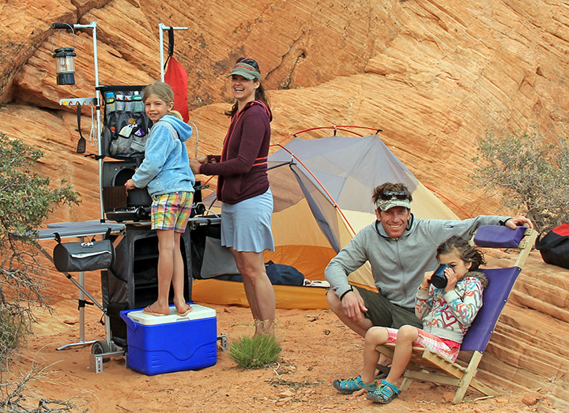
Get a Grub Hub and Get Out There!

