Slide 1



ENTERPRISE
RESEARCH
PLATFORM
One Solution. One Flat Price.
Survey Analytics is a suite of interconnected and easy-to-use information collection and analysis tools including online surveys, mobile data collection, panel management, advanced analysis and data visualization.

Slide 2

ABOUTUS
Survey Analytics offers an enterprise research platform for collecting feedback to enable businesses, governments and consumers to learn from each other. Survey Analytics provides a listening system for you to reach your audience through all major channels including web, email, social media and mobile.
We give companies the power to execute and deliver research in real-time on a global scale.
For more information please visit our website:
www.surveyanalytics.com

Slide 3





OURCLIENTS
.

Slide 4
SOLUTIONS
Voice of the Customer
Brand Equity
Customer Satisfaction
Survey Software
Market Research
Enterprise Feedback
Scalable. Secure. Global.
Ideal for organizations seeking a single platform that is flexible, customizable and comes with unlimited use.
Benefit any number of users at any skill level with everything you need at your fingertips to deploy and manage complex research projects.

Slide 5


PRODUCTS
Research Made Easy
A one stop solution for managing feedback via the web. From simple surveys to international research, the platform exceeds requirements.
Change the way you collect mobile field data. Collect data on tablets and smartphones anywhere, anytime – online/offline.
This smartphone survey system allows you to create and launch mobile friendly surveys and create a mobile research panel.
SurveyAnalytics
SurveyPocket
SurveySwipe

Slide 6



PRODUCTS
Research Made Easy
Easily access and share visual interactive reports and charts from survey results on all of your favorite mobile devices.
This opt-in solution gives you vision into consumers’ daily lives by collecting moment-to-moment data from their mobile devices.
An easy to use online tool for creating a customized portal for your panel. Easily invite, manage and reward your panelists.
SecondPrism
LifeMetrix
Panel

Slide 7
FEATURES
Exceeding Research Requirements
White Labeling
Geolocation
CRM Integration
Unlimited Surveys/Responses
Customized Security
List Management
Customized Reports
Dial Testing
Kiosk Mode
Response Coding
Notification Groups
Tag Clouds
Custom Logic
Social Media Integration
Panel
Conjoint Analysis
Multilingual
Offline Surveys
Data Segmentation
Barcode Scanning
Training Courses
Max Diff Scaling
QR Code Generation
Mobile Applications
Banner/Pivot Tables
Custom Dashboards
MediaBunker

Slide 8
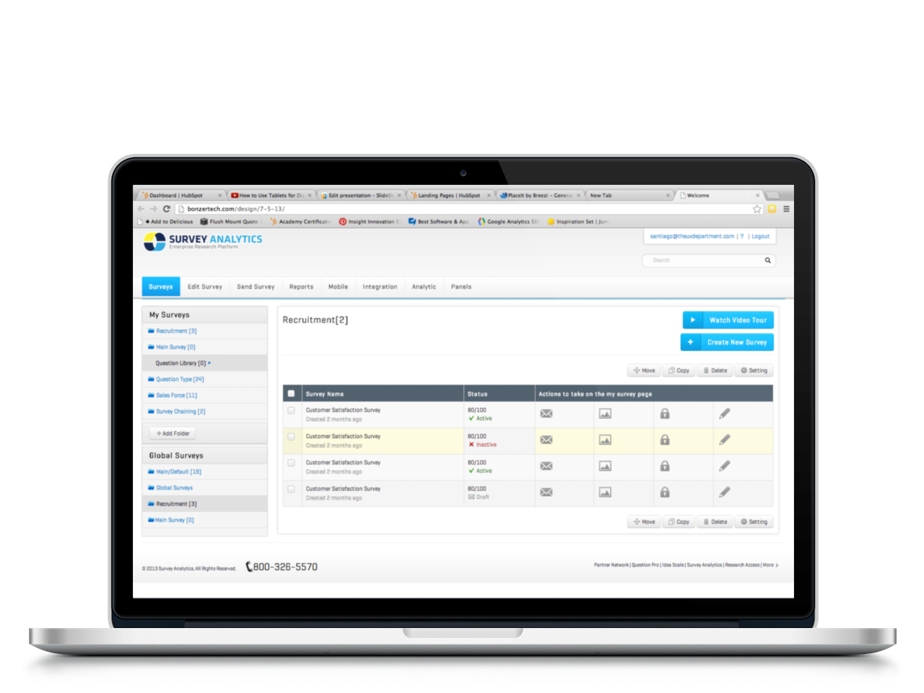
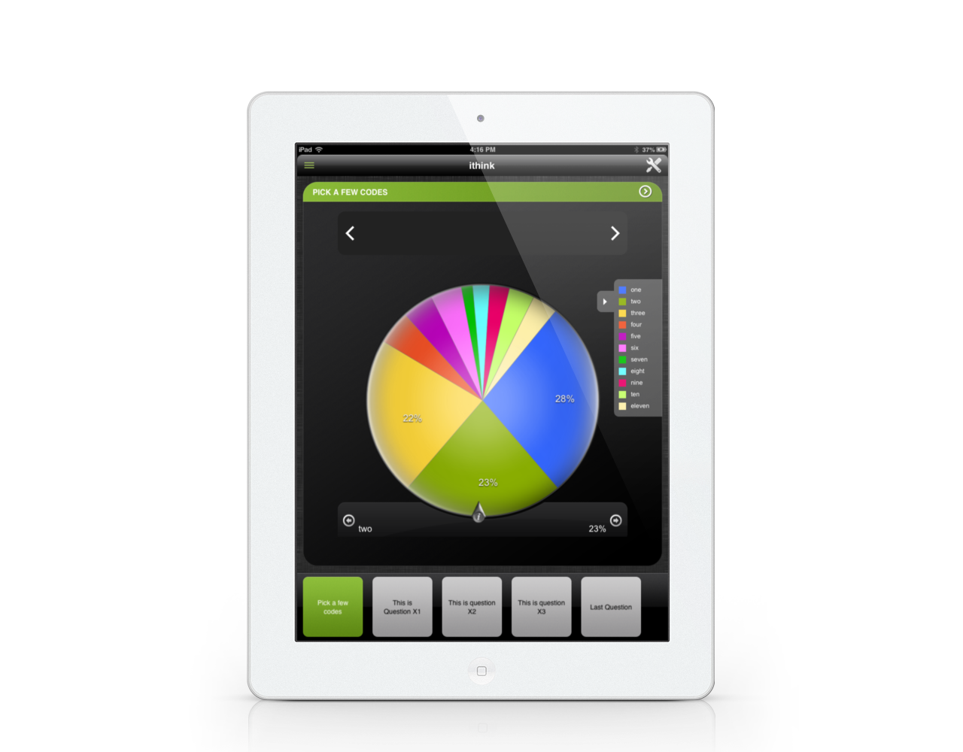
WORKFLOW
Program & Design
Create your survey and customize it to your brand.
Delivery Methods
Manage email lists, share with social media and more.
Report & Share
Analyze the results and download or share reports.

Slide 9
STATISTICS
43 Languages Available
Works in 30+ Browsers
Over 10 Million Surveys Sent Annually
50+ Question Types Available
Used in 15+ Countries Worldwide
Serving 33 Different Industries
Why Choose Survey Analytics?
Save Overall Time Programming Surveys
Reduce Overall Market Research Costs
Support and Training at No Additional Charge
Reduce Internal Support Requests
Increase Survey Response Rates
Get More Productive Using a Unified Tool

Slide 10

CONTACTUS
We welcome you to visit our website at:
www.surveyanalytics.com
Phone: 1 (800) 326-5570
Online: www.surveyanalytics.com/contact
Email: sales-team@surveyanalytics.com
Twitter: @SurveyAnalytics

