Slide 1



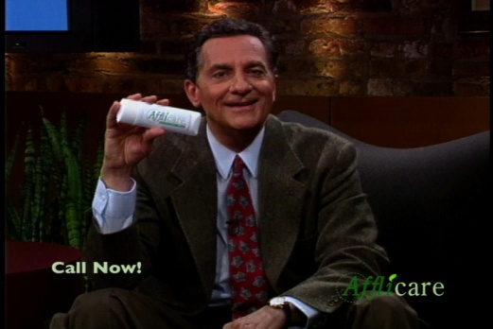
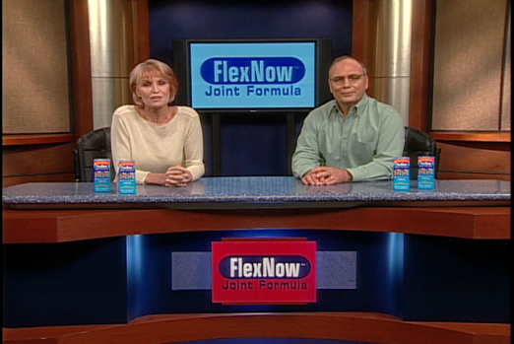
Hard earned $$
Hair Today
No More Pain
Nutra Facts
You don’t need to invest millions to make them!!!!
Get started today @ www.infomercials4less.com

