Slide 1
Energy Intelligence Program Monitor your industrial facility and save energy!
Tool that provides real-time feedback to help you manage energy in your manufacturing plant.
Determine how much and when you use energy.
CEE helps you interpret your energy patterns to improve the efficiency of your operation.

Slide 2
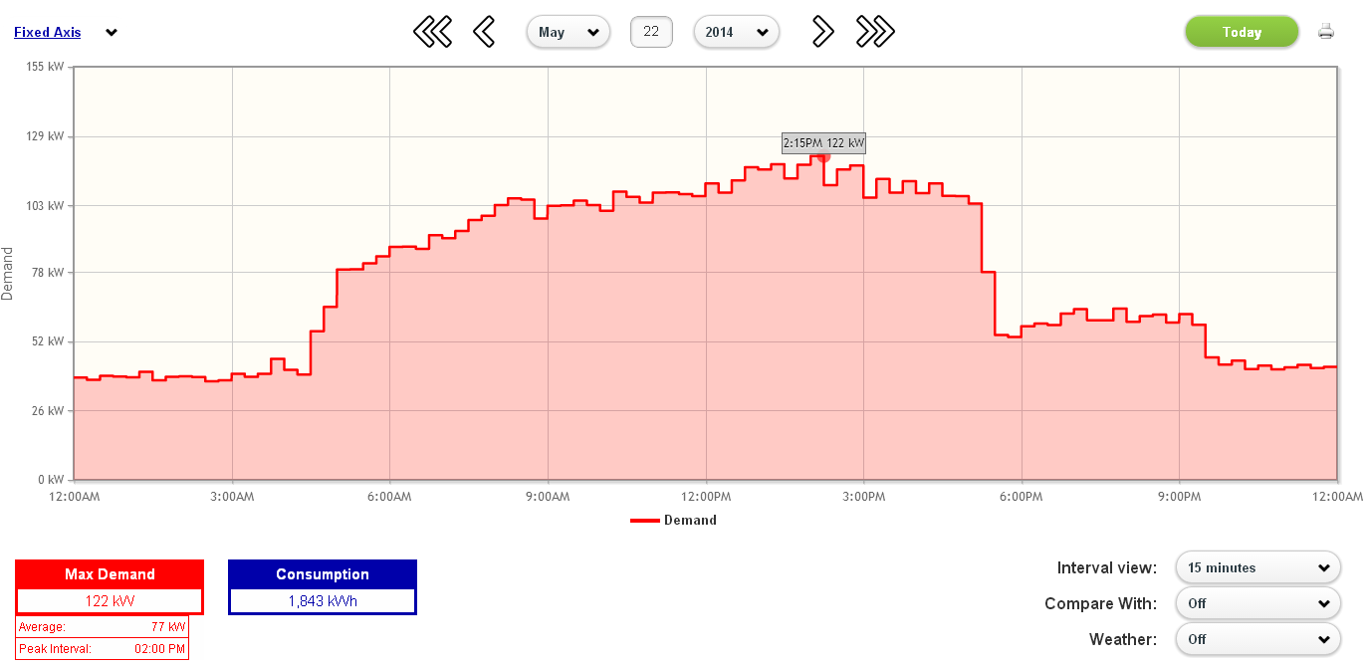
Track And Get Real-Time Feedback

Slide 3
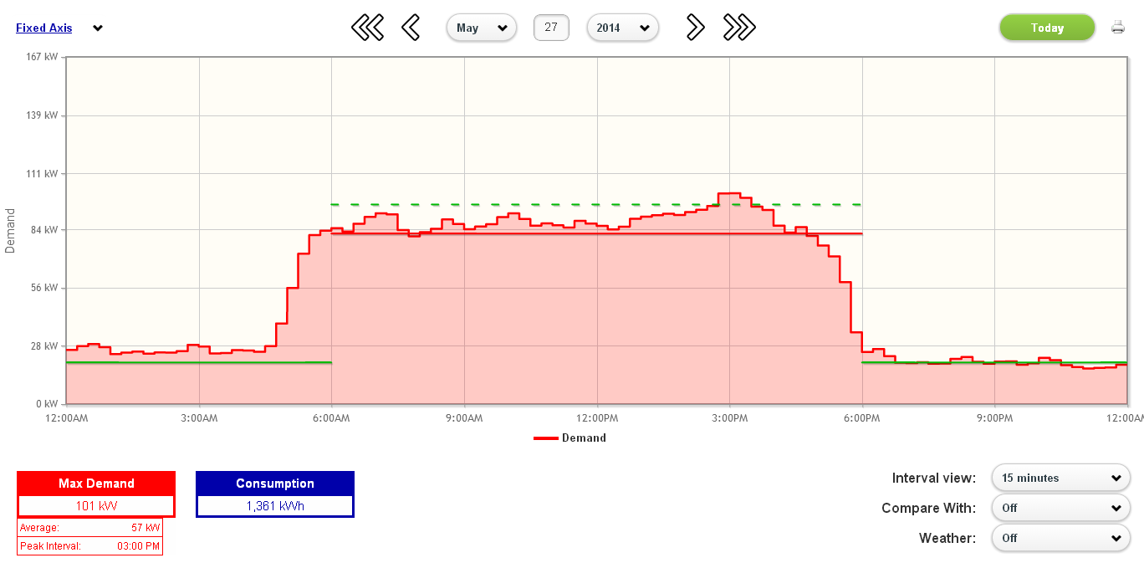
Create Energy Thresholds and Alerts

Slide 4
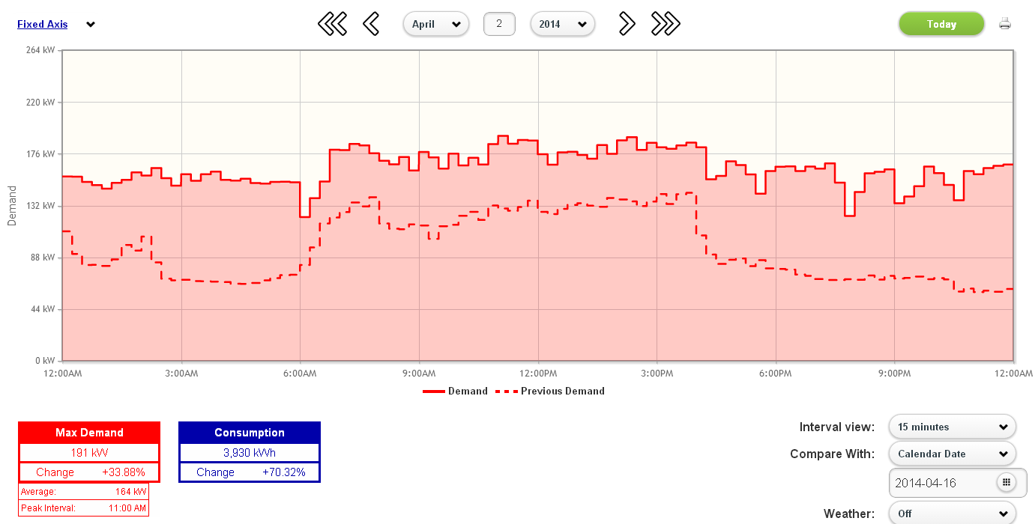
Compare Usage Day-Over-Day

Slide 5
What Are The Benefits Of Participating?
Determine how much and when you use energy:
Identify wasted energy during non-production periods
Identify demand peaks that cause high energy bills
CEE assessment of building and equipment
We develop energy strategies to optimize your energy use
We make suggestions to lower your baseline energy use
Save money by implementing strategies
Our goal is to find a minimum of 5% in energy savings

Slide 6
How Much Does It Cost?
The program requires a customer time commitment and a small electrician expense that is reimbursed by CEE.
Program is paid for by Xcel Energy.
All participants in pilot must be approved by Xcel Energy
Electrician cost is reimbursed by CEE.
Electrician bills customer; Customer bills CEE.
Approximately $500 - $1000 per meter.

Slide 7
How Much Time Does It Take?
Off and on site engagement will require about 8 hours of a facility managers time over the 4-8 month program period.

Slide 8
How Does The Program Work?
Install Monitoring
Conduct Assessment; Collect Data
Energy Patterns Meeting
Low-cost/No-cost Energy Experiments
Energy Impacts Meeting
Equipment and Rebate Recommendations
Uninstall Monitoring

Slide 9
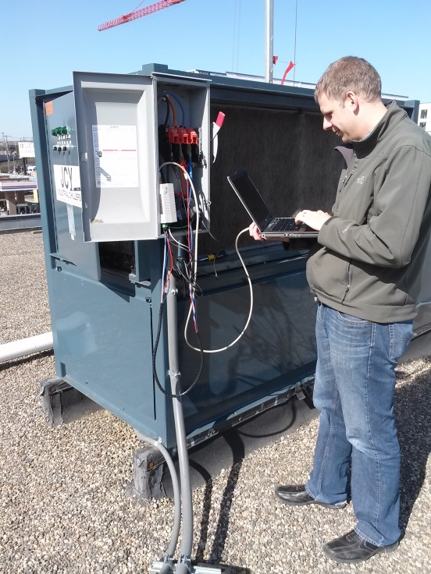
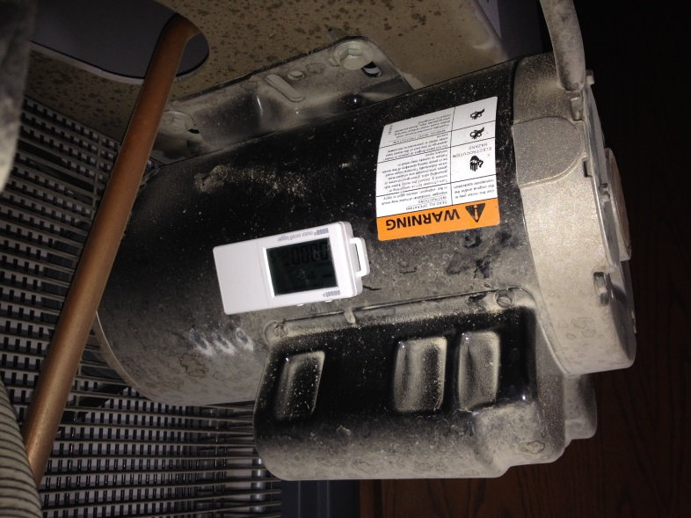
Conduct Assessment
CEE conducts an energy assessment with your staff to understand equipment and schedules.

Slide 10
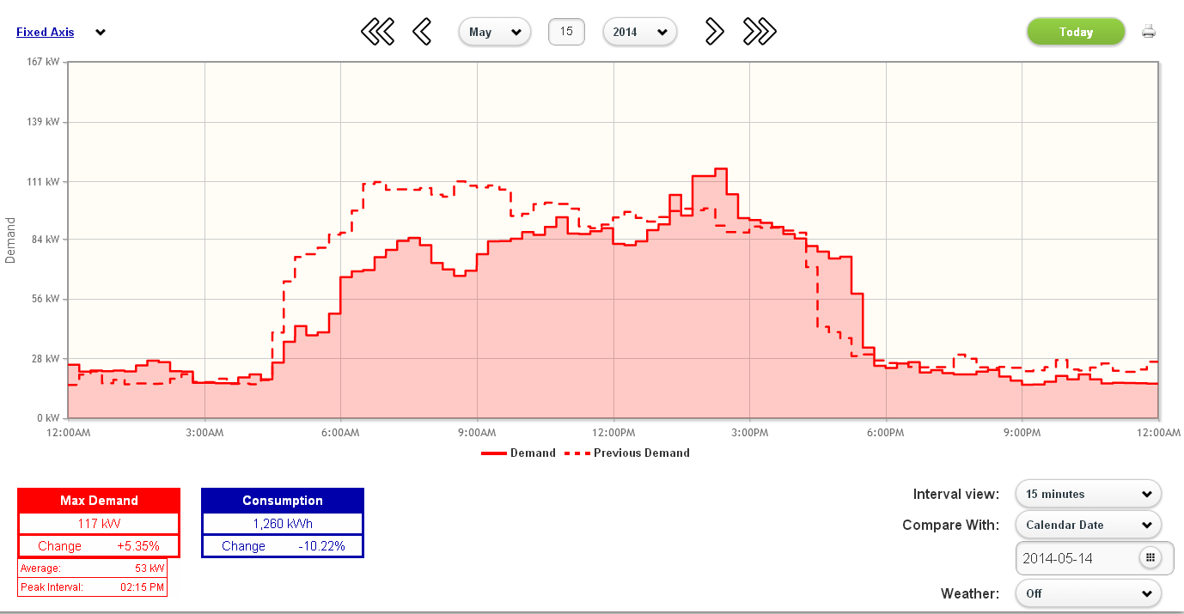
Energy Patterns Meeting
After about three months, CEE meets with you to review Energy Patterns and provide training on the Energy Intelligence dashboard.

Slide 11
Low-cost/No-cost Energy Experiments
CEE and customer experiment to lower energy usage over the next two months and see the impact on the dashboard.

Slide 12
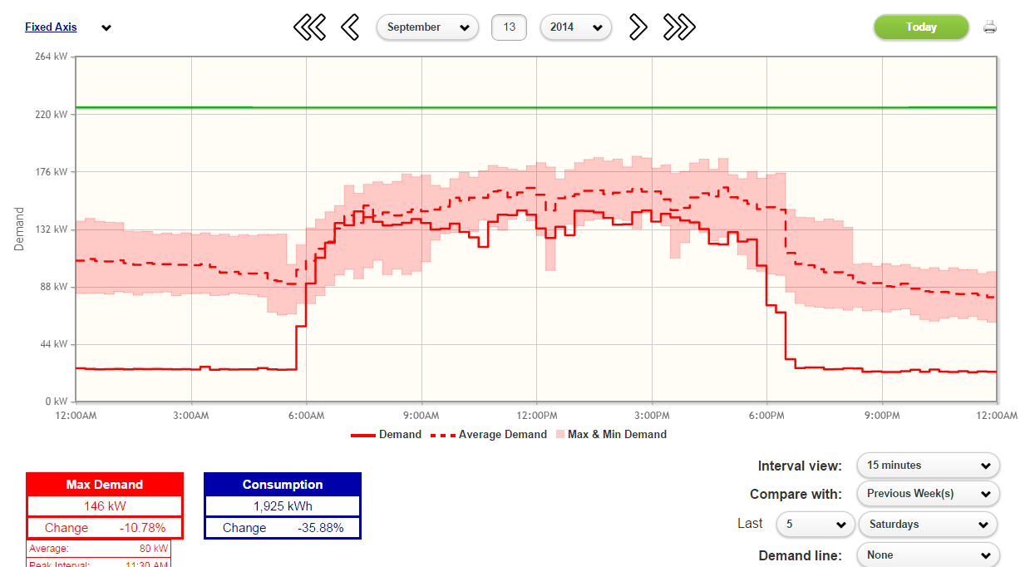
Energy Impacts
Impacts from experiments are validated on dashboard and quantified in $ savings.
$50 energy savings

Slide 13
Equipment and Rebate Recommendations
In addition to identifying low-cost/no-cost operational savings, CEE provides suggestions for equipment upgrades and studies.
Equipment assessment and recommendations
Coordination with Xcel Energy for:
Equipment rebates
Study funding

Slide 14
Example Energy Patterns
The next slides are examples of energy patterns found with real-time monitoring and feedback.

Slide 15
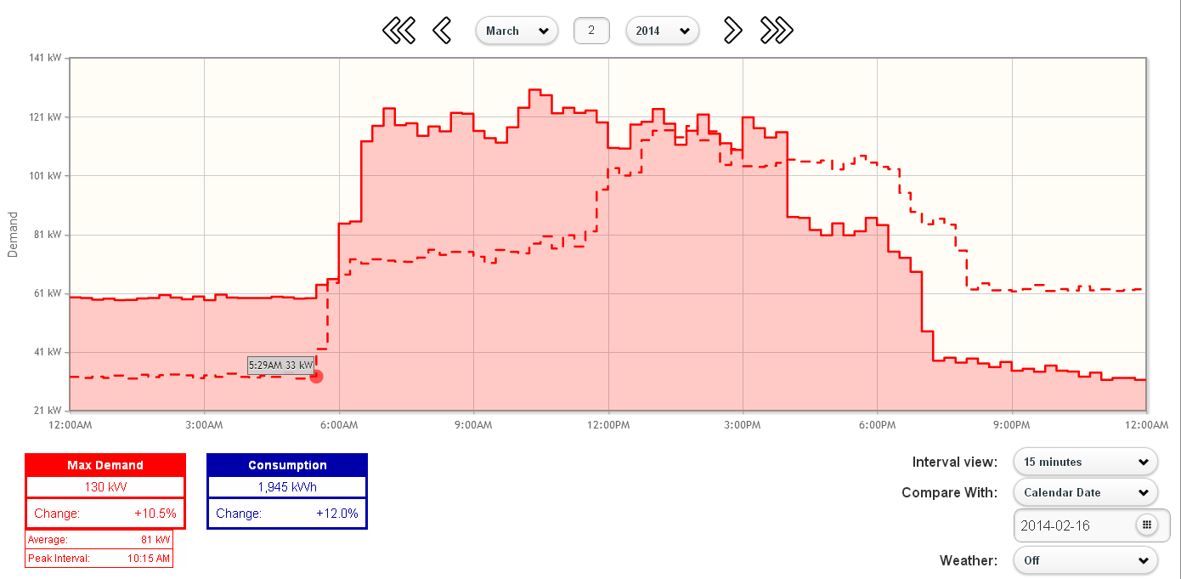
How Low Can You Go? Weekend Use
How come the energy use from Midnight to 6 AM (non-production) varies?

Slide 16
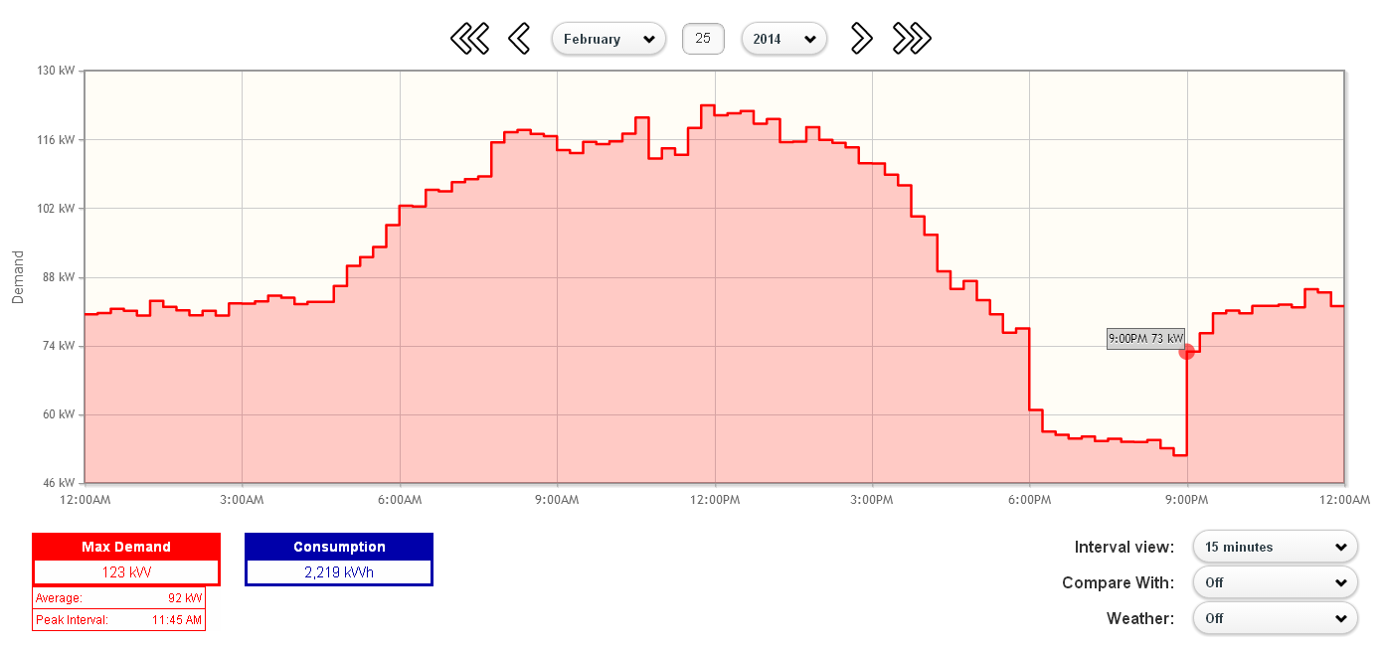
Night Moves! What is going on when you are not there?
Cleaning crew turns on lights at 9 PM and they stay on until morning.

Slide 17
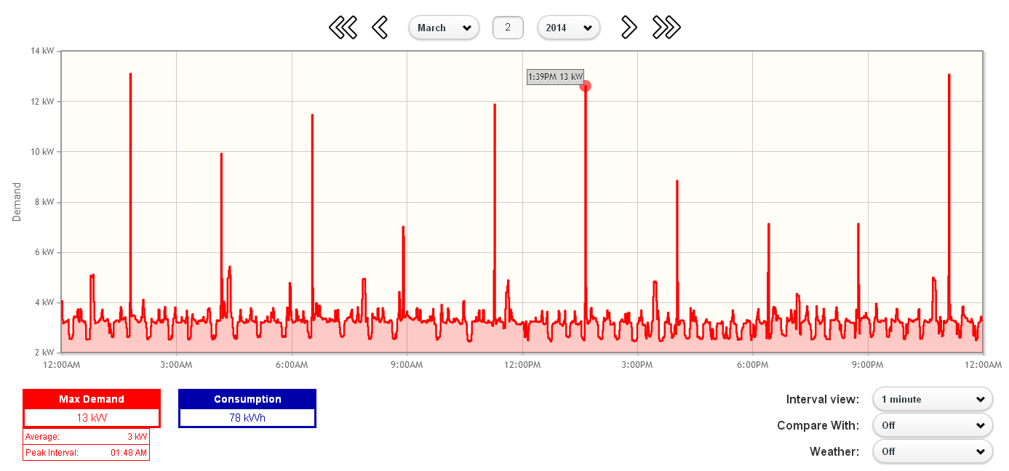
Working for the Weekend? Equipment left running
Air compressor left on over weekend. Leaks cause it to run during non-production time period.

Slide 18
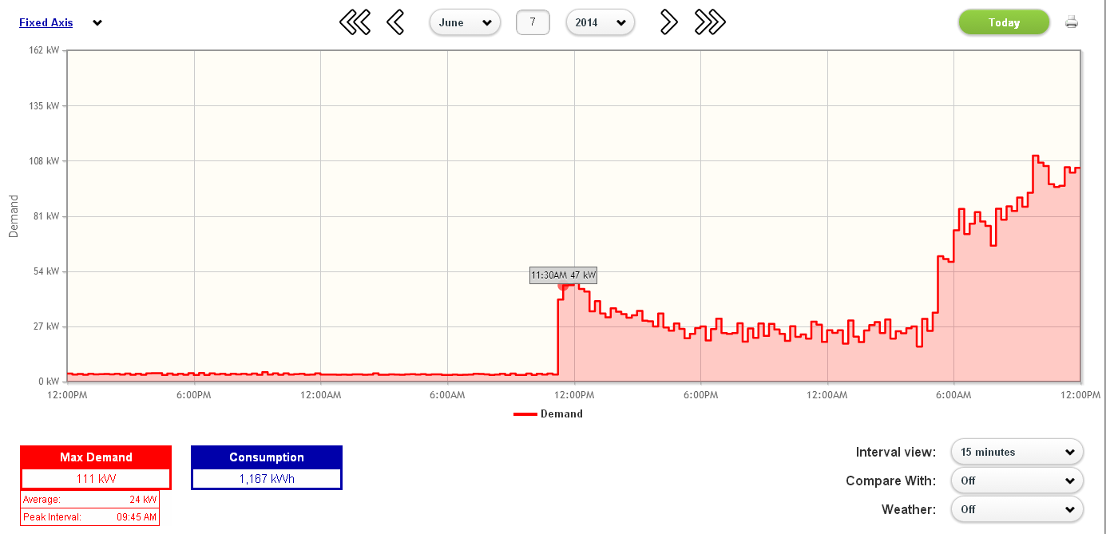
Start Me Up! Excessive start-up time
Electrically-heated tanks are turned at noon during a non-production day.

Slide 19
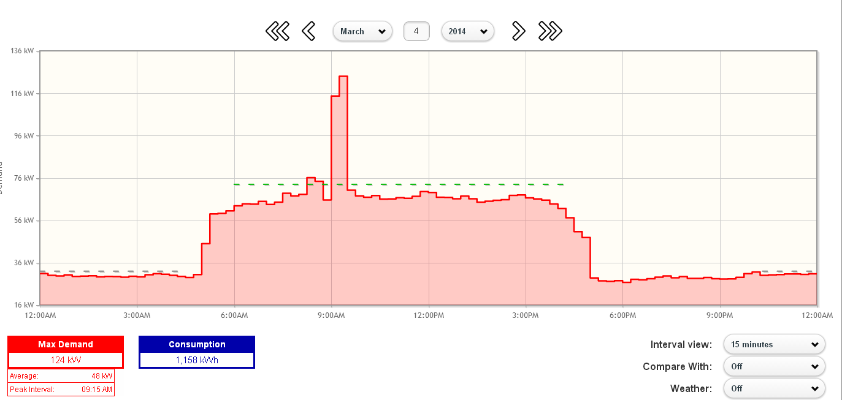
This One Goes to Eleven. Spikes During Production
Electric resistance heat in an air curtain causes a large demand spike (and charge).

Slide 20
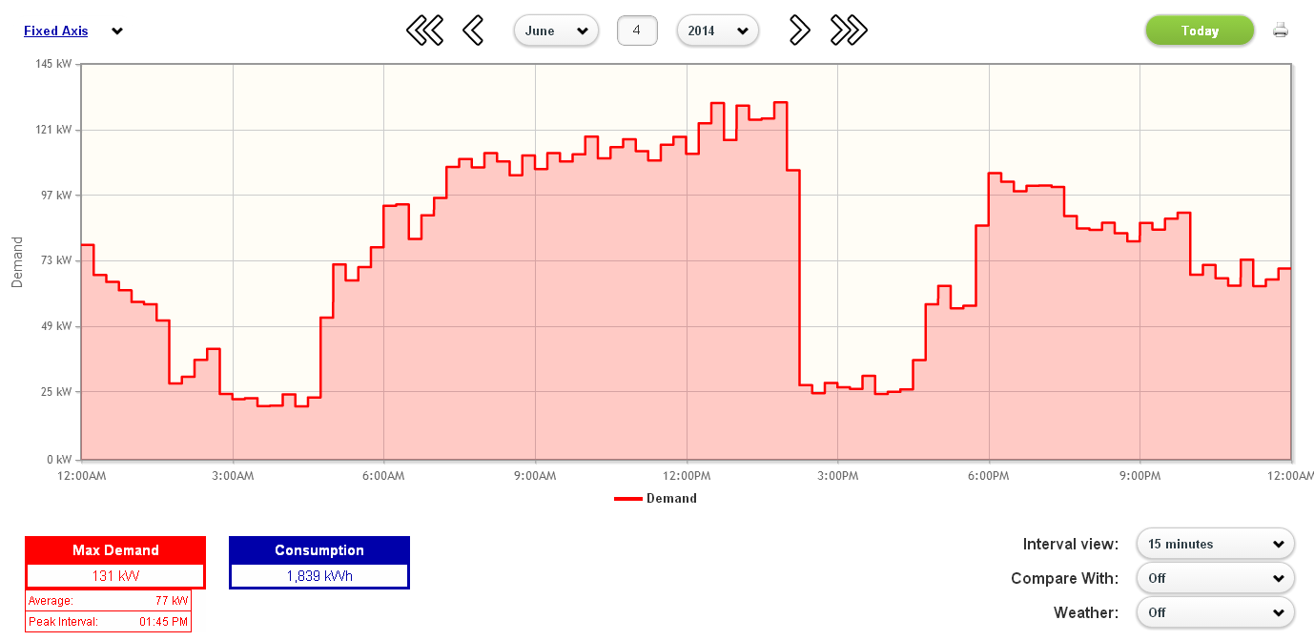
Fight the Power! Sags/Outages during Production
Customer experienced a loss of a phase at 2:30 PM.

Slide 21
Who Is Eligible To Participate?
An Xcel Energy (MN Territory) electric customer.
Small to Mid-Sized:
You pay between $5000 - $25000 per month for electricity.
Your peak electric demand is less than 600 KW.
Your business takes raw materials and uses machinery to produce a finished product.
Acceptance into the pilot program is subject to approval by Xcel Energy.

Slide 22
How Do I Sign Up?
Sign Participant Agreement and Bill History Release
Collect Electrician Contact Information
MAIL/EMAIL TO:
Kevin Bengtson
Project Manager
Center for Energy and Environment
212 3rd Avenue North, Minneapolis MN 55401
kbengtson@mncee.org

