Slide 1
MORE BOOKINGS. LESS WORK.
SHOW ME HOW >

Slide 2



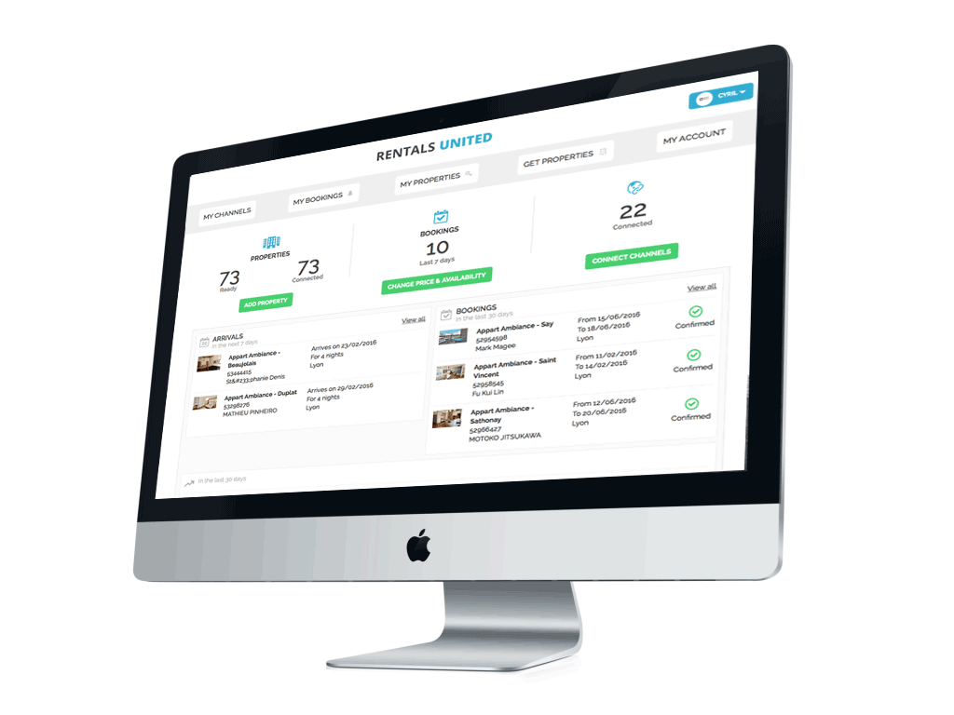
✪ WHAT WE DO
YOU
You only need to update calendars, pricing, photos, descriptions on the Rentals United online platform.
>Save Time
US
WEBSITES
We update all the Hotel websites, Vacation Rental Websites, Comparison Websites, that you decide to work with.
>More Bookings
Notes:
Show all big brands and preferred partnerships

Slide 3
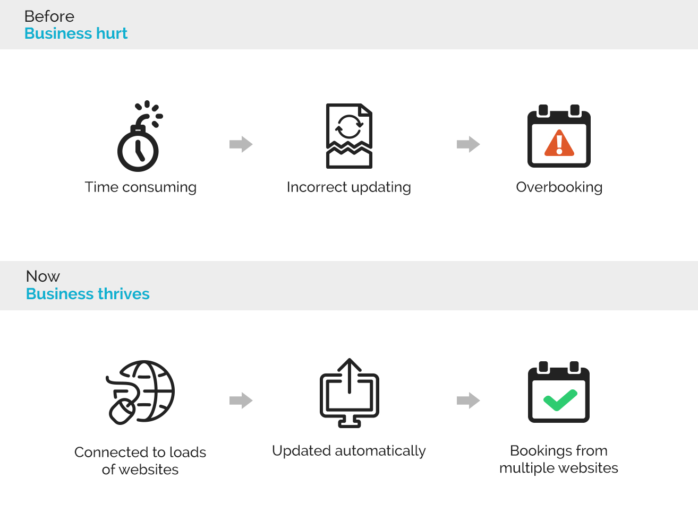
✪ THE PROBLEMS WE SOLVE

Slide 4




















✪ BE SEEN BY +10M TRAVELLERS DAILY
. . .
40+ NICHE AND MAINSTREAM WEBSITES IN 1 CLICK!

Slide 5
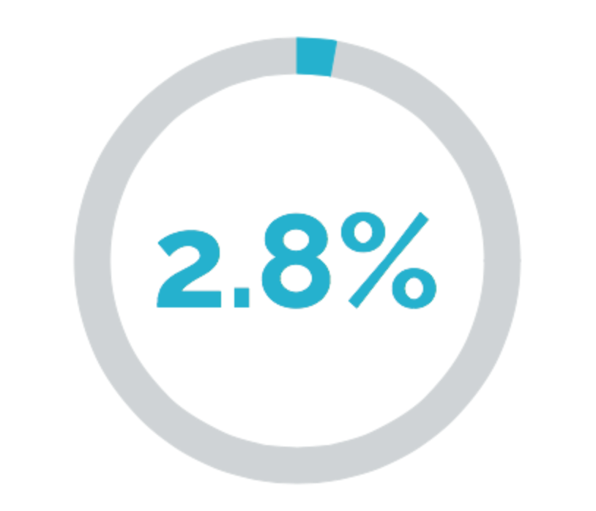
✪ OUR PRICING
Pay our commission only for successful arrivals!
NO SET-UP FEE. NO MONTHLY COST. CANCEL ANYTIME.

Slide 6
JOIN THE OTHER +5000 WORLDWIDE HAPPY OWNERS ON:
http://rentalsunited.com
SIGN UP TODAY!

