Slide 1
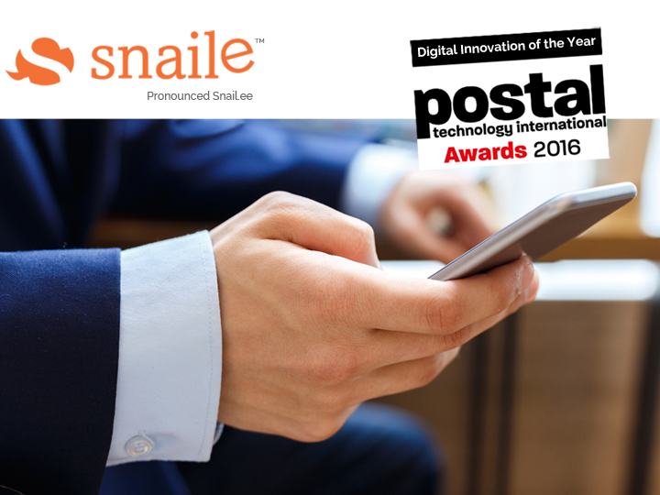
Winner
We make first & last mile boxes smart
Compartment Check & Notify Technology
Patent Pending PCT #CA2016/050214 | USA #62127279 | Canada #2,883,805
info@snaile.com

Slide 2
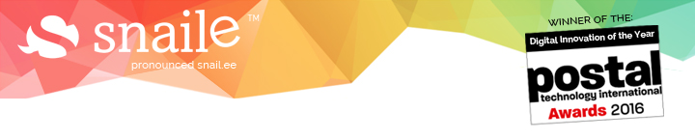

We make first & last mile boxes smart
What is Snaile?
Winner
Snaile is a patent pending Internet of Things (“IoT”) technology that detects usage rates & when something is or is not in any type of postal compartment
Patent Pending PCT #CA2016/050214 | USA #62127279 | Canada #2,883,805
info@snaile.com

Slide 3
We make first & last mile boxes smart
Snaile Devices in Postal Boxes
For the Postal Industry, Snaile Internet of Things (“IoT”) devices can
check & notify of content and observe usage rates via the Cloud in:
First mile postal boxes
Street letter boxes
Last mile postal boxes
P.O. Boxes
Courier drop-off boxes
Parcel lockers
Community mailboxes
etc.
Patent Pending PCT #CA2016/050214 | USA #62127279 | Canada #2,883,805
info@snaile.com

Slide 4
We make first & last mile boxes smart
Snaile in First Mile Postal Applications
Reduce Fuel/Emissions,
Fleet Size and Labor Costs Now &
as Letter Mail Volumes Fall
Patent Pending PCT #CA2016/050214 | USA #62127279 | Canada #2,883,805
info@snaile.com

Slide 5
We make first & last mile boxes smart
What are Current First Mile Network Problems?
Problem
Impact
>
Posts must check their entire street letter mailbox network daily whether there is outgoing mail or not
Unnecessary daily expenses incurred checking empty boxes
Larger than required first mile fleet size
>
>
Unnecessary carbon emissions checking inevitable empty boxes. Will get worse as letter mail volumes fall

Slide 6
We make first & last mile boxes smart
What are Current First Mile Network Problems?
CONTINUED
Problem
Impact
>
Most Posts have a Universal Service Obligation to provide consumers a certain service level but only anecdotal data to make network optimization decisions
No real data-driven analysis to present to parliament for network reduction approvals
>
Fixed first mile network clearing costs & emissions paired with a decreasing letter mail revenue stream will create certain failure

Slide 7
We make first & last mile boxes smart
A Real World First Mile Example
A Leading Postal Company
With Snaile IoT Devices Installed in First Mile Mailboxes
Has 40,000 customer drop-off street boxes
They can save now 4000 unnecessary checks/day or $28,000/day
It costs them $7/box to check (after wages, insurance, fuel, union dues, benefits & vehicle maintenance)
Reduce carbon emissions by 10% immediately
Reduce fleet size by 10% today (millions of $ saved)
They estimate anecdotally a 10% empty rate randomly distributed around the country. This estimate is already dated.
Continue to increase savings & decrease emissions as mail volumes drop
Real time usage rates to stay optimized as mail volumes fall

Slide 8
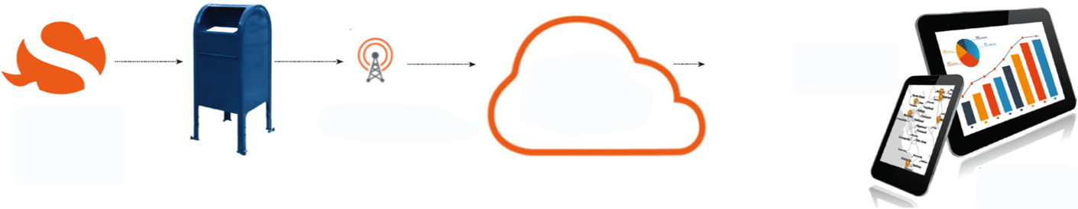
We make first & last mile boxes smart
How do Snaile Devices work?
A FIRST MILE POSTAL OPERATOR APPLICATION
Postal Operator decides how to receive data (i.e. route planning app,
analytics)
Snaile sends notifications via
the Snaile Cloud
Postal Operator to insert Snaile First Mile device
Cellular Network
+ Usage Analytics for network optimization/reduction
+ Reduced trips = reduced
fleet size
Patent Pending PCT #CA2016/050214 | USA #62127279 | Canada #2,883,805
info@snaile.com

Slide 9
We make first & last mile boxes smart
Snaile Devices in First Mile
VALUE PROPOSITIONS
Reduce operating expenses (fleet size and unnecessary stops) by only checking street letter boxes that have content
Verify boxes have been checked & cleared by staff to ensure service levels are met & eliminate mailbox barcode scanning
Reduce emissions (carbon footprint) by reducing unnecessary first mile trips
Optimize/reduce first mile box network by analyzing real usage data and presenting to parliament
Monitor less used and/or remote mailboxes
Patent Pending PCT #CA2016/050214 | USA #62127279 | Canada #2,883,805
info@snaile.com

Slide 10
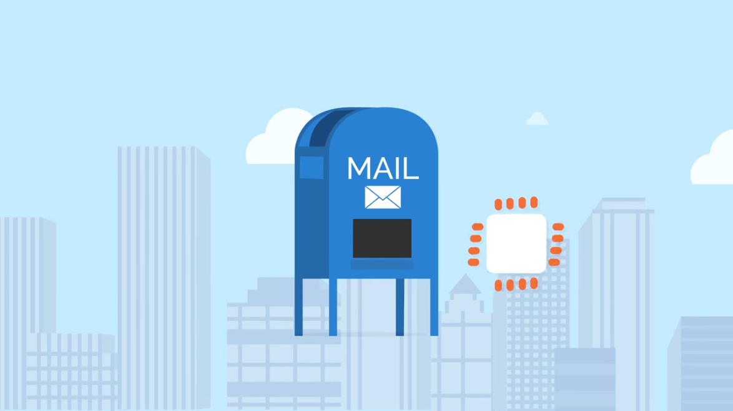

We make first & last mile boxes smart
How does Snaile work in First Mile Applications?

Slide 11
We make first & last mile boxes smart
Snaile Devices in Last Mile Parcel Locker Applications
Upgrade “Dumb” Parcel Lockers
&
Further Secure Automated Parcel Lockers
Patent Pending PCT #CA2016/050214 | USA #62127279 | Canada #2,883,805
info@snaile.com

Slide 12
We make first & last mile boxes smart
Last Mile Parcel Locker Applications
Passive Parcel Lockers
Monitor available parcel locker inventory to determine which lockers can accept new parcels (increase parcel throughput)
Automated Parcel Lockers
Ensure parcel lockers are empty when they are supposed to be as door open/close technology only assumes lockers are empty
Security: Ensure nothing that could be dangerous has been inserted by would-be terrorist locker “customers”
Monitor which parcel lockers have had parcels too long & are now ready to go back to distribution facility (parcel ageing inventory)
Patent Pending PCT #CA2016/050214 | USA #62127279 | Canada #2,883,805
info@snaile.com

Slide 13
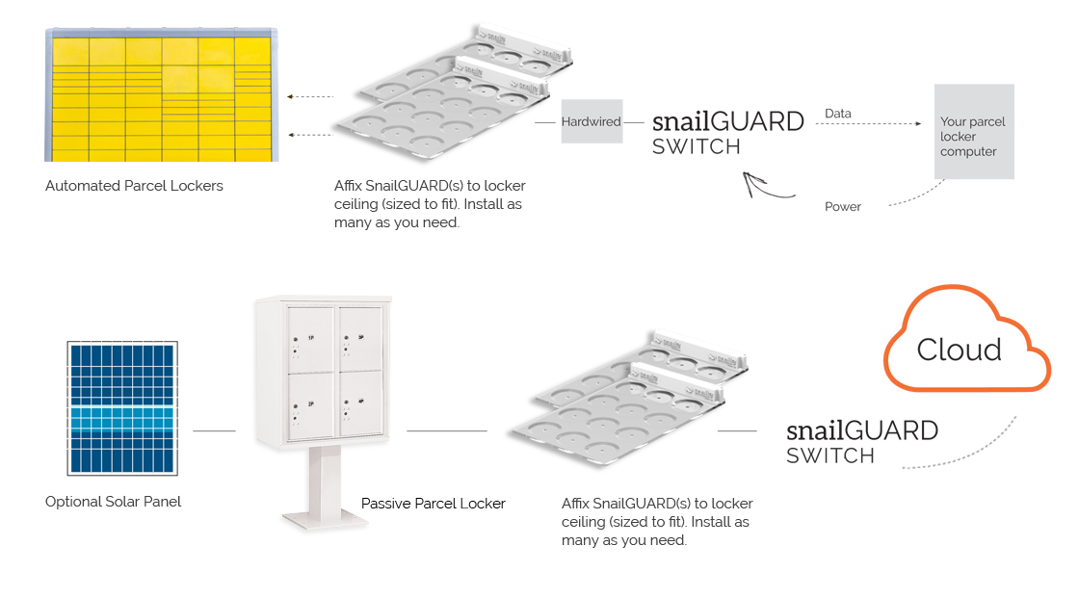
We make first & last mile boxes smart
How do Snaile Devices work in Parcel Lockers?

Slide 14
We make first & last mile boxes smart
Snaile in Last Mile Consumer Applications
Modernize the Mailbox, Compete with Digital,
Increase Mailbox Utilization Rates &
Reduce Carbon Emissions
Patent Pending PCT #CA2016/050214 | USA #62127279 | Canada #2,883,805
info@snaile.com

Slide 15
We make first & last mile boxes smart
What are Current Last Mile Mailbox Problems?
Problem
Impact
>
Consumers must check their P.O. Box or Community Boxes whether or not there is mail
Makes letter mail inconvenient and does not compete with digital
>
Creates unnecessary trips to boxes which causes needless emissions
>
Is difficult for those with mobility issues
>
Service gap between home delivery & mailboxes (P.O. / Community Mailboxes)

Slide 16
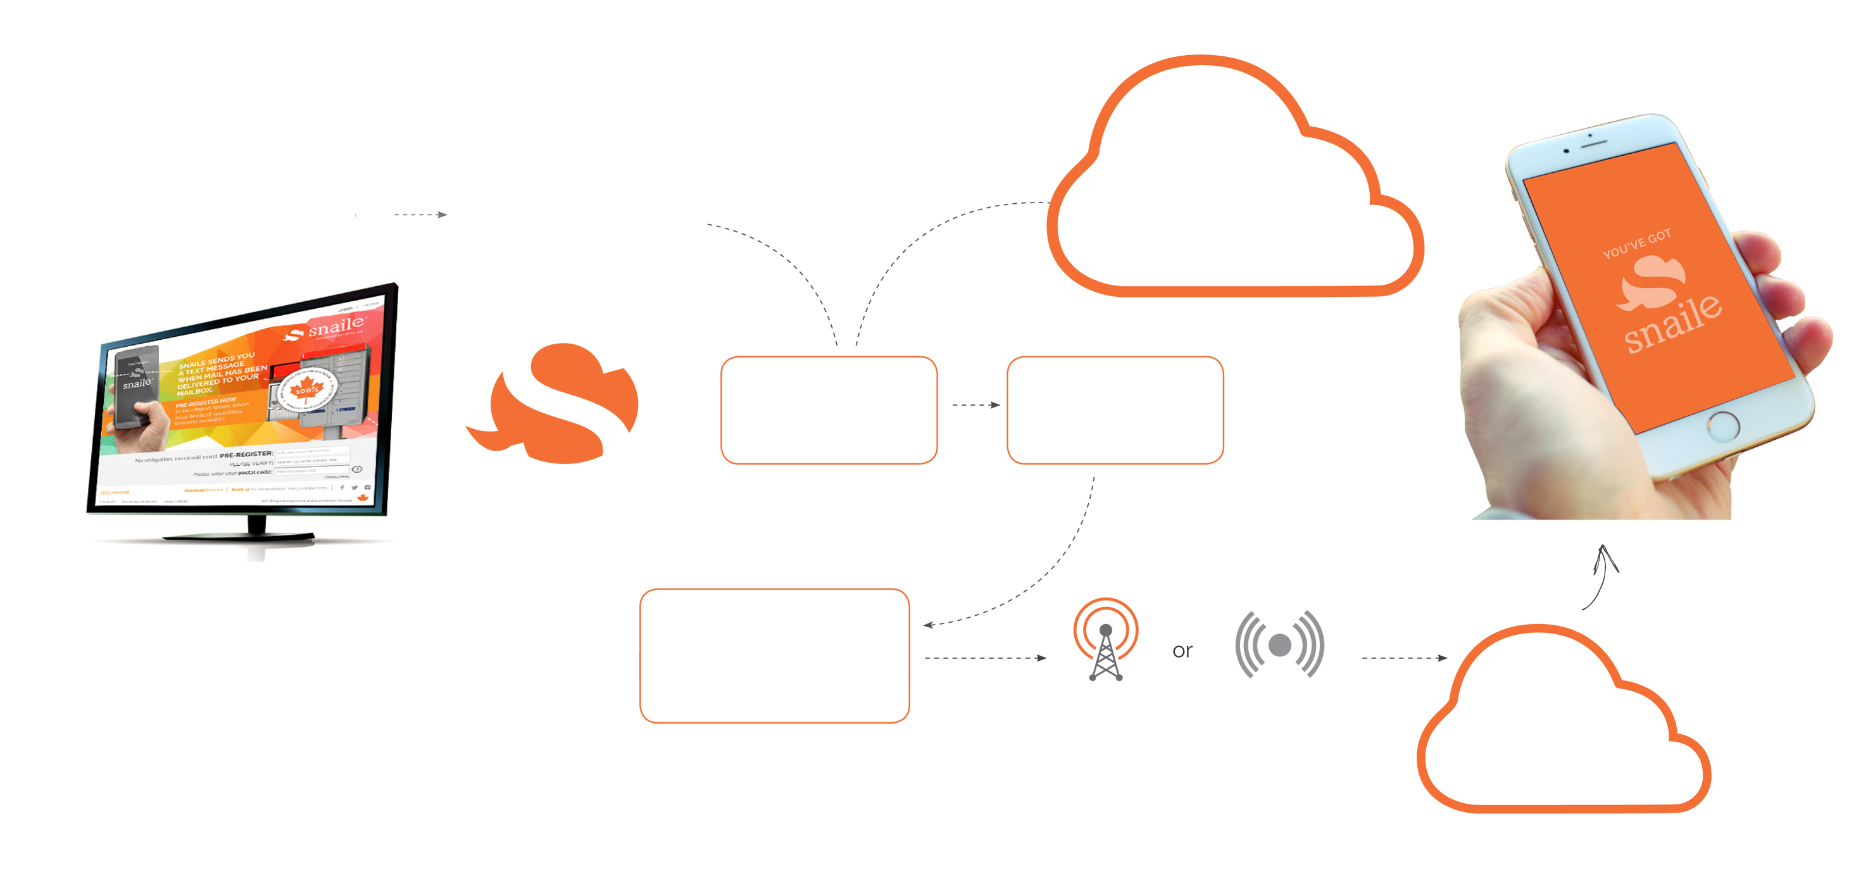
We make first & last mile boxes smart
How do Snaile Devices Work?
A LAST MILE APPLICATION
Consumer sets
up those friends or family who will receive Snaile notifications by SMS, email or App
Consumer subscribes to Snaile online
Snaile sends new consumer a device
Consumer charges device
Postal Service
delivers mail
Snaile detects mail received or picked up and notifies Snaile Cloud
Cellular Network
Wi-Fi
Cloud processes Snaile’s message for consumer
Patent Pending PCT: TBD | Patent Pending: US #62127279 | Canada #2,883,805
info@snaile.com

Slide 17
We make first & last mile boxes smart
Market Research
A Canadian Marketplace Example in a Consumer Mail Notification Application
In March 2015 Snaile had independently surveyed 400 Canadian households using Community & P.O. Boxes
43% answered “yes” they would be interested in a Snaile type of service
Survey confidence level was 95% with a confidence interval of +/- 5%. Conducted by Advanis Inc., an accredited and Gold Seal member of Canada’s Market Research Association (MRIA)
10% answered that they may be interested in a Snaile type of service
Patent Pending PCT #CA2016/050214 | USA #62127279 | Canada #2,883,805
info@snaile.com

Slide 18
We make first & last mile boxes smart
Snaile in Last Mile Applications
VALUE PROPOSITIONS
Potential for new service revenue for postal operators
Eliminate unnecessary trips to empty boxes = reduced emissions
Mailbox modernization + compete w/digital
Drive consumers to the Post Office to increase Point of Sale Opportunities
Increase P.O. Box utilization rates
Gain consumer behavior insights on box usage and stimulate more innovation
Drive consumers to their boxes to increase direct mail response rates
Bridge the service gap between home delivery & mailboxes
Help those with mobility issues
Patent Pending PCT #CA2016/050214 | USA #62127279 | Canada #2,883,805
info@snaile.com

Slide 19
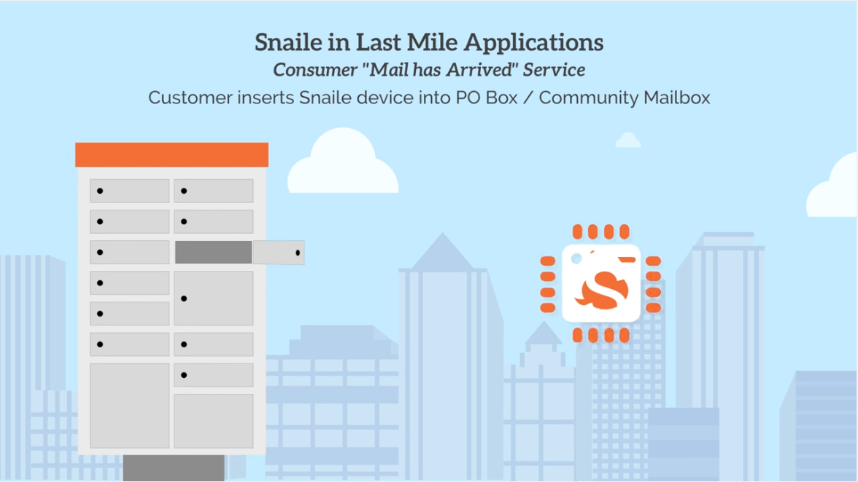
We make first & last mile boxes smart
How does Snaile work in Last Mile?

Slide 20


We make first & last mile boxes smart
Patent Pending PCT #CA2016/050214 | USA #62127279 | Canada #2,883,805
info@snaile.com

