Slide 1
Does your project have a
A web-based platform to manage OCM activities more efficiently

Slide 2
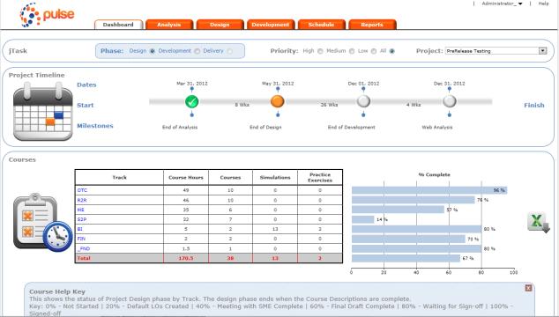
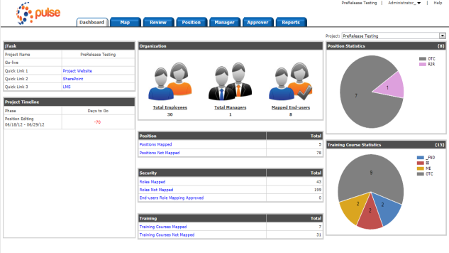
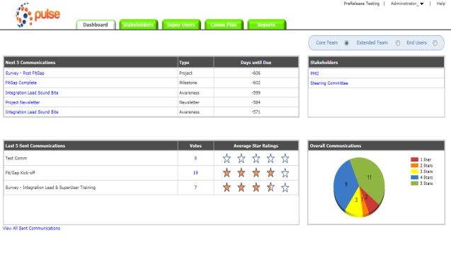
Does your project have a Pulse?
What it is
A web-based application used by a business to manage training design, role mapping and stakeholder engagement
Why it is important
Collaborative groupware establishes intentional group processes and provides plus software to support them
Reduces errors, duplications, and omissions
At Go-live, it reduces the number of help desk calls due to incorrect training, missed training, or no position access
train
map
communicate
*Click a thumbnail for a larger screenshot

Slide 3
Traditional Training Development
Traditional Approach to Training Development
Course Descriptions (outlines) created but not maintained
Development scope hard to maintain
Courses are not standardized
Potential Risks include
Excessive training content is created
Important training objectives are missed
Maintenance costs increase

Slide 4
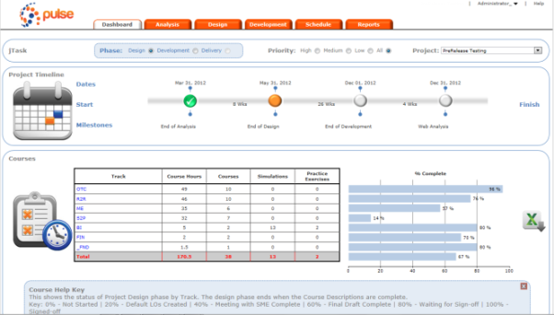
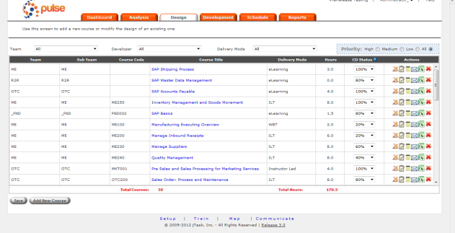
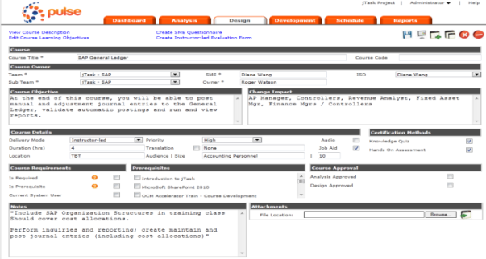
Pulse Train Module
The train module is used to effectively define the scope of training and track development against your training plan
Why it is important
Standardization of learning objectives and course descriptions
Alignment of scope of work against plan
Detailed development completion reporting
Benefits
Comprehensive customizable dashboard
Export course descriptions into a PowerPoint template
Email course descriptions with a push of the button
Provide transcripts, schedule training, manage delivery and track completions from a single location
*Click a thumbnail for a larger screenshot

Slide 5
Traditional Mapping Approach
Traditional approach to mapping
Project team tracks positions, training and security, and end users with multiple, un-managed spreadsheets
Security Team tracks their own security design on separate spreadsheets
Business units bear the resource cost of any errors, duplications, or conflicts
Potential Risks include
Excessive costs associated with training people who don’t need training
Operational cost of end users who don’t receive correct security access at Go-live
Operational cost of end users with access who cannot do their jobs a Go-live because of inaccurate or incomplete training

Slide 6
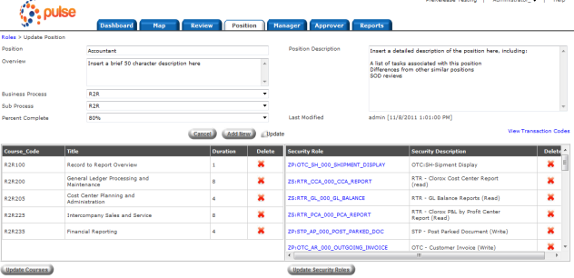
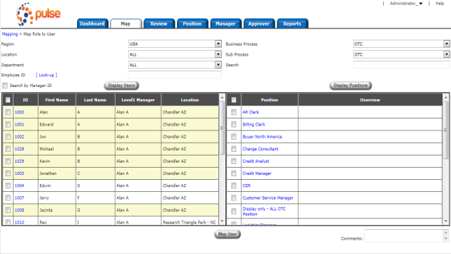
Pulse Map Module
The map module is used to build and map End-users to positions, a unique combination of Training Courses and Security Assignments
Why it is important
Assigns “mapping” ownership directly to the business
Allows simultaneous mapping across organization - eliminates ‘spreadsheet confusion’
Provides audit trail of for SOX audit purposes
Benefits
Reduces ‘misses’ with built-in reporting
Easily map and un-map large numbers of users or modify underlying positions
Provides comprehensive outputs to security and training teams
*Click a thumbnail for a larger screenshot

Slide 7
Traditional Communications Approach
Traditional Approach to a Communications
Stakeholder registers are constantly out of date and inaccurate
Stakeholder engagement is not tracked throughout the life of the project
Communications are one-way, with few effective ways of receiving feedback
Potential Risks include
Neglecting important stakeholders that can negatively impact your project
Outright missing stakeholders when communicating
Degrading your brand equity as a result of over communication
Never establishing a strong presence as a result of under communication

Slide 8
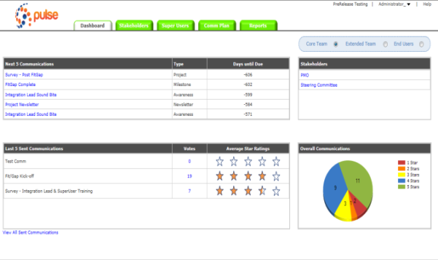
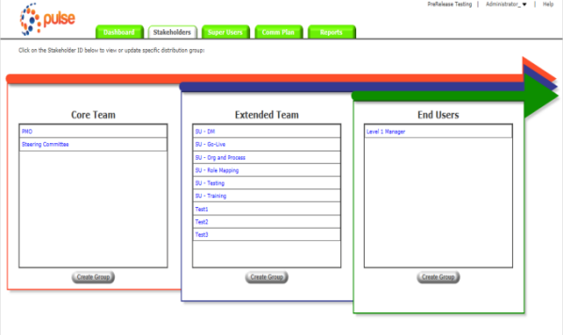
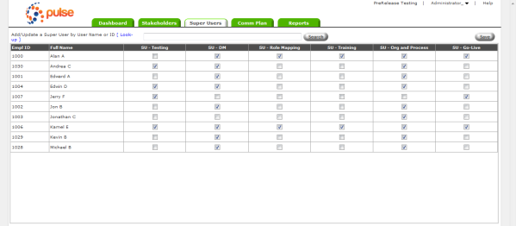
Pulse Communication Module
The communicate module is used to maintain the stakeholder register, gather communications feedback and manage stakeholder engagement
Why is it important
Easily maintain Stakeholder groups using existing people data
Dynamically manage Super Users as their responsibilities change
Historical tracking of who received sent communications
Provides two way channel to rate communications
Provides assessment of key stakeholder sentiment in graphical Heat map
Benefits
Export stakeholder groups for easy review and analysis
Adapt your comms approach based on feedback by channel
View all communications received by an individual
Store historical assessment information of Key Stakeholders throughout the project
*Click a thumbnail for a larger screenshot

Slide 9
Clients include
A few clients include:
Applied Materials | Amkor Technology | Ingram Micro
REC Silicon | SanDisk | Varian Medical
Clorox | Sybase

Slide 10
Server Technical Documentation
Dedicated Server
Hosted by | Alentus Corporation
Operating System | Windows Server 2008 Standard Edition
Disk Space | 200 GB HDD
Memory | 4GB RAM
Web Server | IIS 7
 | .NET Framework 4.0
 | SSL Enabled (RSA 2048 Bits)
 | Note: the application can run on VMWare virtual machine
Database
Database | Microsoft SQL Server 2008 Express Edition
 | Windows scheduled task that runs daily to backup the database and saved to Alentus SecureStor backup server
ASP .NET Application
Authentication | Form-based authentication that requires user name and password
Password | MD-5 encrypted
 | Users are prompted to change password every 3 months
Contact
Technical Contact | Rebecca Tan 408-416-1548 rtan@jtask.com

Slide 11
Try a Free 14-day Trial at jtask.com/products

