Slide 1
A Custom Wine Cellar in Old Tappan, NJ by JosephAndCurtis.com

Slide 2
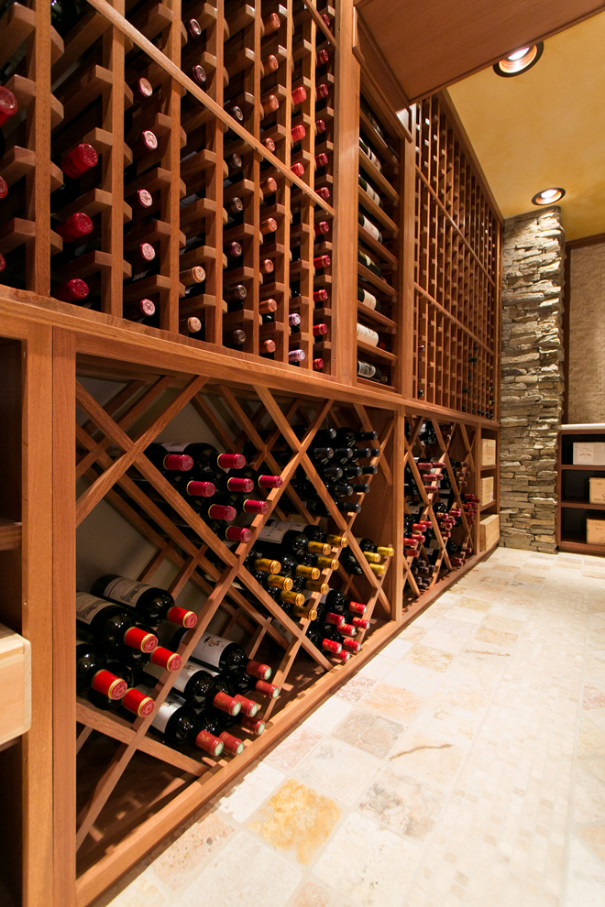
The wine room was a 10 x 12 empty room. A HVAC trunk in the ceiling was covered with a gorgeous beam made from sapele wood.

Slide 3
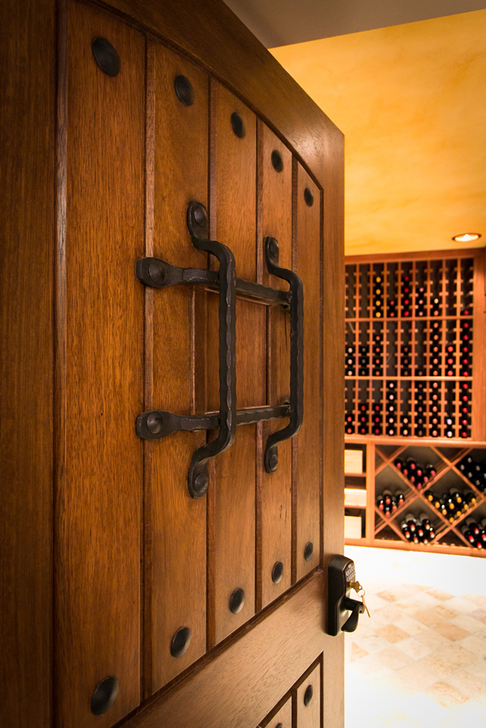
The “speak easy” style entrance is a gorgeous and fun way to create interest and intrigue behind the door and the coded entry allows only those you wish to enter.

Slide 4
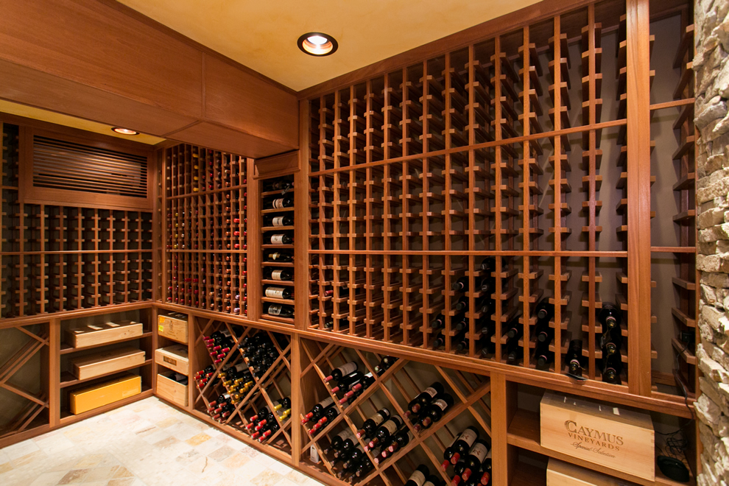
The wine room has magnum horizontal displays (both large and small), diamond bins, and our Joseph & Curtis wine racks that fit most any 750 ml bottle on the market.

Slide 5
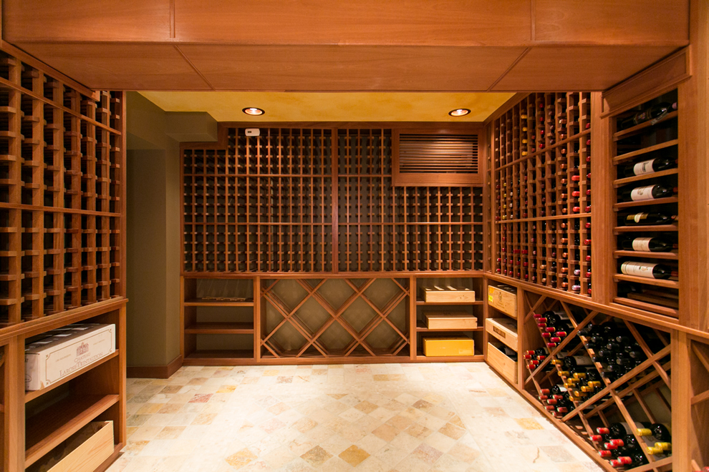
The cellar holds 2000+ bottles with the ability to add a tasting or storage table in the center of the room (holding an additional 3,000 bottles).

