Slide 1
How can a diabetic lead a healthy happy life?

Slide 2
DIABETES

Slide 3
26 million Americans have diabetes 18 million diagnosed, 7 million undiagnosed
1 in 3 people are pre-diabetic

Slide 4
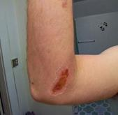
What are the symptoms?
Excessive thirst
Increased urination
Fatigue
Weight Loss
Red, swollen, tender gums
Tingling hands and feet
Slow-healing sores, frequent infections
Blurred Vision

Slide 5
Excessive thirst
Fatigue
The body needs plenty of water as it tries to flush out the excess sugars in your blood. Basically, your thirst is unquenchable at some point. A diabetic becomes thirsty as well because of the increased urination.
With diabetes, your cells are starved for glucose which your body uses as a source of energy. When the sugar stays in your blood and locked out of the cells, you become very tired.
Increased urination
Weight Loss
When you have extra glucose in your blood, due to diabetes, your kidneys work overtime to get rid of it. The extra glucose sucks up water every where in your body, causing you to urinate more often.
When the cells are not getting the energy they need in the form of glucose, the body starts to break down muscle and fat for energy.

Slide 6
Red, swollen, tender gums
Slow-healing sores, frequent infections
High glucose levels weaken white blood cells so they can’t kill germs as well. Gum infections can raise blood glucose levels making it harder to fight infections. Together, diabetes and gum disease create a vicious cycle.
White blood cells are sent to heal damaged tissue. When there is too much glucose in your blood stream, their work is hampered.
Tingling hands and feet
Blurred Vision
Numbness or tingling in your hands or feet may be a sign of peripheral neuropathy caused by nerve damage. This may be one of the first indicators of an individual discovering their diabetes.
When blood sugar levels are high, it changes the shape of the lens and the eye. It is reversible once blood sugar levels go down.

Slide 7
If not dealt with from the beginning what can diabetes become?

Slide 8
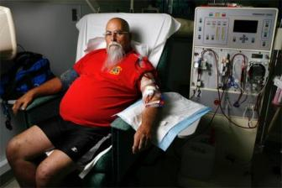
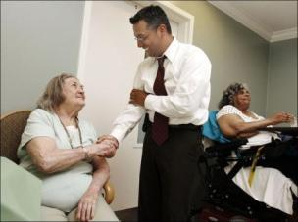
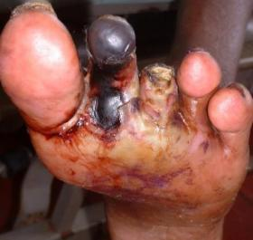
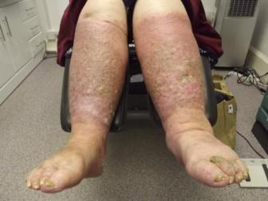
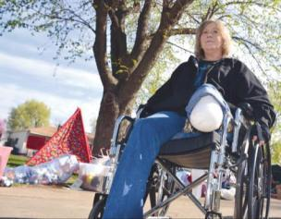
Blindness
Dialysis
Extra Care
Loss of toes
Loss of mobility
Loss of limbs

Slide 9
FEAR
HOPELESSNESS
ANGER
What are they feeling?
HELPLESSNESS
PITY
REGRET
DENIAL

Slide 10
Anger
The diabetic may feel that their body betrayed them. Or they want to continue with their lifestyle unchanged, when the best thing to do is change to a healthier diet and incorporate some exercise.
Fear
The diabetic may not have enough information or support to move through all the changes that need to be made. The process of education and adopting a new healthier lifestyle may be simply overwhelming for them.
Helplessness
A person may feel helpless due to the nature of the disease. Diabetes demands attention. If proper care and support is not provided they may have nowhere to turn.
Hopelessness
Often before a diabetic is diagnosed they feel hopeless. They feel bad emotionally and physically and have no idea what may be causing it or what to do about it. And their closest relationships may be crumbling as a result.
Denial
If a diabetic is set in their ways, they may make no effort to change anything about their life to better their condition. They may deny that any of the complications that plague other diabetics having poor management will be their fate.
Pity
A diabetic may take pity on him or herself, feeling they are the victim of their disease, and use it to get attention. And they may continue in the victim role and not claim responsibility for changing their condition for the better.

Slide 11
And what about the caretakers?

Slide 12
The caretakers have as much association with diabetes as the diabetic themselves.
Most people have a family member, friend or an acquaintance that has diabetes. They experience the mood swings, sugar lows, and all the challenges the diabetic does because of their close association. They can also experience some of the feelings a diabetic has such as helplessness, hopelessness, fear and anger.
They are the silent sufferers.

Slide 13
Does it really have to be that way?

Slide 14
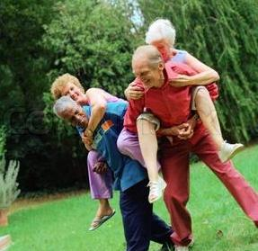
Why can’t it be like this?

Slide 15
How does a diabetic lead a healthy happy life?

Slide 16
Education
Of course,
diabetics all know WHAT to do!
Proper Diet
Exercise

Slide 17
The real issue and question is
HOW?

Slide 18
What every diabetic needs is
SUPPORT!

Slide 19
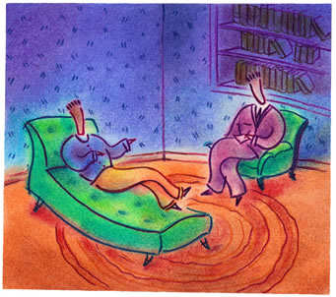
Some people seek it through therapy

Slide 20
The only problem is that a therapist wants you to sit on the couch. Diabetics need someone who can get them off the couch!

Slide 21
“You see, in life, lots of people know what to do, but few people actually do what they know. Knowing is not enough! You must take action.”
Tony Robbins

Slide 22
What everyone really needs to achieve their goals is
A COACH

Slide 23
Who is behind every great tennis player?
A Coach

Slide 24
Who is behind every great singer?
A Coach

Slide 25
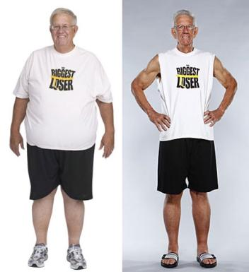
Who is behind the Biggest Losers?
A Coach

Slide 26
Who can help a diabetic lead a healthy and happy life?
A Coach

Slide 27
A Personal Coach who..
Understands their struggles & goals
Provides valuable resources & tips
Gives manageable steps toward goals
Offers encouragement and praise
Follows up on their follow through

Slide 28
Someone who provides them
SUPPORT!

Slide 29
To Be

Slide 30
I am Taylore Caldwell
I have been a diabetic for 12 years
I have been a healthy diabetic for 11 years
I am a coach to diabetics and their caretakers, both in person and long distance

Slide 31
In coaching, as in life, one size does not fit all.
I offer several unique coaching programs designed to fulfill different needs and budgets.

Slide 32
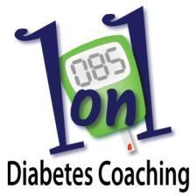
Coaching Programs
Individual
Group
Pantry Makeover
6 and 12 Week
6 and 10 Week
3 and 6 Hour

Slide 33
Find out if coaching will work for you! Visit me online at Fit4lifediabetescoach.com or on my Facebook Page,
Fit4Life Diabetes Coaching

