Slide 1
Subscription Management
&
Recurring Billing
for SaaS

Slide 2
Launching a new product?
Fast-Cycle low cost experiments
3rd Party Solutions
Minimum effort campaigns
Plug and Play
Subscription Billing

Slide 3
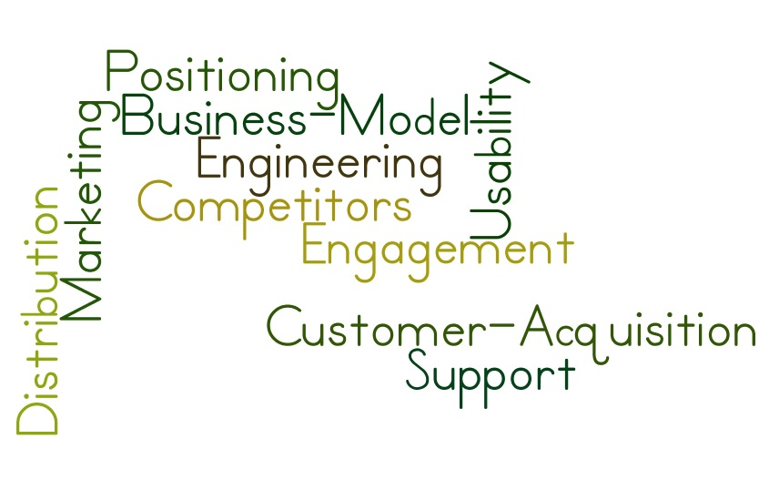
Launching a new product?

Slide 4
Fast-Cycle Low Cost Experiments
Experiments
Accumulate Results
Grow Knowledge
Insights to Improve Product
Use Experimentation as a Key Decision Making Tool

Slide 5
Need systems to run different campaigns with minimum in-house effort
Unable to find resources to do it all?
Limited Time
High Direct Costs
Limited People
High Complexity
Need for High Quality
“
You can always write your own in-house billing system down the road if you need to. But if you start with that now, you'll likely find yourself mired in details that are far removed from your business and core competency and lose your edge to lighter more dynamic competitors who are building great products and iterating quickly*
*http://sbinfocanada.about.com/u/ua/startingadvice/startupmistakes.htm
**http://blog.chargebee.com/recurring-billing-system-build-buy/
* http://stackoverflow.com/a/2747457

Slide 7
Use best in class solutions in each category
Core Product
Helpdesk
Accounting
Marketing
Analytics and Reporting
CRM

Slide 8
For a Subscription Business, That still leaves a significant chunk of billing related items that needs to be built.

Slide 9
Core Product
Customer Lifecycle Management
Billing and Invoicing
Customer Connect
Analytics
Conversion, Retention & Engagement
Automated Payments collection
Transactional emails
Business & Transactional Analytics

Slide 10
What Constitutes Online Billing?
API framework
Automated Recurring Billing
Multiple gateways
Transaction Management
Invoicing
Subscription Management
User engagement
Trial Management
Upgrade / Upsell
Discounting and Affiliates
Coupon Management
Affiliate Management
Credits
Integrations
Helpdesk
CRM
Accounting
Business Intelligence / Transactional Analytics

Slide 11
What makes Subscription Billing Unique?
Large number of customers paying smaller amounts.
High Billing Frequency.
And the challenge of retaining customers while growing the business.

Slide 12
How do you overcome the Challenge?
Try out different business models
Promotional campaigns Minimum effort
Reduce time to market in competitive SaaS space
Trump competition by disruption
Fast-track, low cost experiments.

Slide 13
Customer Retention & Engagement is pivotal for growth
It pays to retain a customer than spending 6-7 times to acquire a new one.
Growth
Retention
Billing
Support
Reduced Churn Rate
Upselling
Customer Engagement
Customer Acquisition
Customer Engagement
based on behavior-
track user activity
correlate data
create report
draw inferences

Slide 14
How can ChargeBee help?
Extend Trials
Automate Customer Engagement
Dunning Management To Handle Failed Transactions
Preemptive Follow-ups For Expiring Cards
Providing A Great Billing Experience To Customers
Coupons
Increase Average Revenue Per Customer (ARPU)
Upsell Add- Ons
Reduce Customer Drop-off
Managing Churn
Identifying & Retaining Unhappy Customers
Credits
Adjusted Billing Dates
http://web.appstorm.net/roundups/15-great-apps-for-your-business-subscription-needs/

Slide 15
Reporting and Analytics
Reports on profits and expenditures, subscription count by each plan
Reports on user sign-up data and user activity
Provides Integration with CRM and Analytics software

Slide 16
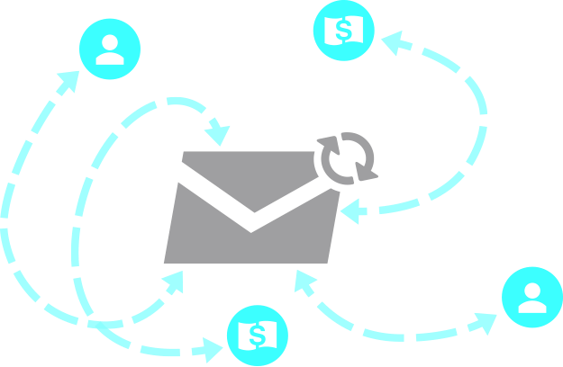
Leverage the power of Transactional Emails
Increase customer engagement with email transaction systems
Customizable Email Templates
Automatic Email Notification
Image Source: http://support.futuresimple.com/customer/portal/articles/962410-setting-up-email-integration

Slide 17
Responsive customer support
Your Extended Billing Support Team

Slide 18
Will your data be held hostage?
No Lock-ins. EVER.

Slide 19
Peace of Mind: Data Security
SECURE BILLING EXPERIENCE: PCI COMPLIANT
Ensure Customer Data Safety

Slide 20
http://www.chargebee.com
Subscription Billing. Simplified.
Reserve your free sandbox today!

