Slide 2
Test drive the entire suite of Microsoft’s Business Productivity Platform across a variety of mobile devices
Create a true digital workplace to improve employee experience
Discover tools to be productive when outside the office
Connect in real-time with co-workers and customers

Slide 3
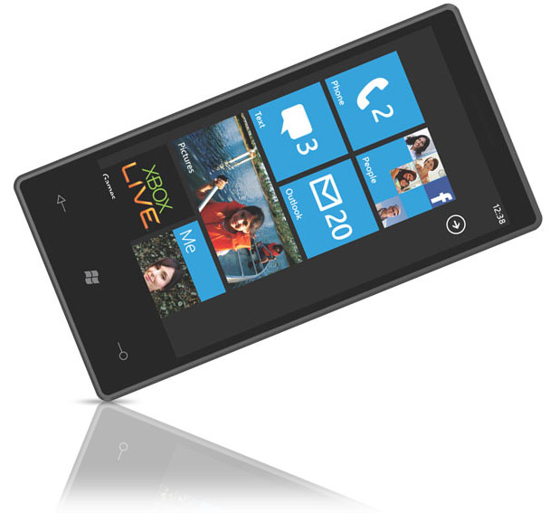
Productivity On the Go

Slide 4
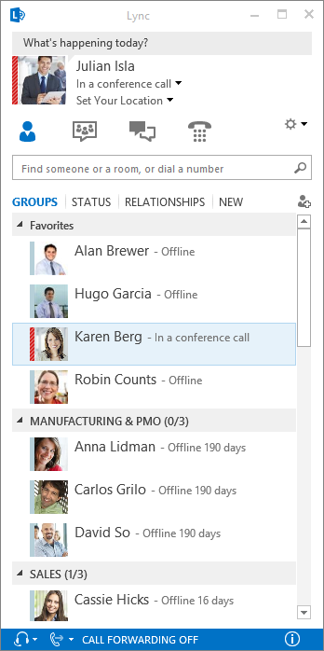
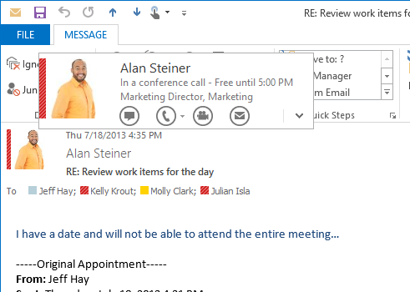
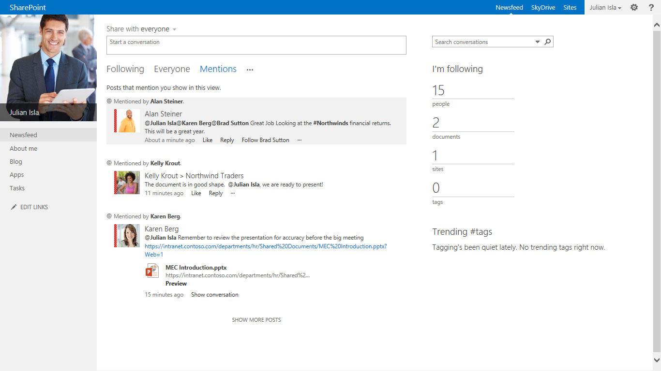
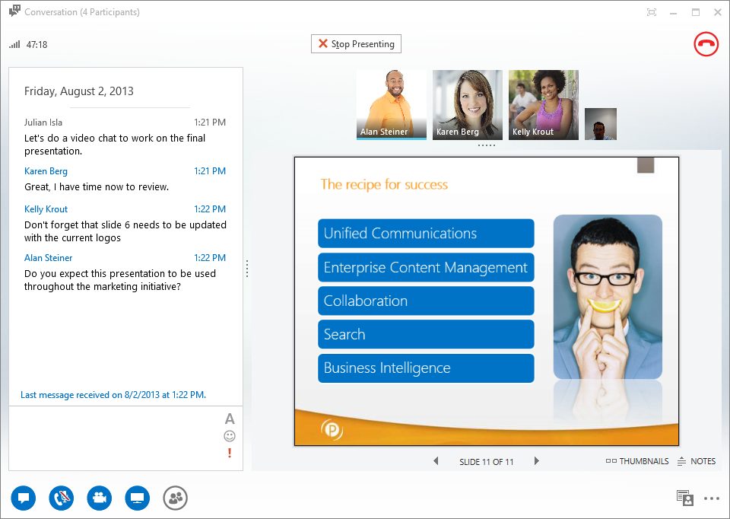
Connecting with Co-Workers

Slide 5
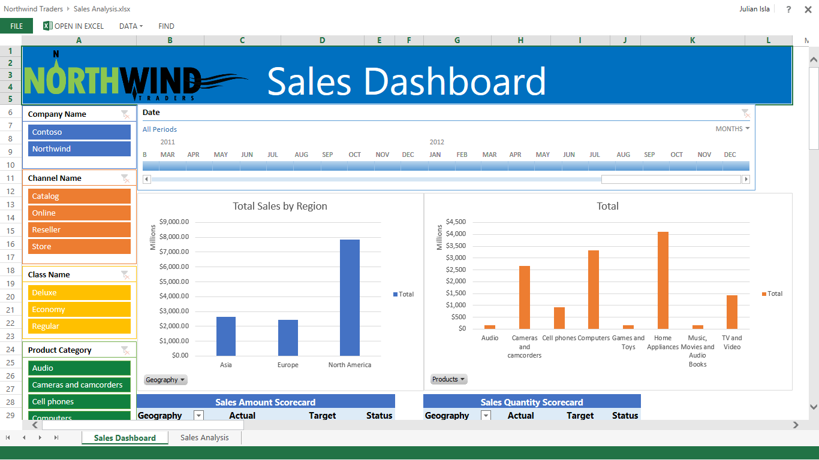
Real-Time Answers

Slide 6
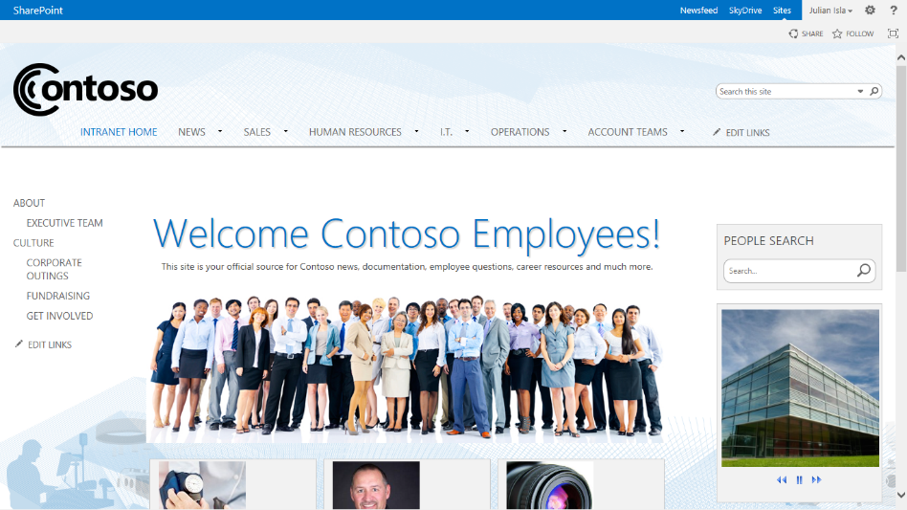
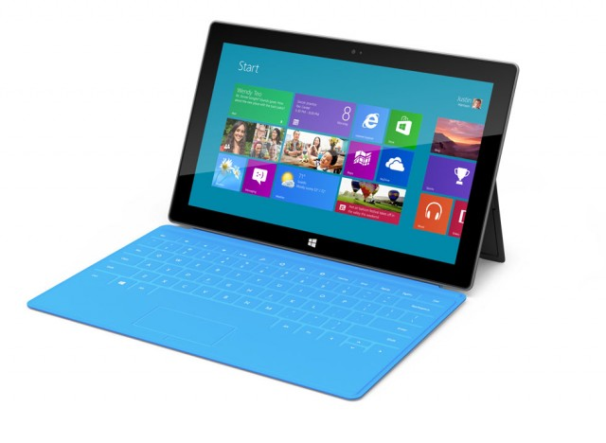
Collaborate Anywhere
Collaborate Anywhere

Slide 7
See for yourself how Microsoft’s Productivity Platform can make your workforce...
better
smarter
happier

Slide 8
Schedule a DWX Session at our Maryland facility today!
Send an email to DWX@portalsolutions.net or go to www.portalsolutions.net for more details.
Be ready to be amazed.

