Slide 1
70+ enterprise customers
Customers in 15+ industry segments
6 million+ work hours analyzed
1000+ alerts generated daily

Slide 2
Why Cyber Intelligence is needed?
inDefend uses Business Cyber Intelligence as a unique approach towards reducing the business risks of a company through intelligent analysis of the information flowing within and outside the company in four major problem areas:
Unexpected Attrition
predicting and controlling employee attrition
Productivity Loss
Tracking Entertainment and Unproductive activities of the employees
IT Misuse & Espionage
IT misuse, espionage and Corporate Fraud
Data Theft
Loss of confidential and business sensitive data from un authorized insiders or external entities

Slide 3
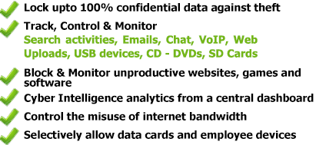
Solution
What is inDefend Business in-Cloud? inDefend is the next generation cloud based technology which uses Cyber intelligence to keep you informed about business risks through data loss, productivity, attrition and malicious insider behaviour and helps you reduce these risks.

Slide 4
Why inDefend Cyber Intelligence ?
Job Search Tracking
Monitor Job searches across different job portals
Monitor resume uploads by employees
Monitor emails related to employee attrition
Monitor confidential customer and lead database uploads before resignation
Helpful in predicting employee resignations thereby enabling you to take necessary steps beforehand
Productivity Tracking
Track web activities of all employees like social media usage, video streaming, pornography access, Google & other web searches and 56 other web categories
Tracking unproductive activities of employees like Gaming, Social Media Usage, Chatting, Online Shopping, etc.
Track application usage of different employees
Monitoring Employee
Determine misuse of IT resources by employees
Detect emails sent to unrelated internal recipients
Detect confidential corporate information being sent to suspicious third parties by employees
Detect internal freelancing by employees
Detect probable corporate fraud and espionage by using sensitive keywords in sensitive web searches and employee chats
Award winning Data Security
Control emails, attachments and web file uploads
Control file copy onto USB and CD-DVD media
Control website activities through different browsers
Control file transfer over IM Clients like Skype and Windows Live Messenger
Control usage of internet data cards
Control usage of different applications and proxies which generally bypass standard firewalls

Slide 5
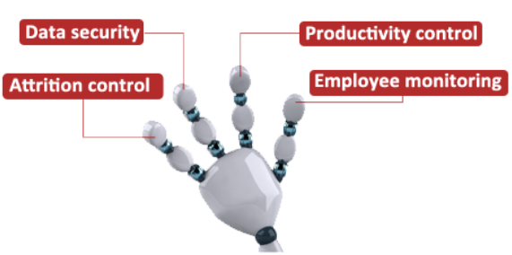
The Intelligence Factor - 1
The intelligence in the solution lies in the feature where the product aggregates all the malicious alerts generated in the network, and presents it to the business owner or the top management in three ways:
Cyber Intelligence Sensors
Social network style alerts
Daily Email Reports
Summary of alerts generated throughout the day
Real-time SMS Alerts
SMS Notification sent for the most sensitive activities happening in your network
Cyber Intelligence Reports
Advanced insights are provided into your organization’s activities and recommendations are given to improve processes
4 focus areas of inDefend Cyber Intelligence

Slide 6
The Intelligence Factor - 2
inDefend is loaded with 7 Cyber Intelligence alerts
Social networking alerts
Pornography access alerts
Job search alerts
Sensitive search alerts
Pen drive usage alerts
Web file upload alerts
Gmail attachment alerts
23 more sensors being added to the existing product

Slide 7
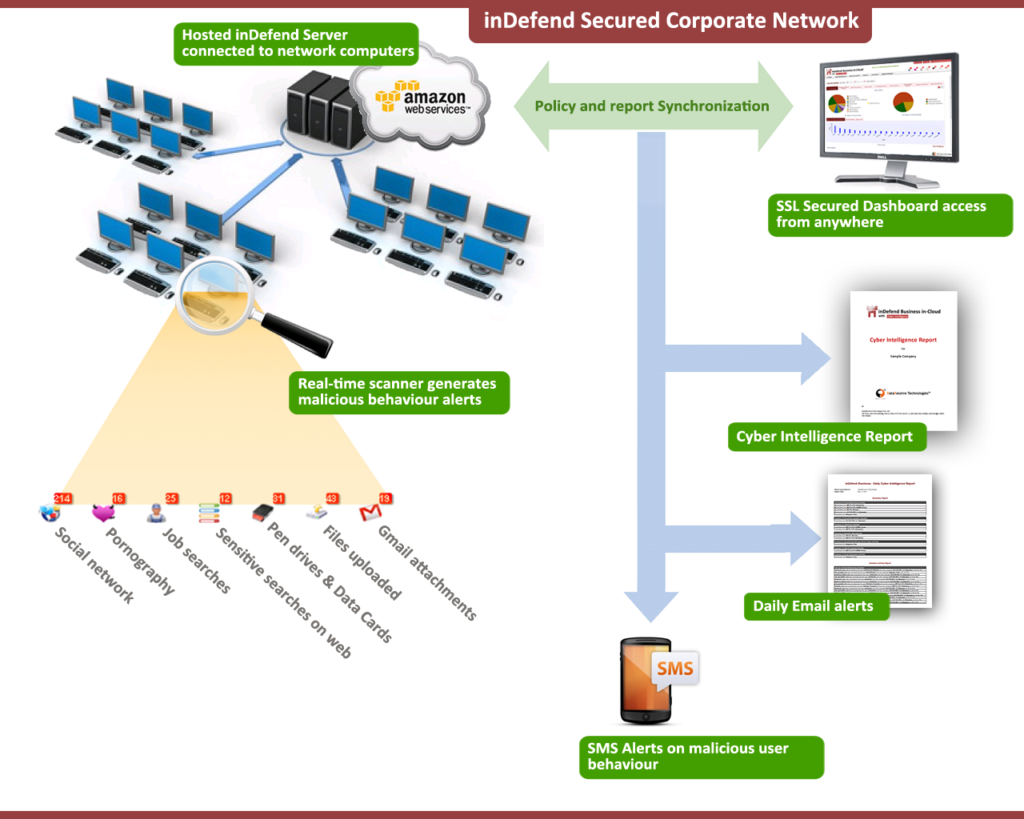
How does it work ?

Slide 8
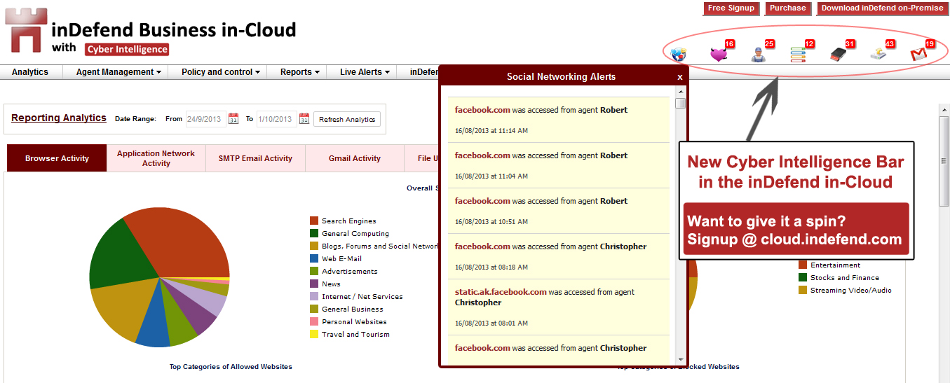
Social network style Dashboard

Slide 9
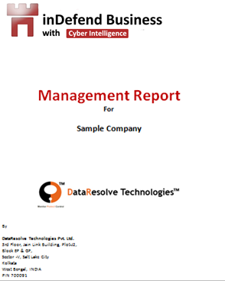
Cyber Intelligence Report
The solution also offers a service based on its product inDefend called CI (Cyber Intelligence) Reporting for the management.
This report is created by manually by our cyber security analysts by analyzing the data collected over time and then compiling it in a comprehensive document which gives a report on the different business risk areas, using which the management can take appropriate actions to avoid such risks.
Sample report can be downloaded from here.

Slide 10
Daily Email Report
inDefend sends you email reports of the following activities on a daily basis:
Aggregate of all Cyber Intelligence Alerts
PDF report of the alerts with details like:
Activity Time
Computer where activity occurred
User linked to the alert type
Details related to the activity type
Daily email reports keep you updated on the move when you do not have direct access to the dashboard.

Slide 11
Cyber Intelligence Add-ons
SMS Alerts for various sensitive activities
Job Searches
Pornographic Access
Sensitive Web searches
Screenshot Monitoring
Periodic screenshots of end-user’s desktop activities

Slide 12
Data Collection modules – CI Engine
By monitoring the following points of information flow out of your computers:
All Website activities through Firefox, IE, Safari, Chrome.
SMTP Emails
Gmails
SMTP Email Attachments
Personal Webmail Attachments
Files uploaded to the Internet
Google Chats
Skype Chats
Google /Yahoo/Bing Searches
Applications
Proxies
USB Storage Devices (Pen Drives/External Storage Drives/SD Cards)
CD/DVD Drives
Offline computers
By deeply monitoring end-user’s activity on your computers using the following :
Screenshots

Slide 13
Endpoint Protection
By Controlling
Outgoing email attachments and File Uploads
USB and CD-DVD activities
Browsing activities
File transfer over IM/Messaging Clients like Skype and Windows Live Messenger
Data copied on personal devices
Different Applications and Proxies
By Shadow logging of crucial & suspicious data transfer
Shadow Log Email, Email Attachments and File Uploads
By Blocking internet data cards and allowing selectively
By Enforcing policies on laptops and desktops both inside and outside your network
By Enforcing the use of only encrypted storage devices
By Blocking employees from copying information on their personal media devices

Slide 14
Who is using inDefend ?
70+ enterprise customers and counting
Serving customers in 16 different industry segments
Customers spread out in 13 different countries
6 million work hours analyzed till date
An average of 1000+ alerts generated on a daily basis and counting
To know more about our customers, please click here.

Slide 15
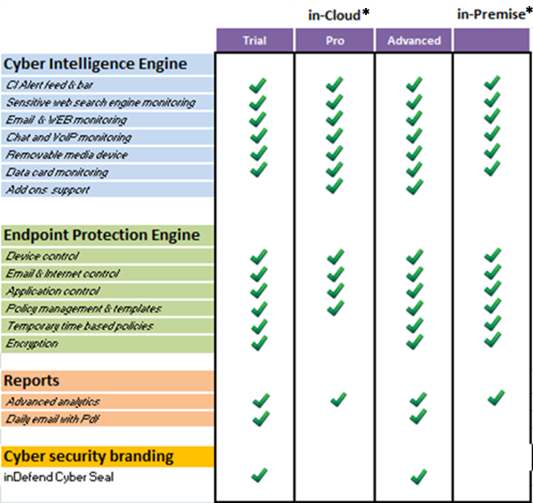
Product Offerings
*Pricing of each version available on request

Slide 16
How to start ?
Get started by signing up for inDefend Business Cyber Intelligence from our Cloud Signup Link
On signup you will get access to the following:
Free 14 day Trial of inDefend Business Cyber Intelligence
Online Live Demo of the product
Free Product Demo and Assisted Installation
Introductory Cyber Intelligence Report for your company

Slide 17
About Data Resolve
Data Resolve Technologies is a fast growing young software product company, in the area of Cyber Security and Cyber Intelligence, and helps businesses secure their data from theft and loss, along with business risk mitigation through the security analytics module of their award winning product – inDefend Business.
Data Resolve has thousands of footprints in their customers’ network spread out in dozens of countries, and is highly recommended for any medium size company’s top management who want to assess the risk of their business through Cyber Intelligence, and achieve global standard of data security.
“The Game Changers” – A national best seller published by Random House Publishing has covered the story of Data Resolve under top 20 extraordinary success stories from Indian Institute of Technology, Kharagpur.
More details about the company, products, customers, promoters, management, advisors etc. can be found at www.dataresolve.com. More about product available at www.indefend.com
Contact Us
If you would like to speak to us on phone or want to set up a meeting we are available on the following:-
Data Resolve Technologies Private Ltd
3rd Floor, J2, Jain Link Building,
Block EP & GP, Sector – V
Salt Lake City, Kolkata, INDIA 700 091
Mobile: +91-84201-94203
Phone: +91-33-4061-1242/1241
Email: sales@dataresolve.com

