Slide 2
What if
everything your parents told you about your life was a lie?

Slide 3
What if
To save your life, You had to leave the only home you’d ever known?

Slide 4
What if
You were caught in a strange place with obnoxious kings, horrible monsters…

Slide 5
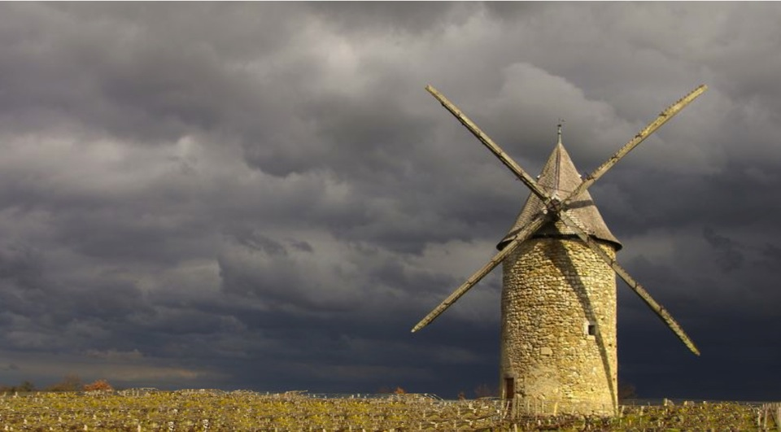
and even the occasional evil windmill?

Slide 6
And What if
The one thing you sought – the only thing that can save you and get you homE…

Slide 7
no longer exists?

Slide 8
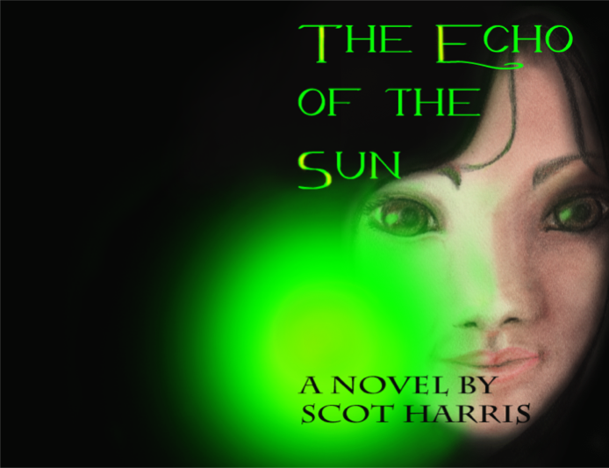
Find out in the Echo of the Sun
the far flung fantasy with a radically new style of heroine

