Slide 1
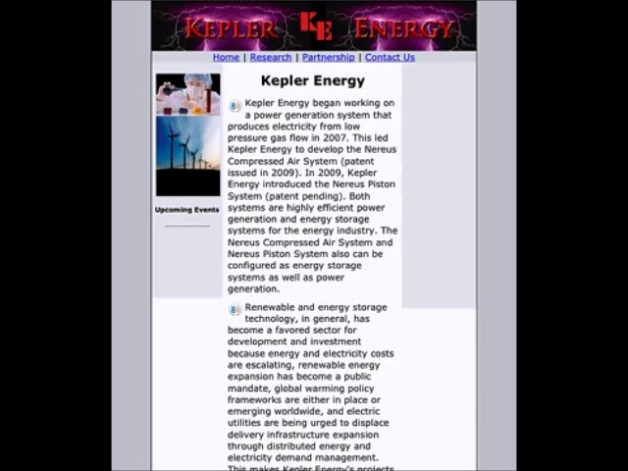
Mobile Content Delivery – When the 8tech button is clicked, the audio plays which is mirroring the text content so the mobile visitor can hear the information.
Video Demonstration, click to activate

