Slide 1
Top 7 Advantages of Outsourcing
http://www.glocalrpo.com/

Slide 2
http://www.glocalrpo.com/

Slide 3
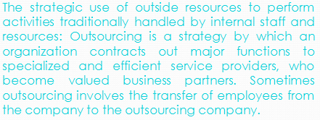
Definition
http://www.glocalrpo.com/

Slide 4
Operational Control
Stay Focused on Your Core Business
Cost and Efficiency Savings
Continuity & Risk Management
Flexible Staffing
Reducing Overheads
Developing Internal Staff
http://www.glocalrpo.com/

Slide 5
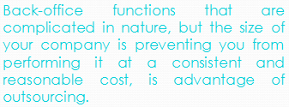
Cost and Efficiency Savings
http://www.glocalrpo.com/

Slide 6
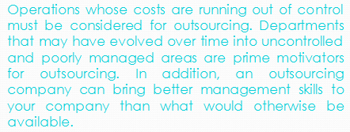
Operational Control
http://www.glocalrpo.com/

Slide 7
Stay Focused on Your Core Business
http://www.glocalrpo.com/

Slide 8
Flexible Staffing
http://www.glocalrpo.com/

Slide 9
Reducing Overheads
http://www.glocalrpo.com/

Slide 10
Developing Internal Staff
http://www.glocalrpo.com/

Slide 11
Continuity & Risk Management
http://www.glocalrpo.com/

Slide 12
As you evaluate your choices and decisions in outsourcing different components of your operations, you will need to consider the advantages of outsourcing. When done for the right reasons, outsourcing will actually help your company grow and save money. Want more Information about Outsourcing Click HERE !
http://www.glocalrpo.com/

Slide 13
Contact-Us
Support: info@glocalrpo.com
Kunal Jaggi: kunal@headfield.com
Call: US +1 425 818 0748 | India +91 11 46140625
Address: Glocal RPO LLC
3422 Old Capitol Trail
Wilmington DE 19808, USA
Website: http://www.glocalrpo.com/

