Slide 1
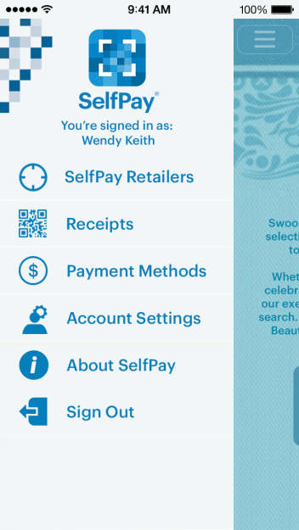
SelfPay Screenshots
In-Store Shopping Page
Navigation
Store Info
1

Slide 2
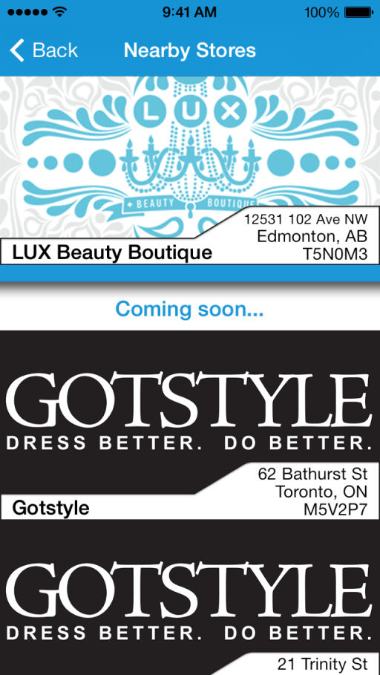
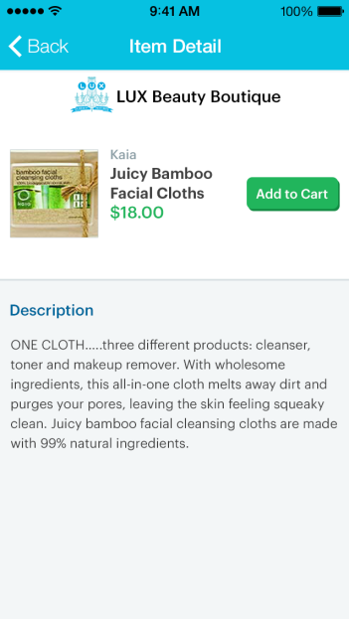
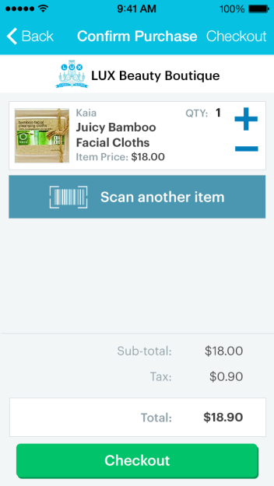
SelfPay Screenshots
Confirm Purchase
Nearby Stores
Item Detail
2

Slide 3
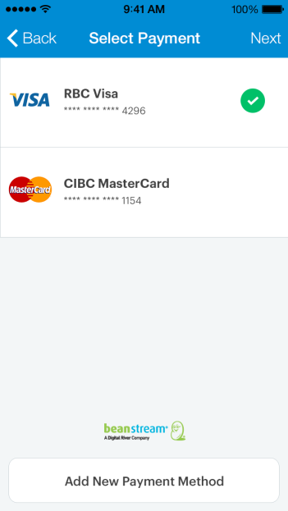
SelfPay Screenshots
Select Payment
Receipt
3

