Slide 1
We are here to Skyrocket your sales

Slide 2
About Us
We are a live chat and multi channel contact center
1
4
Our service allows your potential and existing customers to communicate directly with one of our professionally trained live chat agents
Main Text
2
3
We work in 2 areas, in customer acquisition and customer service
We specialise in live chat and social media

Slide 3
Our Mission
To turn casual visitors into customers by having a live chat support service available to answer any queries
01
To generate more sales leads and increase your conversion
02
To provide a more efficient customer service and fast customer response.
03

Slide 4
Some True Fact About The Live Chat Service
Main Text

Slide 5
U.S. Consumers Preferences in Resolving Problem

Slide 6
Most businesses don’t install live chat on their website
Because…
High Cost of hiring someone to sit at a desk and respond to chats
Complacency

Slide 7
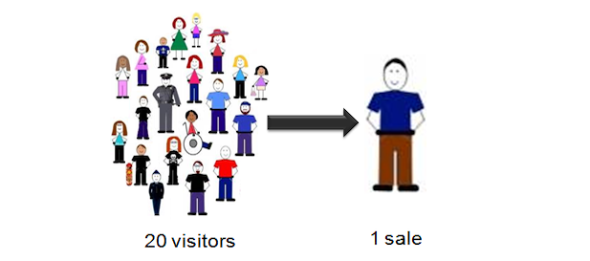
Low conversion is positively related with inefficient or no live chat support
Companies spend thousands on marketing, SEO, Pay per Click but they still can't solve the low conversion issue.
That's because the company doesn’t have someone to provide a "concierge" service to a customer.

Slide 8
Most common Live Chat Service: Not Available to Chat
95%
We are not available to chat, please Email
of websites don't have someone available to chat to you

Slide 9
One Bad Experience Can Cost You
82%
of the respondents stopped doing business with an organization due to a poor customer experience
Source: http://techcrunch.com/2010/10/13/customer-service-rightnow/

Slide 10
One Bad Experience Can Cost You
79%
claimed that they passed their horrible experience to other consumers and urged them to avoid the brand all together
Source: http://techcrunch.com/2010/10/13/customer-service-rightnow/

Slide 11
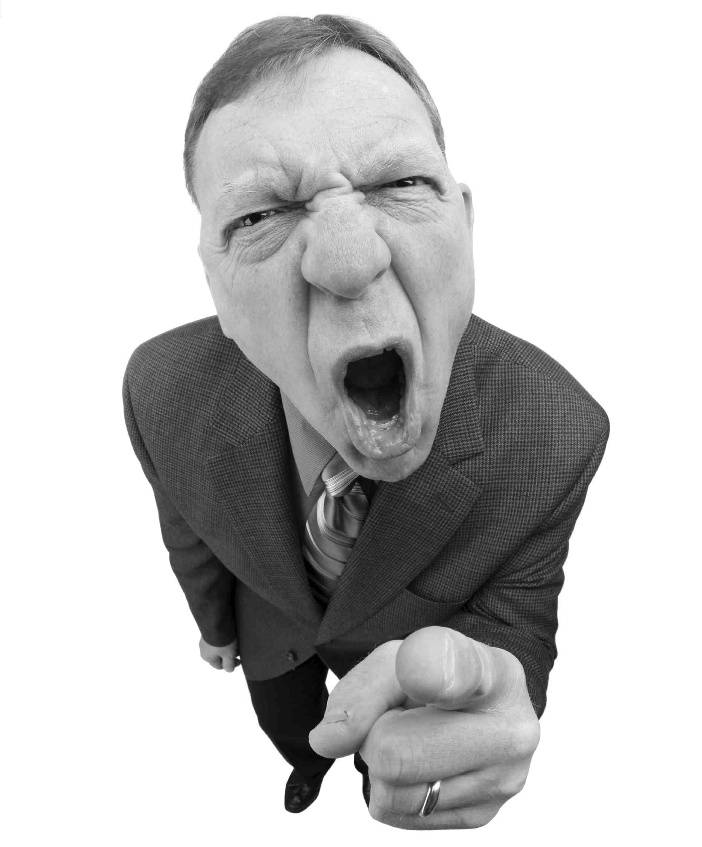
One Bad Experience Can Cost You
95%
of customers who had a bad experience claimed they would take action and even worse
Source: http://techcrunch.com/2010/10/13/customer-service-rightnow/

Slide 12
Do Not Let This Happen

Slide 13
There is a Solution to all of this

Slide 14
Chat Bee
Our service will increase your sales. we are an investment
Increase Sales
Convert More Visitors
There is no doubt that live chat agents available 24/7 will increase your conversion rate and your sales, we are passionate about increasing sales!
Cut Overheads
Make Every Buck Count
Your staff can be more efficiently employed than spending time on calls and e-mails. Our Live Chat Service will only cost $3.99 per hour! Bargain.

Slide 15
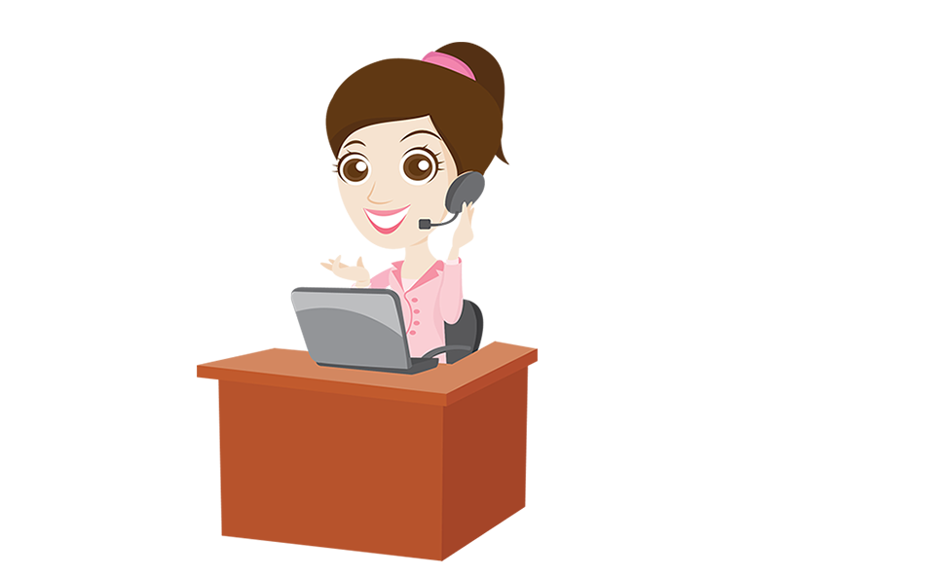
Chat Bee
The best thing about our live chat service? It's FREE!
Pay on Result
Happy Customers
E-mail Response
No More Queing or Waiting!
Covert Mail to Solid Leads
No-one likes to be kept waiting; We’re all busy people these days. Make your customers happy customers by having live chat agents available 24/7.
Many people still prefer to communicate via e-mail. Our professionally trained live chat agents can respond to those too, leaving your staff free to do their job.
Be More Social
Find Your Voice
Engage + Covert SM
A Friendly Voice Sells
Our live chat agents communicate through Facebook and Twitter; Social Media Marketing can be a massive tool to increasing conversions!
Some customers still prefer to talk to a person; in fact people buy from people. Our friendly live chat agents can help close the deal - where other channels fail.

Slide 16
Chat Bee: No One Quite Like Us
6
1
5
We can find a conversation that happened 6 months ago in less than 15 minutes
Every single conversation, every chat, every word is recorded
We are real people serving real customers
2
4
We treat every customer as an individual and as a person. We make them feel valued, as they should be
We provide a highly reliable Managed Live Chat service, with 99.9% uptime guarantee
We provide complete transparency and accountability
3

Slide 17
How it works
We can typically setup most "small" business in less than 3 hours. To summarize: 2 things need to happen for us to service your customers. When these 2 simple steps are complete we can start talking to your visitors.
Step -1
We need you to paste a code onto your website.
Step-2
We need you to complete a questionnaire about your business which will mean that we can answer common questions and queries from your customers.
Easy as pie. You could be up and running the same day

Slide 18
Our Pricing
we are confident in our service...free trial and no contracts
Our Live Chat Service Started from
Also you can Sign Up for a
Only $3.99 per hour!
Free 7 Day Trial

Slide 19
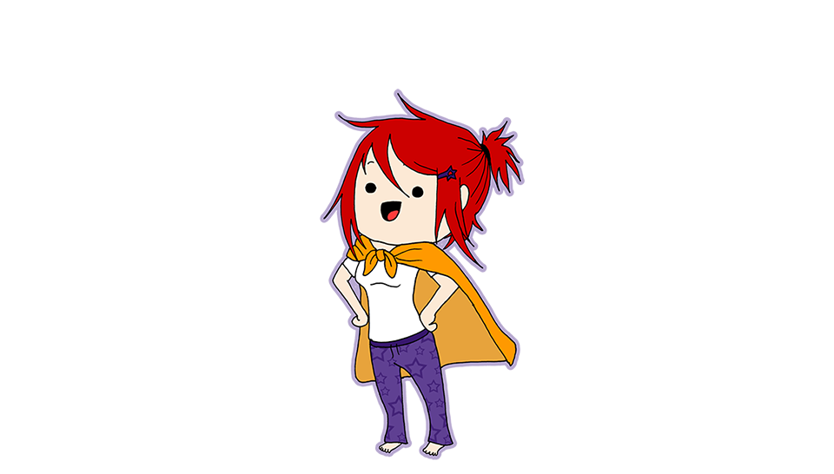
Why wait! Contact with US
Toll Free: 855 410 1402
hello@chatbee.com
twitter.com/ichatbee
facebook.com/ichatbee

Slide 20
Thank You

