Slide 1
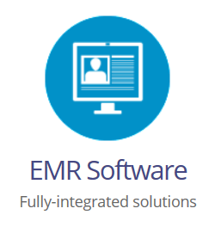
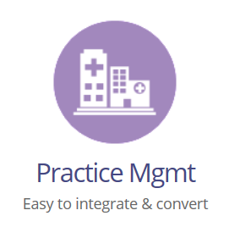
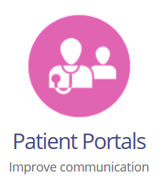
Learn about PrognoCIS Integrated Healthcare
Practice Solutions in this Brief Presentation
EMR SOFTWARE PRACTICE MGMT MEDICAL BILLING PATIENT PORTALS

Slide 2
OUR COMPANY
Getting to know Bizmatics, developer of PrognoCIS:
Incorporated in May 2002 and located in San Jose, CA with sales and support presence throughout the USA. We’re profitable and growing; we currently have 150+ employees.
Principle product and services: PrognoCIS EMR, Practice Management and Revenue Cycle Management Service.
Add-on modules include: Patient Portal, Integrated FAX Service, Text Messaging, Eligibility Verification, IPL (independent Patient Login) and Progno Synch.
3000+ small and medium size practices as customers; our largest practice: 180 clinics, 350 physicians. Our customers are spread across all the states in the US; we have a large presence in Puerto Rico and Caribbean.
www.bizmaticsinc.com/company

Slide 3
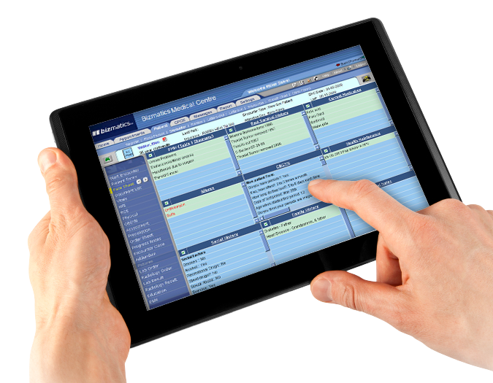
Our solutions
What makes our products different from our competitors’?
Latest technology based solution - Cloud Computing
Takes advantage of the Internet Paradigm and Modular Design
Ability to support both subscription model and client Server setups
Intuitive User Interface and configurable workflows
Design your own interface with Doc and Patient forms
Supports all major browsers
Runs on laptops, tablets, iPad and Mac PCs
iPhone native app
www.bizmaticsinc.com/products/solutions

Slide 4
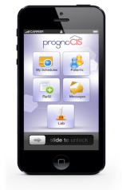
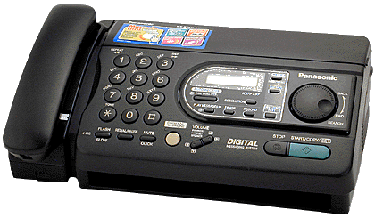
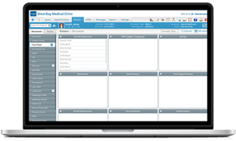
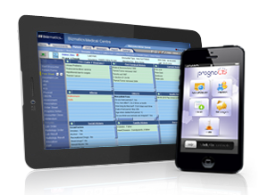
Our products
FAX Server
PrognoCIS App on patient iPhone
Nurse laptop with PrognoCIS EMR
LAB
PrognoCIS Server
Patient Chart Management,
Drugs, CPOE, Scheduling,
Billing, Patient Portal
Pharmacy
Physician mobile device with PrognoCIS EMR
PrognoCIS
Database
Drug
Database
Integrator
Radiology
Admin laptop with PrognoCIS EMR
Insurance
www.bizmaticsinc.com/products/solutions

Slide 5
Our SPECIALTIES
Our products support these medical specialties:
Request a Free Demo of PrognoCIS EMR:
www.bizmaticsinc.com/request-for-free-demo

