Slide 1
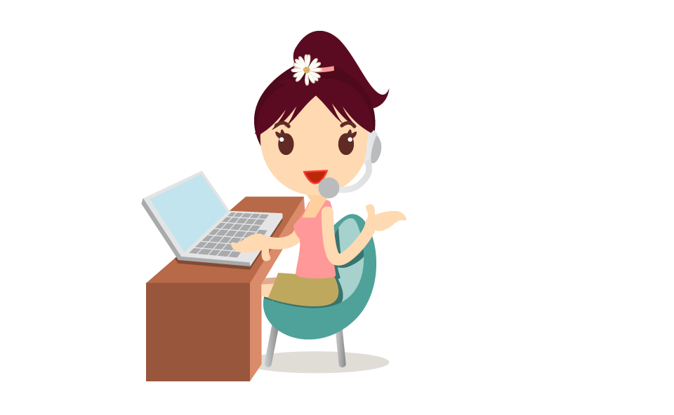

We are here to Skyrocket your sales
Main Text

Slide 2

About Us
We are a managed live chat service for business
1
4
Our service allows your potential and existing customers to communicate directly with one of our professionally trained live chat agents
Main Text
2
3
We work to help you acquire more customer, increasing conversion rates and sales. We can also provide customer service
We specialize in live chat and social media. That’s all we do.

Slide 3
Our Mission
To turn casual visitors into customers by having a live chat support service available to answer any queries
01
To generate more sales leads and increase your conversion
02
To provide a more efficient customer service and fast customer response.
03

Slide 4
Some Fact About Live Chat

Slide 5
Consumers prefer live chat for customer service: stats
Notes:
On slide #5 , you may want to change, the statistics to include the information on this link http://econsultancy.com/blog/63867-consumers-prefer-live-chat-for-customer-service-stats where it shows that 73% of people prefer live chat. You could put it in a bar graph if you want. At the moment you have two bars, one that says “Preferred speaking to live agent” with 83% and another one that says “preferred chat” at 12%. So I think the image under the title “stats in brief” could be presented within the PP.

Slide 6

1 in 5 Website Shoppers Prefer Live Chat
A survey of 1,000 regular online shoppers revealed that live chat is the preferred communication method for 20% of the population.
Those that prefer live chat are more likely to buy frequently, live in households with higher annual incomes, and be aged 31 to 50.

Slide 7


Most businesses don’t install live chat on their website
Because…
High Cost of hiring someone to sit at a desk and respond to chats
Complacency

Slide 8
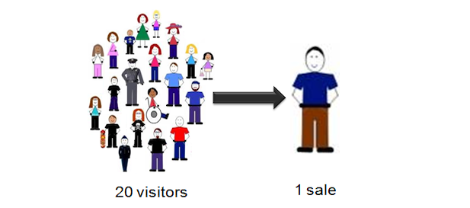
Low conversion is positively related with inefficient or no live chat support
Companies spend thousands on marketing, SEO, Pay per Click but they still can't solve the low conversion issue.
That's because most businesses don’t have someone “available” to service the customer when they need them the most!

Slide 9
Most common Live Chat Service: Not Available to Chat
95%
We are not available to chat, please Email
of websites don't have someone available to chat to you

Slide 10

One Bad Experience Can Cost You
82%
of the respondents stopped doing business with an organization due to a poor customer experience
Source: http://techcrunch.com/2010/10/13/customer-service-rightnow/

Slide 11

One Bad Experience Can Cost You
79%
claimed that they passed their horrible experience to other consumers and urged them to avoid the brand all together
Source: http://techcrunch.com/2010/10/13/customer-service-rightnow/

Slide 12

One Bad Experience Can Cost You
95%
of customers who had a bad experience claimed they would take action and even worse
Source: http://techcrunch.com/2010/10/13/customer-service-rightnow/

Slide 13
Do Not Let This Happen

Slide 14
?
Now the question is would you like to…

Slide 15
Would you like to?
2
1
3
Are you looking for a way to stop shopping cart abandonment on your website?
Would you like to turn more website visitors into customers?
Increase your website conversion rates?
4
6
Would you like to increase sales?
Would you like to reduce your sales and customer service costs?
Would you like to increase overall customer satisfaction?
5
Notes:
On slide #16, the two images within the circle look squashed. Either edit the images or use different ones.

Slide 16

If you answered
‘YES’
to any of these questions then
is your answer!
Let us show you how…

Slide 17
Why ChatBee
A US & UK based company that knows your market inside out. We specialize in SaaS and eCommerce.
We specialize in Live Chat & Social Media Services and that’s all we do.
We are the only only PAYG, managed Live Chat Service provider using only US and UK agents, for customers based in those countries. As far as we know this unique in the SMB market place.
Named Agents feature is unique to us. We are only Live Chat Service company that has the ability to assign named agents to your business. That means the same named agents will be talking to your customers every single day. They are your team. No other live chat business we know can offer this level of personalized service.
Our unique Co-Browsing feature runs natively within your browser utilizing JavaScript, meaning it will not require any downloads, plug-ins or installations. It’s 100% instant, making it perfect for all your sales and customer service needs; no time-wasting, no fuss! No other companies may claim co-browsing, but not like this. Companies, often will call “pushing links” feature as co-browsing. That’s not true co-browsing.
Our confidence and belief in our product is demonstrated with free trial and no contract.

Slide 18

Why Chat Bee
Our service will increase your sales. Our service is an investment
Increase Sales
Convert More Visitors
There is no doubt that live chat agents available 24/7 will increase your conversion rate and your sales, we are passionate about increasing sales!
Cut Overheads
Make Every Buck Count
Your staff can be more efficiently employed than spending time on calls and e-mails. Our Live Chat Service will only cost $3.99 per hour! Bargain.

Slide 19
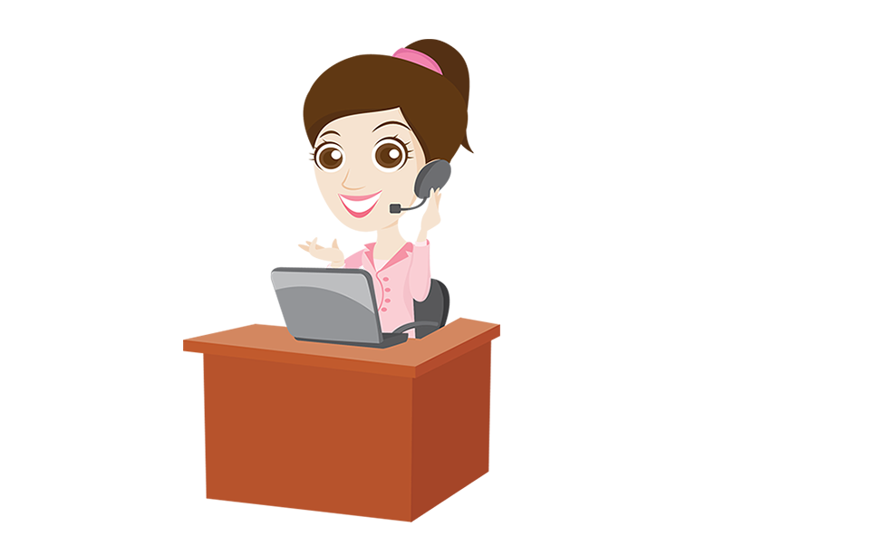


Why Chat Bee
The simple truth is customers love it when you are there for them. They will love your product or brand even more if you make them feel valued and important. Being available is the first step in that process.
Happy Customers
Always Available
No More Queing or Waiting!
Available 24/7, 365
No-one likes to be kept waiting; We’re all busy people these days. Make your customers happy customers by having live chat available 24/7.
Our team will be there to convert your visitors into customers 24-7, 365. Your visitors will feel re-assured and confident that help is always available.
Local Agents
Bee Social
Deeper Understanding
Engage & Convert Socially
We assign local agents to local businesses, so our agents speak the “same language” and thus having a deeper connection.
We can provide Live Chat to your FB page. We also have a sister company, that provides Social Media contact center services.

Slide 20


ChatBee: No One Quite Like Us
6
1
5
We are available 24 hours a day, 365 days of the year. So we are always there.
Unique to ChatBee, dedicated named teams.
We are real people, local people, serving real customers
2
4
We specialize in SaaS and eCommerce businesses. So we understand your industry.
We specialize in Live Chat and Social Media and that’s all we do.
The very best cobrowsing technology in the world. Not all co-browsing is the same!
3
Notes:
On slide #16, the two images within the circle look squashed. Either edit the images or use different ones.

Slide 21
How it works
We can typically setup most "small" business in less than 3 hours. To summarize: 2 things need to happen for us to service your customers. When these 2 simple steps are complete we can start talking to your visitors.
Step -1
We need you to paste a code onto your website. We can also do it for you.
Step-2
We need you to complete a questionnaire about your business which will mean that we can answer common questions and queries from your customers. We create a database system for your business that evolves and grows.
Easy as pie. You could be up and running the same day

Slide 22
Our Pricing
we are confident in our service...free trial and no contracts
Our Live Chat Service Starts from
Also you can Sign Up for a
Only $3.99
an Hour!
Free 7 Day Trial

Slide 23
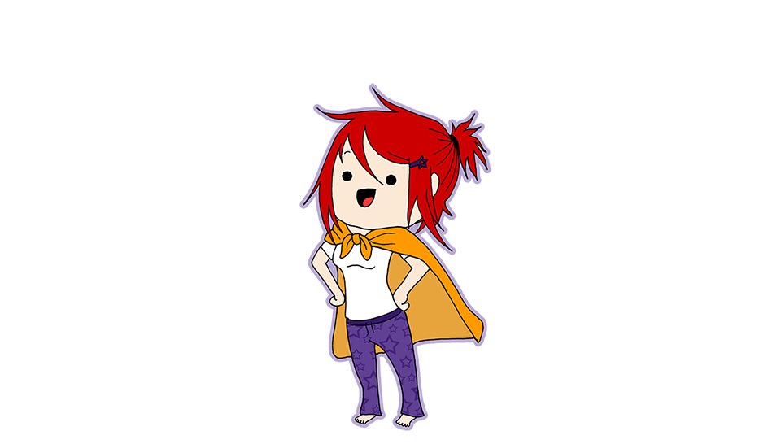
Why wait! Contact with US
Tel: +1-650-262-0900
hello@chatbee.com
twitter.com/ichatbee
facebook.com/ichatbee

Slide 24
Thank You

