Slide 1
International GutCheck

Slide 2
18 New International Markets
On-Demand Recruitment: Instant access to millions of global consumers
In-Country Research Network: Understand cultural nuances and perspectives
N. America | S. America | Europe | Asia Pacific
US (incl. Spanish) | Argentina | Austria | Japan
Canada | Brazil | France | China
Mexico | Colombia | Germany | Australia
 | Venezuela | Russia
 |  | Switzerland
 |  | UK
9 Supported Languages: English, Spanish, German, French, Italian, Portuguese, Russian, Chinese, Japanese

Slide 3
Our In-Country Research Network
Sasha B.
Experienced Researcher Native language: Russian
Olga C.
Experienced Researcher
Native language: English
Alain H.
Experienced Researcher
Native language: French
Daniela F.
Experienced Researcher
Native language: German
Maria B.
Experienced Researcher
Native language: Spanish
Cyris C.
Experienced Researcher
Native language: Chinese
Gaby O.
Experienced Researcher
Native language: Spanish
Helen D.
Experienced Researcher
Native language: English
Mami
Experienced Researcher
Native language: Japanese
Mariandrea O.
Experienced Researcher
Native language: Spanish
Natasha B.
Experienced Researcher
Native language: Portuguese
Penny B.
Experienced Researcher
Native language: English
Soledad A.
Experienced Researcher
Native language: Spanish
Rolan B.
Experienced Researcher
Native language: Spanish
In-Country Researcher Profiles
5+ years experience in market research or related field
Excellent business writing skills
Currently resides in and native to the country
Bilingual: Local language + English
Works well in a fast-paced, agile environment
GutCheck Certification Process
Completes GutCheck training
Signs confidential NDA agreement
Proficient using the GutCheck platform
Reviews discussion guide and moderation
Passes analysis and report certification test
Identifies key cultural nuances for specific country

Slide 4
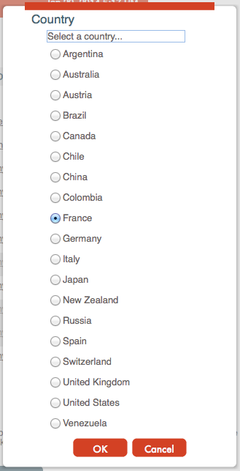
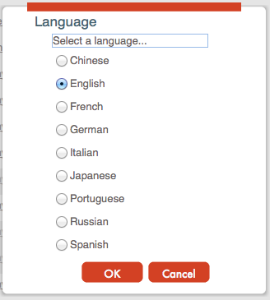
Demo & Report Example

