Slide 1
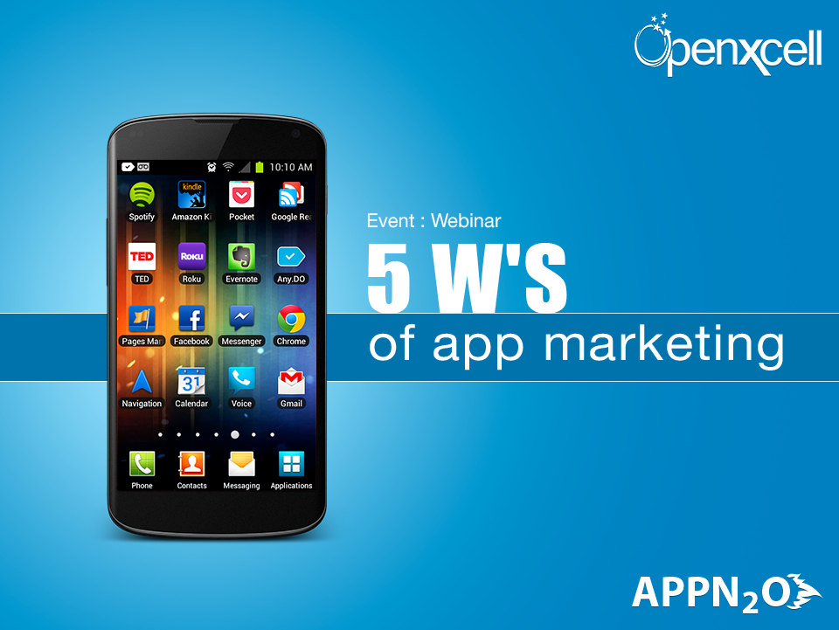

Slide 2
Introduction to OpenXcell & AppN2O
OpenXcell Technolabs is an ISO 9000:2008 certified company located in India and USA
We are a team of enthusiastic designers, Developers and managers exceeding the strength of 200
We have strong hold in Mobile App Development, Game Development, Web Development, E-commerce Development and Enterprise Systems
AppN2O is subsidiary of OpenXcell and focused to provide app marketing solutions.

Slide 3
Objectives : 5 W’s of App Marketing
Why App Marketing
What we need to start app marketing
How to do app marketing
When we should introduce app marketing
Where should be the focus for better results

Slide 4
Why App Marketing

Slide 5
The Business Model
App
Sales
Business
Users
Concept and Development of App
Profit
Marketing
Monetization Strategy

Slide 6
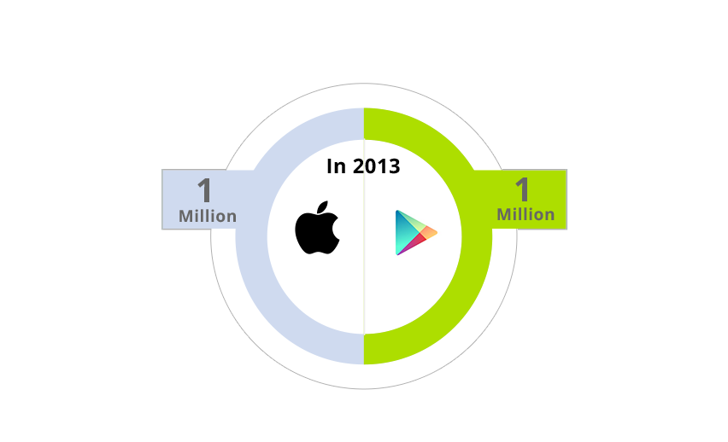
1 Million in Apple = 1 Million in Android

Slide 7
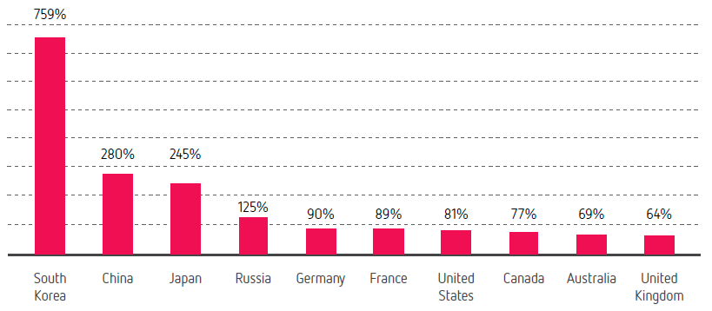
Market Growth in 2013 - Revenue
Three Countries with Highest Market growth in 2013 compared to 2012 –
South Korea, China and Japan
Source: Distimo

Slide 8
What we need to start app marketing

Slide 9
What we need to start app marketing
Build The Best App
Focused Marketing Strategy
Monetization Plan
In-depth knowledge of App Store and SEO
Target Geographical Territories
Media Connections & App Experts Network
Expertise in Buzz Marketing & Viral Promotion

Slide 10
Build The Best App
Build The Best APP
The Golden Rule
What Does “Best” Mean?
Offers users something of value
Offers users a streamlined, enjoyable experience

Slide 11
Focused Marketing Strategy
Market Research
Marketing Road Map
Target Users Analysis
User Behavior Analysis
Competitive Analysis
App USP Evaluation

Slide 12
Monetization Plan
Sales Plan
Free with in App Purchases
Paid App
Paid with in App Purchases
Sales Forecast
ROI Analysis

Slide 13
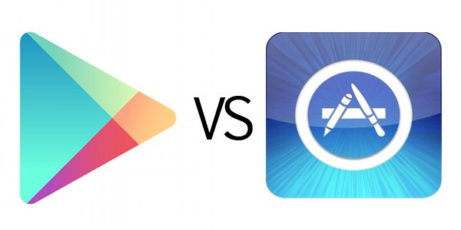
In-depth knowledge of App Stores
Target App Stores
Specific Features
Ranking on App Store
Optimization Process
Importance of App Reviews
Manage Ratings
User Reviews

Slide 14
Target Geographical Territories
Identification of territories
Reach to the maximum no. of users in a specific territory
Specific features for respective territory
Translation of app to local language
Expertise of app store localization

Slide 15
Media Connections & App Experts Network
Media Coverage for App
Connections with the right media platforms for mobile apps
Media Buying
Network with app review websites
Reach to mobile app bloggers

Slide 16
Expertise in Buzz Marketing & Viral Promotion
Buzz around the app
Viral promotion
Social Media Marketing Strategy
Videos of App
Network with advertising platforms
Knowledge of ad networks
Ad mediation

Slide 17
How to do app Marketing

Slide 18
How to do app Marketing
App Store Optimization
App Landing Page
App Localization
Video Creation
App Reviews
Press Release
Social Media Marketing
Advertising

Slide 19
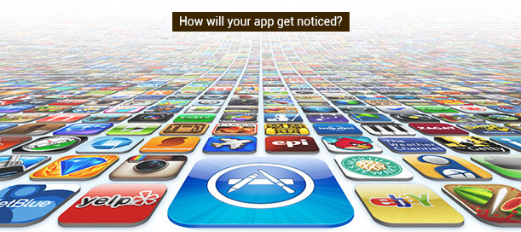
App Store Optimization
Improve your App Name
Design an eye catching and appealing app icon
Keyword creation and optimization
Unique description
Screen shot creation & optimization

Slide 20
App Landing Page
Design and develop an effective app landing page (app website of 3-4 pages)
SEO through app landing page

Slide 21
App Localization
Localization of Keywords
Localization of App Name
Localization of Screenshots
Localization of Description
Localization of Language strings within the App
LSEO (Local Search Engine Optimization) through app localization

Slide 22
Video Creation
Video trailers to increase downloads and conversions for apps
Video submissions on You Tube and other top video sites
Quality video to improve SEO results

Slide 23
App Reviews
App submission to various app review websites
Guaranteed coverage at app review websites
You tube video for app reviews

Slide 24
Press Releases
Press release writing
Carefully designed press releases to create awareness of your app amongst your target audience
Optimization of press release to ensure that it is keyword heavy to improve its search engine visibility
Press release distribution
Press release distribution to leading PR agencies

Slide 25
Social Media Marketing
Social media marketing strategy
Social bookmarking
Blog posts
Social Media Platforms
Google +
Facebook
Twitter
Linkedin
Source Of Notifications & Submissions

Slide 26
Advertising
Advertisement through Ad Networks
Ad mediation
Ad campaigns management
Analysis of campaign
Reports of campaign

Slide 27
Ads - Glossary
CPM (Cost Per Mile)
Price per 1000 views (paid by Advertiser)
CPC (Cost Per Click)
Price per Click (paid by advertiser)
Fill Rate:
Number of Displayed Ads / Number of Views
CTR (Click Through Rate)
Number of Clicks / Number of Views

Slide 28
When we should introduce app Marketing

Slide 29
Pre Launch
Launch
Post Launch
After App Launch
Before App Launch
On the time of Launch

Slide 30
Pre Launch
Market Research
Target User Analysis
Competitive Analysis
USP Evaluation
Monetization Strategy
App Store Optimization
App Landing Page

Slide 31
Launch
App Localization
Video Creation
App Reviews by App Review Websites
Social Media Marketing initiation
Social Media Marketing implementation
Press Release
App Launch

Slide 32
Post Launch
Social Media Marketing Execution
Social Media Marketing Optimization
SEO (Global and Local)
App Reviews by App Review Websites
Press Release
Advertising Campaigns
Campaigns Monitoring & Optimization
Reporting

Slide 33
Where should be the focus for better results

Slide 34
Where should be the focus for better results
Monetization
App Localization
Advertising

Slide 35
Monetization

Slide 36
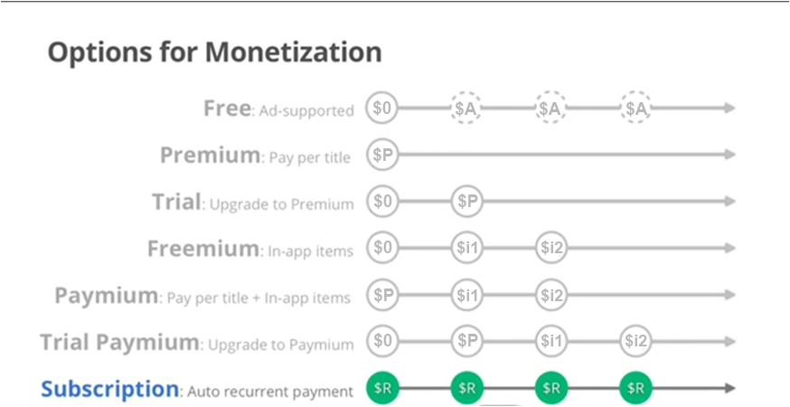
Monetization

Slide 37
Monetization Tips
Few Suggestions:
Play by number not by price
Higher price not always means higher revenue
Higher price could be low User/Transaction
100K users with 1$ transaction is better than 10K users with 10$
Why? More Users = More Viral Effect = More Transactions
For Paid Apps
Always have a Free Version (Freemium)
For Ads
Always track your eCPM revenue

Slide 38
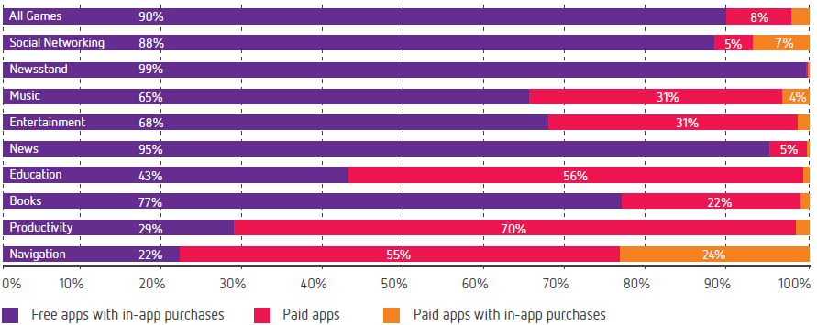
Revenue Distribution by Category
Source: Distimo

Slide 39
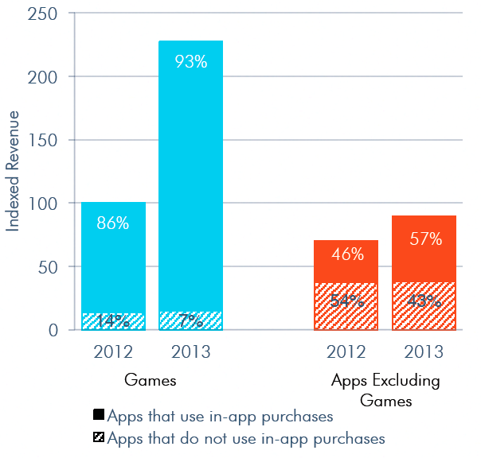
Freemium Proves its Worth
Source: App Annie

Slide 40
App Localization

Slide 41
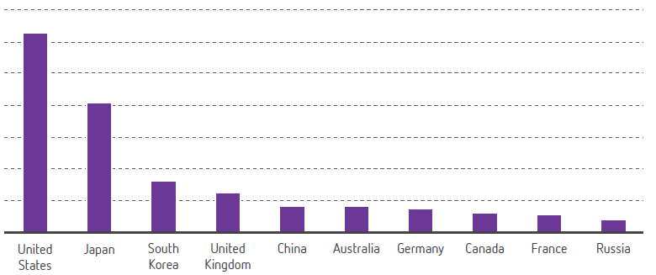
Top 10 Countries by Mobile App Revenue
Source: Distimo

Slide 42
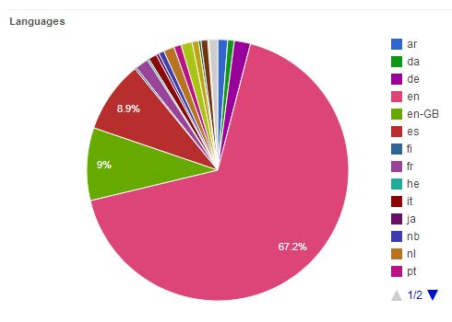
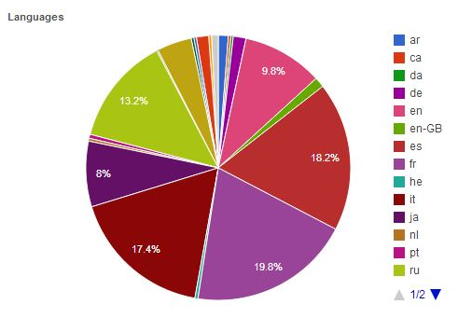
App Localization – Case Study by David Jenner
Before Localization
After Localization
76% Traffic from English Speaking Counties
3000 Downloads
10% Traffic from English Speaking Counties
23000 Downloads

Slide 43
Case Study – Out Comes
Localizing the app helped increase downloads by 767%
Localization Means:
Localization of Keywords
Localization of App Name
Localization of Screenshots
Localization of Description
Localization of Language strings within the App
Please find the detail analysis of the research at http://makeappmag.com/iphone-app-localization-keywords/

Slide 44
Advertising

Slide 45
Advertising
House Ads
Ad Network
Ad Mediation

Slide 46
Monetization – House Ads
ABC Mobile App Ad Agency
Showing Ads on XYZ Apps
Show Ads to Users
Request Setting Ads in his own App
XYZ Publisher
Need to advertise any other app of his portfolio or upgrades for the current app

Slide 47
House Ads
Requirements:
You must have channels to Advertisers
You must be having enough user base to attract Advertisers

Slide 48
Ad Network
Advertiser
Request Ads
Showing Ads on XYZ Apps
Show Ads to Users
Request Ads
ABC Ad Network
Advertiser
Report
Request Ads
Advertiser
XYZ Publisher

Slide 49
Ad Mediation
Ad Mediation enables you to connect with multiple ad networks through one simple integration
You can control your allocation or choice of network
By using multiple networks, you can assess which are performing best and optimize accordingly to maximize fill rates and increase your revenues

Slide 51
End to End Mobile App Solution
“No matter what your idea is, we can conceptualize and develop great apps for you and also can help you to market the same and make money out of it.”

Slide 52
Thanks

