Slide 1
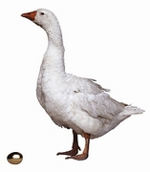
Joel Wissing
S&P 500
emini futures
April 26-28Calgary
www.MoneyMakerEdge.com

Slide 2
Money Maker Edge Trader Training
Participation
Level determines success
Pay back is based
Courage, Commitment, and Enthusiasm
Exponential once you break through
Key is Direction

Slide 3
Trading and traders
90% mental - psychological (values)
10% technical
Core competencies
Knowledge of market
Price and Direction
How to get out of your own way?

Slide 4
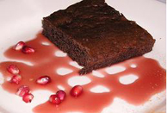
Trader competency Ability to show appreciation
Live by Rules or a Code

Slide 5
Money Maker Edge™ Trading Code™
I have a business strategy
I follow my trading rules
I keep a record to review and quantify my results
I have entry points
I see price and direction
I follow my trade strategy
I know when to trade and when not to trade
I follow my plan
I let the trades come to me
I always trade with a stop and a target
I am the master of my strategy

Slide 6
3 groups in Market
Market Maker
Makes Direction
less than 1/4%
Money Maker
Follow Direction
less than 1¾%
Investor
Willing to keep working for small, no return or a loss ---98% of the market

Slide 7
2 most important things
1. Risk management
Being able to stay in the game
How to play the game?
2. Exposure
How much is too much?
Never let losers run

Slide 8
Market Makers and Money Makers know
No Rules
just Tendencies

Slide 9
What is it we do?
S& P 500 index E mini Futures contracts which controls STOCK
Top 500 Large cap corporations
Around $1350 a contract but we can control it for about $500

Slide 10
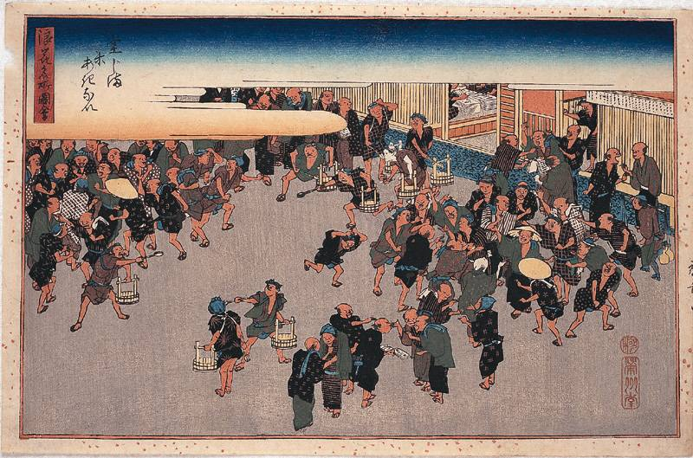
Where are futures markets from?

Slide 11
Why S&P 500 emini futures
Direct line into the market, broker is for clearing
Low entry price $2,500 to open an account
Mark to Market Fast liquidity - access to money after 4:30 same day
No redemptions
Real time simulated accounts
Stops and Targets are honored over 99.99%
50% of gains Long term capital gains, 50% Short term capital gains
24 hours a day 5 ½ days a week

Slide 12
How do we make money?
Every .25 ( a tick) it moves we make $12.50
UP or DOWN
Our Goal on our first trade is .50 a day
Notes:
How many ticks is that?

Slide 13
Money maker edge Strategy
We learn to trade 3 Contracts or more for 3 targets, .50, $1.00, $2.00
We normally get our targets in the first 5 minutes of a trade
This gives us $175 on a $1500 trade
When we get better,
we can trade bigger targets and take advantage of the market moves.

Slide 14
$25 per contract
To control a contract you need $500
Brokerage fees are about 4.50 per contract (in and out)
We make about $20 or around 4% on capital traded.

Slide 15
Go Long
Buy
and
Sell High
Go
Short
Promise to
Sell then buy lower

Slide 16
Is a two tick move a lot?
The market ranges an average of
16 points (dollars) a day.
1 point = 4 ticks
During the day the market moves over
800 ticks with direction

Slide 17
How long does it take?
2 seconds to 10 minutes

Slide 18
2 types of Trader
Fundamental Trader
Technical Trader
Money Maker Edge
Price Action
Indicator Based

Slide 19
Candlestick Price
Close
open
Close
open
OPENS then closes HIGHER
OPENS then closes LOWER

Slide 20
Results
Trading a $6,000 account. 4 contracts
Commission per contract around $5
Here is one of our Money Maker Edge™ traders(TM) that joins us in the room 6 days a month. This is their actual statement.
***US DOLLAR REG ***
BEGINNING BALANCE 6,654.00
THIS MONTH'S ACTIVITY 953.32
ENDING BALANCE 7,607.32
NET FUTURES P&L 953.32
ACCOUNT VALUE AT MARKET 7,607.32
TOTAL COMMISSIONS 34.88-
TOTAL CLEARING FEES 12.48-
TOTAL EXCHANGE FEES 24.00-
TOTAL NFA FEES .32-
TRADE DATE BALANCE 7,607.32

Slide 21
Results
Here is one more active Money Maker Edge™ Traders statement. This is for the whole month.
He trades under an hour a day.
He has been trading a total of 5 months.
** DOMESTIC USD **
BEGINNING BALANCE 12,937.50
THIS MONTH'S ACTIVITY 3,004.50
ENDING BALANCE 15,942.00
NET FUTURES PROFIT OR LOSS 3,029.50
ACCOUNT VALUE AT MARKET 15,942.00
CONVERTED MARKET VALUE 15,942.00
*** CURRENT MONTH ***
FUTURES PROFIT OR LOSS US 3,029.50

Slide 22
Trading results – 1 day
Performance | All Trades | Long Trades | Short Trades
Total Net Profit | 912.5 | 0 | 912.5
Gross Profit | 912.5 | 0 | 912.5
Gross Loss | 0 | 0 | 0
Commission | 0 | 0 | 0
Profit Factor | 99 | 1 | 99
Cumulated Profit | 1.91% | 0.00% | 1.91%
Max. Drawdown | 0.00% | 0.00% | 0.00%
Sharpe Ratio | 1 | 1 | 1
Total # of Trades | 3 | 0 | 3
Percent Profitable | 100.00% | 0.00% | 100.00%
# of Winning Trades | 3 | 0 | 3
# of Losing Trades | 0 | 0 | 0

Slide 23
Performance | All Trades | Long Trades | Short Trades
Total Net Profit | 2025 | 0 | 2025
Gross Profit | 2025 | 0 | 2025
Gross Loss | 0 | 0 | 0
Commission | 0 | 0 | 0
Profit Factor | 99 | 1 | 99
Cumulated Profit | 2.48% | 0.00% | 2.48%
Max. Drawdown | 0.00% | 0.00% | 0.00%
Sharpe Ratio | 1 | 1 | 1
Total # of Trades | 28 | 0 | 28
Percent Profitable | 100.00% | 0.00% | 100.00%
# of Winning Trades | 28 | 0 | 28
# of Losing Trades | 0 | 0 | 0

Slide 24
How do you do it?
First we assess the type of Money Maker™ you are with the Money Maker Test™
We give you a trading system to follow
Then we have our business plan (template)
We show you how to get in, get out, and run with the money.
We know where our low hanging fruit is to pick
You never need to trade alone.

