Slide 2
AxiSource~ Expand Your Brand!
Axis Global invites you to start sourcing today
with our brand new division AxiSource
Our mission at AxiSource is to “expand your brand” through creativity, client collaboration and compelling promotional solutions
~Branded Promotional Merchandise
~Corporate Apparel & Inventoried Uniform Programs
~Event/Supply Chain Management, Fulfillment & Distribution
~Global Procurement Services

Slide 3
AxiSource Search Engine
www.axisource.espwebsite.com

Slide 4
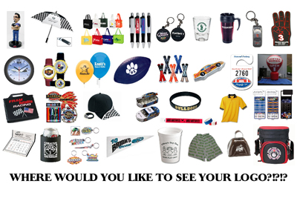
AxiSource Premium Items
Branded Promotional Merchandise

Slide 5
AxiSource Apparel
Corporate Apparel ~ Reward & Recognition Programs

Slide 6
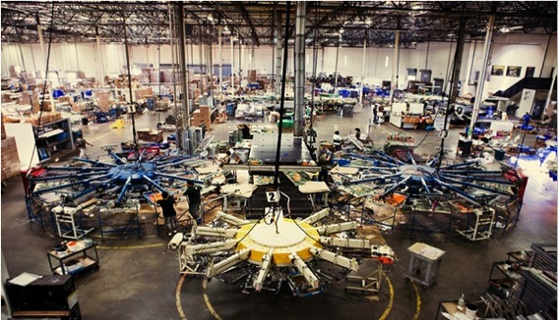
Full Service Textile Printing
Local production in Secaucus, NJ with capabilities of producing 50,000 units a day
100,000 sq./ft. facility with (4) 18 color M&R presses and (7) 14 color M&R presses
Full service distribution and finishing (folds, poly-bags, sews, tickets, labels) over 30,000 units a day on premise

Slide 7
Web Stores
E-Commerce ~ Real Time Inventory Management

Slide 8
Thank You
Start branding with us today at sourcing@axisg.com
www.axisource.espwebsite.com

