Slide 1
Belkasoft Acquisition and Analysis Suite
www.belkasoft.com

Slide 2
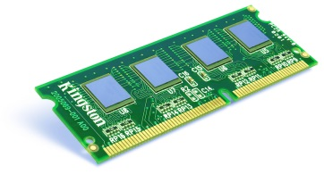
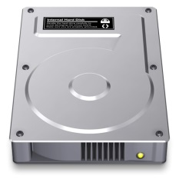
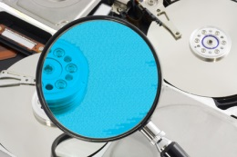
Computer Acquisition Step By Step
The Complete Cycle of Forensic Process
Acquisition
Capturing volatile memory
Imaging disks
Discovery and analysis
Discovering existing evidence
Carving destroyed evidence
Analyzing data
Management
Reporting
Sharing evidence
Managing cases
Preparing for the next case
www.belkasoft.com

Slide 3
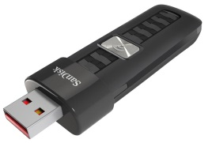
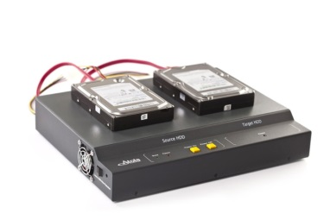
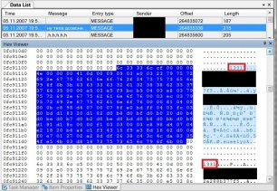
Computer Acquisition Step By Step
What’s Inside?
Ready-to-use portable memory dumping tool
High-capacity USB pen drive
Kernel mode RAM acquisition software
Disk imaging hardware
Disk cloning
Secure erase
Evidence discovery and analysis software
Analysis and reporting
Evidence sharing, archiving and management tools
www.belkasoft.com

Slide 4
Step 1: Live RAM Acquisition
www.belkasoft.com

Slide 5
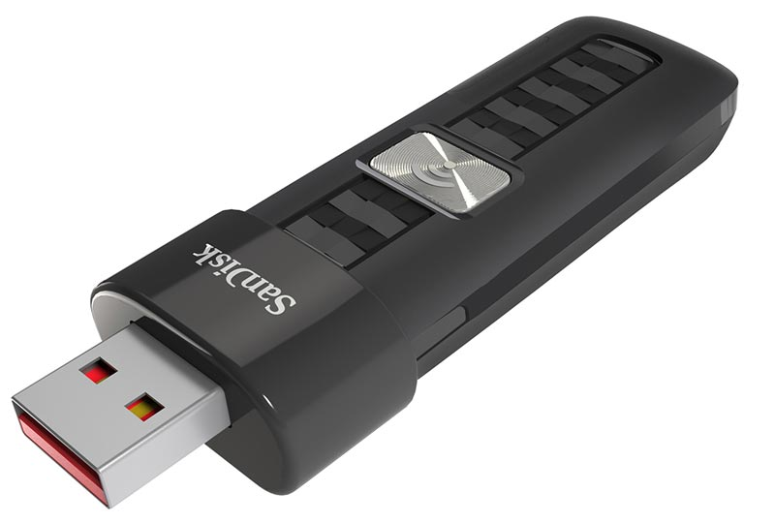
Acquiring Information Never Stored on the Disk
Getting The Most Out of a Computer
RAM contains information never stored on a hard drive
1-16Gb of important data
decryption keys for encrypted volumes
Facebook chats, InPrivate browsing history, etc
Our solution
Portable software
Can run from a thumb drive
Dumps all available memory contents
Very small executable (~150Kb)
www.belkasoft.com

Slide 6
Overcoming Memory Protection
Malicious software can prevent memory dumping
Malware can detect user-mode memory dumping, block acquisition or fake content
Certain games do this as well
Our solution
Capturer tool runs in kernel mode
Transparent to other software
32-bit and 64 -bit kernel-mode drivers supplied
www.belkasoft.com

Slide 7
Step 2: Disk Acquisition
www.belkasoft.com

Slide 8
Problems solved: Unknown Device Condition
Devices Being Acquired Are in Unknown Condition
Many imaging products stall on damaged devices
Other imagers may take hours to show an issue
You are not in control
Our solution
Detailed real-time acquisition information
Remote diagnostics (RDC, Ethernet)
www.belkasoft.com

Slide 9
Problems Solved: HDD Passwords
ATA password may lock the device
ATA passwords effectively prevent all disk access
In Maximum Security mode, Secure Erase follows unsuccessful unlock attempts
Few duplicators can deal with ATA passwords
Possible loss of data
Our solution
Automatic acquisition of password-protected disks
www.belkasoft.com

Slide 10
Problems Solved: Physical Damage
Physical damage prevents imaging
May slow down or prevent acquisition
Our solution
Real-time diagnostics and reporting
Advanced options to skip bad sectors and heads
Skipped areas can be analyzed later
Forward (linear) and backward (reverse) modes
Imaging of specified sectors only
Receive data from undamaged areas really fast
Damaged areas can be analyzed later
Important for field investigations
www.belkasoft.com

Slide 11
Problems Solved: HPA/DCO Areas
Device may be clipped with HPA/DCO techniques
HPA/DCO areas are “invisible” to most imagers
HPA/DCO areas can be of any size
Our solution
Instantly resets HPA/DCO
Acquires data from HPA/DCO areas
www.belkasoft.com

Slide 12
Step 3: Discovering and Analyzing Evidence
www.belkasoft.com

Slide 13
Belkasoft Evidence Center: Searches Everywhere
Looks in:
Storage devices Hard drives and removable media
Disk images EnCase (including Ex01), FTK, raw (DD), SMART
Mobile devices iPhone/iPad, Android and Blackberry backups
Mobile dumps UFED dumps, chip-off dumps
Virtual machines VMWare, Virtual PC
Volatile memory Live RAM dumps
Fragmented memory set analysis with BelkaCarving™
Virtual memory Hibernation files and Page files
Unallocated space File carving discovers destroyed evidence
Network traffic PCAP files
www.belkasoft.com

Slide 14
Belkasoft Evidence Center: Data types
Can find and analyze:
Office documents
Emails
Mobile device backups
Social network chats (Facebook, Twitter etc.)
Browsing history
Instant messenger chats
Pictures
Videos
System Files
SQLite databases
Chats in multi-player online games
Data from P2P and file sharing apps
Encrypted files
www.belkasoft.com

Slide 15
Analyze Evidence
Automated Evidence Analysis
Picture analysis Detects faces, scanned text and pornography
Authenticity analysis Detects altered pictures with Forgery detection
Geolocation analysis Determines EXIF and GPS coordinates for images
Video analysis Extracts key frames from videos
Encryption detection Discovers encrypted files and volumes
www.belkasoft.com

Slide 16
Evidence in Images and Videos
Automated Image Content Analysis
Automatically discovers scanned text and human faces
Automated detection of pornographic content
Extracts EXIF data and GPS coordinates
Speeds up content analysis
Speeds Up Video Analysis
Lengthy videos are represented as series of key frames and displayed as galleries of still images
Key frames automatically analyzed for all supported evidence types
www.belkasoft.com

Slide 17
SQLite Evidence
Cleared Skype Histories and Deleted SQLite Records
Native SQLite support recovers more evidence
SQLite is used in:
most system and user-level Android and iOS apps
Skype, Yahoo Messenger, eBuddy, PhotoBox, Picasa Explorer
Major Web browsers: Mozilla, Chrome, Safari
Support for damaged and destroyed SQLite databases
‘freelist’ analysis recovers deleted records
Cleared Skype histories and conversation logs can be recovered
www.belkasoft.com

Slide 18
Evidence in Smartphones and Tablets
Android, BlackBerry, Apple iOS Backups
Locates Android, BlackBerry and iTunes backups
Extracts information from mobile backups for many popular applications
Parses and analyzes evidence
GPS coordinates and geolocation information
Evidence from mobile devices automatically added to the Timeline
SQLite analysis recovers cleared histories with freelist support
Industry standard dumps
UFED dumps
Chip-off dumps
www.belkasoft.com

Slide 19
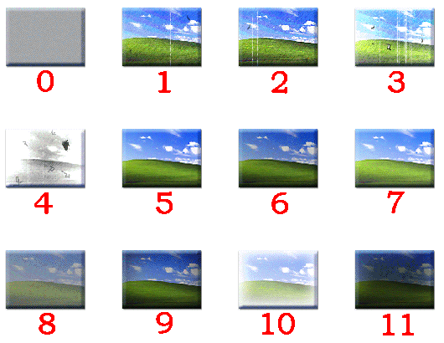
Jumplists and Thumbnails
Looking for Evidence in Obscure Places
Jumplists: little known, rarely cleaned, kept forever
Information on files being viewed, opened, or launched
Even for deleted files or data stored on remote or external devices
Definite proof of access: information contains full file name, path and meta data
Thumbnails: not just pictures
Cached preview images of many file formats
JPEG, GIF, DOC/DOCX, XLS/XLSX, PDF, and hundreds of others
www.belkasoft.com

Slide 20
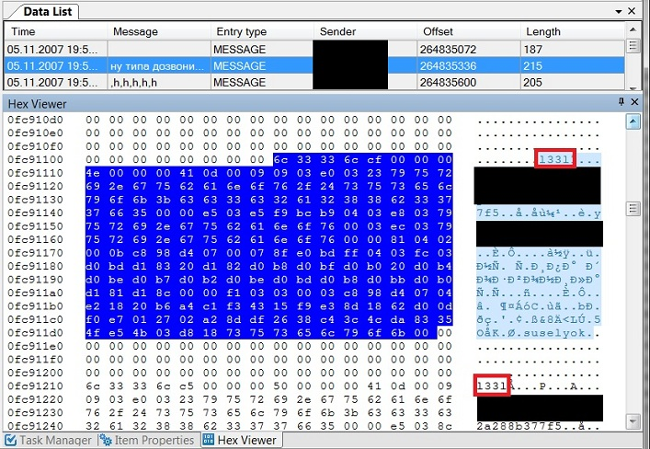
Destroyed Evidence
Discover Destroyed Evidence with Data Carving
Finds destroyed evidence on hard drives and Live RAM
Recovers evidence from formatted volumes and repartitioned hard drives
Allocated/unallocated disk space analysis
Carving for physical disks, forensic drive images, memory dumps, hibernation and page files
Fully automated operation requires no special skills
www.belkasoft.com

Slide 21
Analyzing Ephemeral Evidence
Live RAM Analysis
Evidence Center analyzes Belkasoft and third-party RAM dumps
Hibernation and page file also supported
Instant access to TrueCrypt, PGP, BitLocker and other encrypted volumes with binary encryption keys
Recent social network communications
Data from browsing sessions with enforced privacy settings
Registries and pictures
BelkaCarving™ recovers fragmented data from memory dumps
www.belkasoft.com

Slide 22
Convenient Presentation
Present and Share Evidence. Create and Submit Reports
All events during a certain time period displayed in single visual timeline
Printable reports admissible as court evidence
Collected evidence can be exported and shared with others
www.belkasoft.com

Slide 23
Sharing and Archiving Evidence
Sharing and Archiving Evidence
Evidence can be shared with colleagues and coworkers
Free tool available for viewing shared evidence
Case Management enables long-term archiving
Unlimited database size
Easy management
What You Get:
Evidence presented to colleagues or archived for future use
www.belkasoft.com

Slide 24
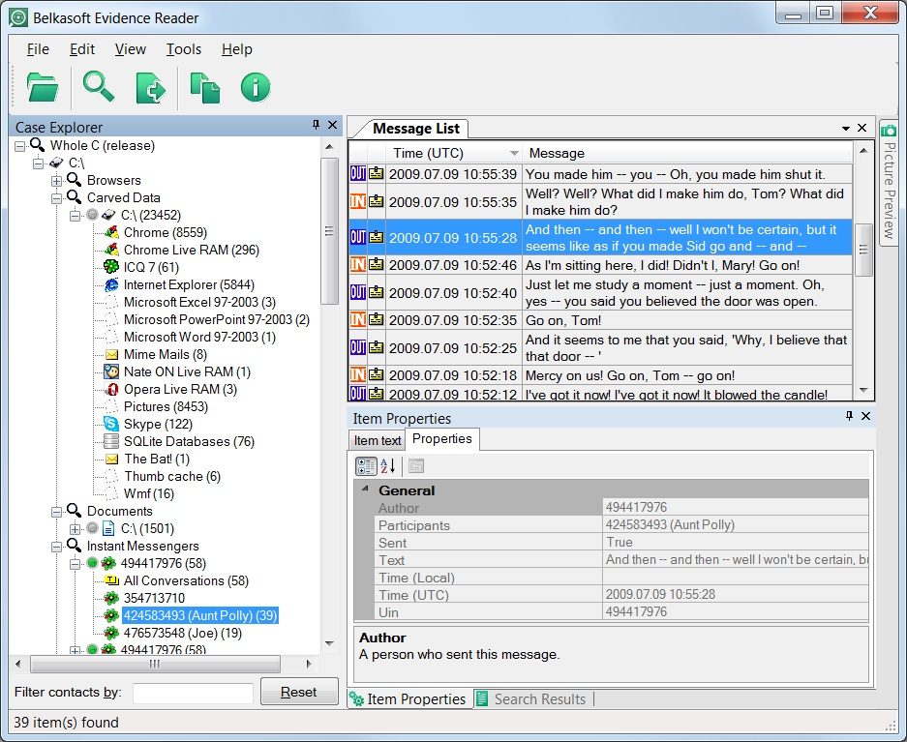
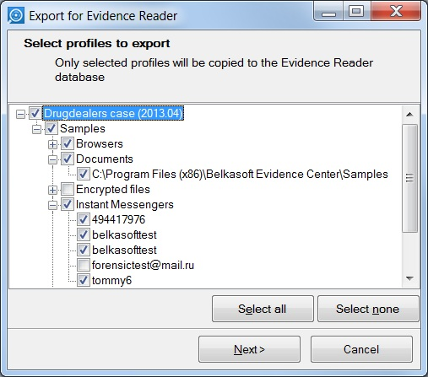
Sharing Evidence
Evidence Reader:
Share Collected Evidence
Evidence collected with Evidence Center can be saved or shared
Offers extra value at no extra charge
Export to Evidence Reader
Free to all licensed users
www.belkasoft.com

Slide 25
Integrate with EnCase
Full EnCase Integration
Integrated with EnCase 7
Launches via EnScript module
Processes E01s & Ex01s
Imports discovered evidence back into EnCase
Guidance approved for EnCase AppCentral
Available in EnCase AppCentral
www.belkasoft.com

Slide 26
Our Customers
www.belkasoft.com

Slide 27
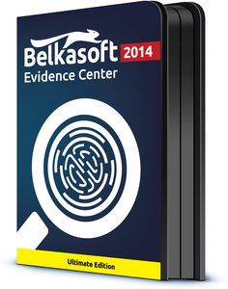
Hands On Experience
Free Demo Version
Downloadable evaluation version belkasoft.com/get
Request your FREE LE demo at belkasoft.com/trial
www.belkasoft.com

