Slide 1
click here to
start the demo
Intro
|
Top 10 Fruits
|
Top 10 Beetles
|
Bucket List
|
How It Was Created
|
More
To navigate around this demo presentation:
◆ Click a section in the green bar.
❖ Click slides in the yellow bar that appears.
⬥ Click to hide the navigation bar.
Your challenge : get to the Bucket List Eiffel slide (#31) in just 2 clicks!
Created solely with PowerPoint and ActivePrez
Demonstrates non-linear presenting
2 hierarchy levels enable navigation to any slide in 2 clicks maximum
Includes optional mouse over/click sounds
Contains 36 slides
Navigation design : less than 5 minutes
Navigation apply : 33 seconds (1158 shapes and 546 hyperlinks)
Everything you can see and interact with is available in the source PowerPoint file
Click for demo facts
Copyright © 2011 GMARK Ltd. Copying or reuse of this content is strictly prohibited.
Notes:
Shapes:
L1=36 slides x 12 shapes (432)
L2=33 slides x 22 shapes (726)
1158
Hyperlinks & tooltips:
L1=36 slides x 6 links (216)
L2=33 slides x 10 links (330)
546

Slide 2
My Top 10 Fruits
Intro
|
Top 10 Fruits
|
Top 10 Beetles
|
Bucket List
|
How It Was Created
|
More
Apple
|
Banana
|
Orange
|
Peach
|
Pear
|
Grapes
|
Pineapple
|
Blackberry
|
Mango
|
Cherry
In this section, we’ve listed the fruits in reverse numerical order and the names are hidden from the navigation.
You can also see the content of each section by hovering over the navigation items.

Slide 3
Apple
Intro
|
Top 10 Fruits
|
Top 10 Beetles
|
Bucket List
|
How It Was Created
|
More
Apple
|
Banana
|
Orange
|
Peach
|
Pear
|
Grapes
|
Pineapple
|
Blackberry
|
Mango
|
Cherry
10

Slide 4
Banana
Intro
|
Top 10 Fruits
|
Top 10 Beetles
|
Bucket List
|
How It Was Created
|
More
Apple
|
Banana
|
Orange
|
Peach
|
Pear
|
Grapes
|
Pineapple
|
Blackberry
|
Mango
|
Cherry
9

Slide 5
Orange
Intro
|
Top 10 Fruits
|
Top 10 Beetles
|
Bucket List
|
How It Was Created
|
More
Apple
|
Banana
|
Orange
|
Peach
|
Pear
|
Grapes
|
Pineapple
|
Blackberry
|
Mango
|
Cherry
8

Slide 6
Peach
Intro
|
Top 10 Fruits
|
Top 10 Beetles
|
Bucket List
|
How It Was Created
|
More
Apple
|
Banana
|
Orange
|
Peach
|
Pear
|
Grapes
|
Pineapple
|
Blackberry
|
Mango
|
Cherry
7

Slide 7
Pear
Intro
|
Top 10 Fruits
|
Top 10 Beetles
|
Bucket List
|
How It Was Created
|
More
Apple
|
Banana
|
Orange
|
Peach
|
Pear
|
Grapes
|
Pineapple
|
Blackberry
|
Mango
|
Cherry
6

Slide 8
Grapes
Intro
|
Top 10 Fruits
|
Top 10 Beetles
|
Bucket List
|
How It Was Created
|
More
Apple
|
Banana
|
Orange
|
Peach
|
Pear
|
Grapes
|
Pineapple
|
Blackberry
|
Mango
|
Cherry
5

Slide 9
Pineapple
Intro
|
Top 10 Fruits
|
Top 10 Beetles
|
Bucket List
|
How It Was Created
|
More
Apple
|
Banana
|
Orange
|
Peach
|
Pear
|
Grapes
|
Pineapple
|
Blackberry
|
Mango
|
Cherry
4

Slide 10
Blackberry
Intro
|
Top 10 Fruits
|
Top 10 Beetles
|
Bucket List
|
How It Was Created
|
More
Apple
|
Banana
|
Orange
|
Peach
|
Pear
|
Grapes
|
Pineapple
|
Blackberry
|
Mango
|
Cherry
3

Slide 11
Mango
Intro
|
Top 10 Fruits
|
Top 10 Beetles
|
Bucket List
|
How It Was Created
|
More
Apple
|
Banana
|
Orange
|
Peach
|
Pear
|
Grapes
|
Pineapple
|
Blackberry
|
Mango
|
Cherry
2

Slide 12
Cherry
Intro
|
Top 10 Fruits
|
Top 10 Beetles
|
Bucket List
|
How It Was Created
|
More
Apple
|
Banana
|
Orange
|
Peach
|
Pear
|
Grapes
|
Pineapple
|
Blackberry
|
Mango
|
Cherry
1

Slide 13
My Top 10 Beatles Tracks
Intro
|
Top 10 Fruits
|
Top 10 Beetles
|
Bucket List
|
How It Was Created
|
More
Twist And Shout
|
She Loves You
|
Paperback Writer
|
Please Please Me
|
Can’t Buy Me Love
|
Help
|
Yesterday
|
She Loves You
|
Let It Be
|
Hey Jude
In this section, we’ve listed the singles in reverse numerical order and the names are hidden from the navigation.
You can also see the content of each section by hovering over the navigation items.

Slide 14
Twist And Shout
Intro
|
Top 10 Fruits
|
Top 10 Beetles
|
Bucket List
|
How It Was Created
|
More
Twist And Shout
|
She Loves You
|
Paperback Writer
|
Please Please Me
|
Can’t Buy Me Love
|
Help
|
Yesterday
|
She Loves You
|
Let It Be
|
Hey Jude
Release Date : 24th June 1977
Label : Lingasong
Highest Position : -
Weeks in Chart : -
10

Slide 15
She Loves You
Intro
|
Top 10 Fruits
|
Top 10 Beetles
|
Bucket List
|
How It Was Created
|
More
Twist And Shout
|
She Loves You
|
Paperback Writer
|
Please Please Me
|
Can’t Buy Me Love
|
Help
|
Yesterday
|
She Loves You
|
Let It Be
|
Hey Jude
Release Date : 23rd Aug 1963
Label : Parlophone
Highest Position : 1
Weeks in Chart : 31
9

Slide 16
Paperback Writer
Intro
|
Top 10 Fruits
|
Top 10 Beetles
|
Bucket List
|
How It Was Created
|
More
Twist And Shout
|
She Loves You
|
Paperback Writer
|
Please Please Me
|
Can’t Buy Me Love
|
Help
|
Yesterday
|
She Loves You
|
Let It Be
|
Hey Jude
Release Date : 10th June 1966
Label : Parlophone
Highest Position : 1
Weeks in Chart : 11
8

Slide 17
Please Please Me
Intro
|
Top 10 Fruits
|
Top 10 Beetles
|
Bucket List
|
How It Was Created
|
More
Twist And Shout
|
She Loves You
|
Paperback Writer
|
Please Please Me
|
Can’t Buy Me Love
|
Help
|
Yesterday
|
She Loves You
|
Let It Be
|
Hey Jude
Release Date : 11th Jan 1963
Label : Parlophone
Highest Position : 2
Weeks in Chart : 18
7

Slide 18
Can’t Buy Me Love
Intro
|
Top 10 Fruits
|
Top 10 Beetles
|
Bucket List
|
How It Was Created
|
More
Twist And Shout
|
She Loves You
|
Paperback Writer
|
Please Please Me
|
Can’t Buy Me Love
|
Help
|
Yesterday
|
She Loves You
|
Let It Be
|
Hey Jude
Release Date : 20th March 1964
Label : Parlophone
Highest Position : 1
Weeks in Chart : 14
6

Slide 19
Help
Intro
|
Top 10 Fruits
|
Top 10 Beetles
|
Bucket List
|
How It Was Created
|
More
Twist And Shout
|
She Loves You
|
Paperback Writer
|
Please Please Me
|
Can’t Buy Me Love
|
Help
|
Yesterday
|
She Loves You
|
Let It Be
|
Hey Jude
Release Date : 23rd July 1965
Label : Parlophone
Highest Position : 1
Weeks in Chart : 14
5

Slide 20
Yesterday
Intro
|
Top 10 Fruits
|
Top 10 Beetles
|
Bucket List
|
How It Was Created
|
More
Twist And Shout
|
She Loves You
|
Paperback Writer
|
Please Please Me
|
Can’t Buy Me Love
|
Help
|
Yesterday
|
She Loves You
|
Let It Be
|
Hey Jude
Release Date : 8th March 1976
Label : Parlophone
Highest Position : 8
Weeks in Chart : 7
4

Slide 21
She Loves You
Intro
|
Top 10 Fruits
|
Top 10 Beetles
|
Bucket List
|
How It Was Created
|
More
Twist And Shout
|
She Loves You
|
Paperback Writer
|
Please Please Me
|
Can’t Buy Me Love
|
Help
|
Yesterday
|
She Loves You
|
Let It Be
|
Hey Jude
Release Date : 23rd Aug 1963
Label : Parlophone
Highest Position : 1
Weeks in Chart : 31
3

Slide 22
Let It Be
Intro
|
Top 10 Fruits
|
Top 10 Beetles
|
Bucket List
|
How It Was Created
|
More
Twist And Shout
|
She Loves You
|
Paperback Writer
|
Please Please Me
|
Can’t Buy Me Love
|
Help
|
Yesterday
|
She Loves You
|
Let It Be
|
Hey Jude
Release Date : 6th March 1970
Label : Apple Records
Highest Position : 2
Weeks in Chart : 9
2

Slide 23
Hey Jude
Intro
|
Top 10 Fruits
|
Top 10 Beetles
|
Bucket List
|
How It Was Created
|
More
Twist And Shout
|
She Loves You
|
Paperback Writer
|
Please Please Me
|
Can’t Buy Me Love
|
Help
|
Yesterday
|
She Loves You
|
Let It Be
|
Hey Jude
Release Date : 30th Aug 1968
Label : Apple Records
Highest Position : 1
Weeks in Chart : 16
1

Slide 24
My Top 10 Bucket List
Intro
|
Top 10 Fruits
|
Top 10 Beetles
|
Bucket List
|
How It Was Created
|
More
Dive
|
Fly
|
Drive
|
Space
|
St. Paul’s
|
Home
|
Eiffel
|
Eye
|
Jump
|
Family
In this section, we’ve listed the activities in reverse numerical order and included hints to the slides in the navigation.
You can also see the content of each section by hovering over the navigation items.

Slide 25
Dive in the deep blue
Intro
|
Top 10 Fruits
|
Top 10 Beetles
|
Bucket List
|
How It Was Created
|
More
Dive
|
Fly
|
Drive
|
Space
|
St. Paul’s
|
Home
|
Eiffel
|
Eye
|
Jump
|
Family
10

Slide 26
Fly a paraglider
Intro
|
Top 10 Fruits
|
Top 10 Beetles
|
Bucket List
|
How It Was Created
|
More
Dive
|
Fly
|
Drive
|
Space
|
St. Paul’s
|
Home
|
Eiffel
|
Eye
|
Jump
|
Family
9

Slide 27
Drive a Lotus Car
Intro
|
Top 10 Fruits
|
Top 10 Beetles
|
Bucket List
|
How It Was Created
|
More
Dive
|
Fly
|
Drive
|
Space
|
St. Paul’s
|
Home
|
Eiffel
|
Eye
|
Jump
|
Family
8

Slide 28
Take a Space Flight
Intro
|
Top 10 Fruits
|
Top 10 Beetles
|
Bucket List
|
How It Was Created
|
More
Dive
|
Fly
|
Drive
|
Space
|
St. Paul’s
|
Home
|
Eiffel
|
Eye
|
Jump
|
Family
7

Slide 29
Visit St. Paul’s Cathedral
Intro
|
Top 10 Fruits
|
Top 10 Beetles
|
Bucket List
|
How It Was Created
|
More
Dive
|
Fly
|
Drive
|
Space
|
St. Paul’s
|
Home
|
Eiffel
|
Eye
|
Jump
|
Family
6

Slide 30
Build your Dream Home
Intro
|
Top 10 Fruits
|
Top 10 Beetles
|
Bucket List
|
How It Was Created
|
More
Dive
|
Fly
|
Drive
|
Space
|
St. Paul’s
|
Home
|
Eiffel
|
Eye
|
Jump
|
Family
5

Slide 31
Climb the Eiffel Tower
Intro
|
Top 10 Fruits
|
Top 10 Beetles
|
Bucket List
|
How It Was Created
|
More
Dive
|
Fly
|
Drive
|
Space
|
St. Paul’s
|
Home
|
Eiffel
|
Eye
|
Jump
|
Family
4

Slide 32
Ride the London Eye
Intro
|
Top 10 Fruits
|
Top 10 Beetles
|
Bucket List
|
How It Was Created
|
More
Dive
|
Fly
|
Drive
|
Space
|
St. Paul’s
|
Home
|
Eiffel
|
Eye
|
Jump
|
Family
3

Slide 33
Jump out of a Plane
Intro
|
Top 10 Fruits
|
Top 10 Beetles
|
Bucket List
|
How It Was Created
|
More
Dive
|
Fly
|
Drive
|
Space
|
St. Paul’s
|
Home
|
Eiffel
|
Eye
|
Jump
|
Family
2

Slide 34
Have a Family
Intro
|
Top 10 Fruits
|
Top 10 Beetles
|
Bucket List
|
How It Was Created
|
More
Dive
|
Fly
|
Drive
|
Space
|
St. Paul’s
|
Home
|
Eiffel
|
Eye
|
Jump
|
Family
1

Slide 35
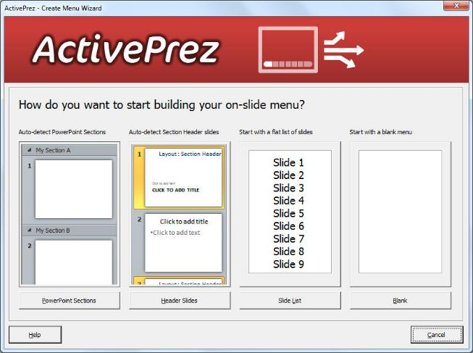
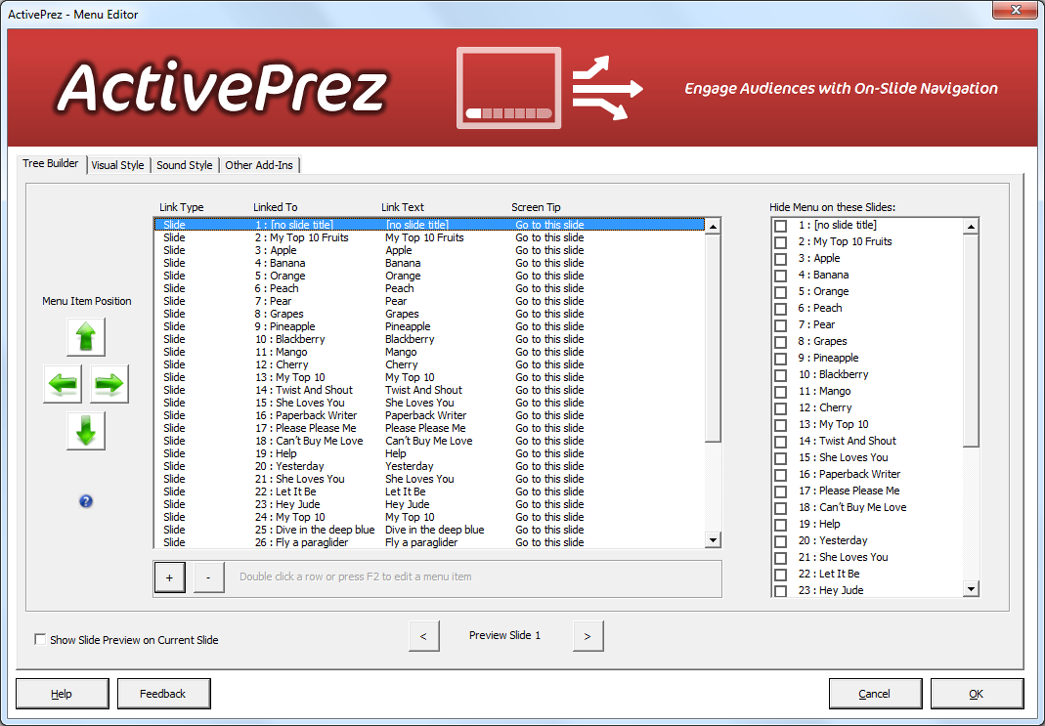
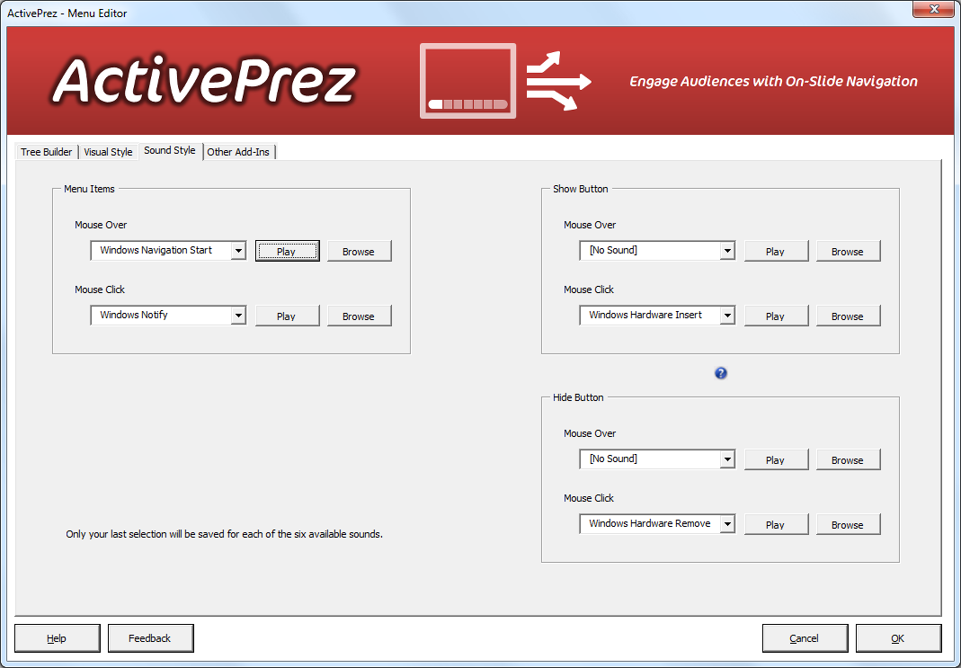
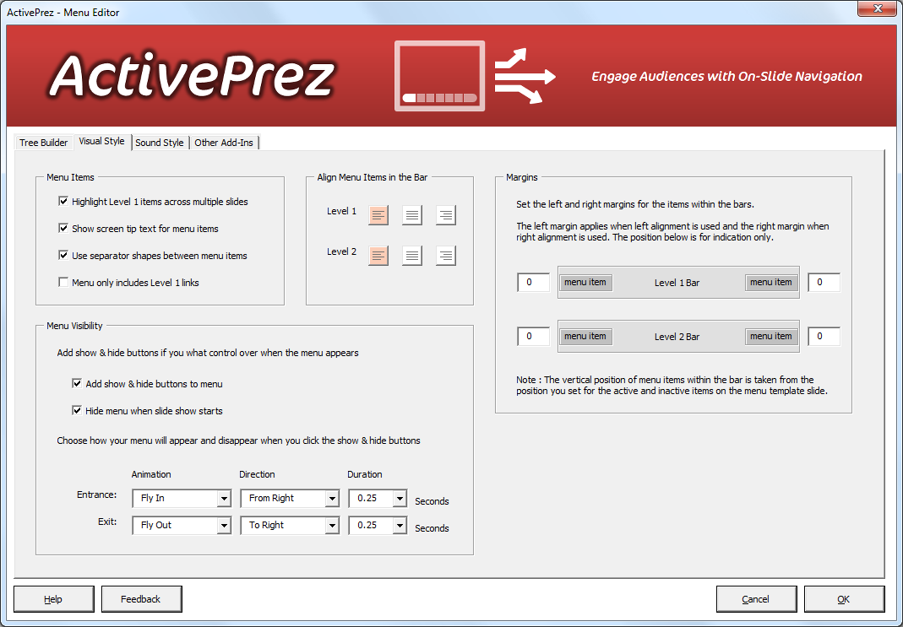
Intro
|
Top 10 Fruits
|
Top 10 Beetles
|
Bucket List
|
How It Was Created
|
More
This 30 second sequence shows
how this presentation was built.
And that’s all there is to it!
Setup visual style
To create this navigation, 1158 shapes and 546 hyperlinks (with screentips) were automatically added by ActivePrez.
It took it just 45 seconds.
You could do the same… in about 8 hours!
Your ROI is made in a single presentation.
Play
Choose auto mode
Hide menu from specific slides
Choose visibility settings
Choose mouse sounds
Edit the navigation tree
Click OK

Slide 36
Intro
|
Top 10 Fruits
|
Top 10 Beetles
|
Bucket List
|
How It Was Created
|
More
More examples online

Slide 37
Level 1 bar
Menu Text (on)
|
Menu Text (off)
Level 2 bar
Menu Text (on)
|
Menu Text (off)
Separators
Show & Hide
Buttons
Getting started with your ActivePrez menu template
Your menu may consist of 1 or 2 levels.
Each level is made up of one Menu Bar shape (or group) plus one or more Menu Text shapes and Link Separator shape (or group).
Before you apply your menu bar, you may change the size, position and style of these elements on this slide, which includes; font size and color, effects, fills etc.
Do not change the text of any of the elements on this slide or try to replace them with other shapes or copy/paste them to/from anywhere.
If you delete this slide, any changes to your template will be lost so it is advisable to keep a backup of this slide if you modify anything.
The following settings are defined in the ActivePrez Menu Builder:
Link Elements : Link Text, Screen Tip, Links Alignment within the Bar
Menu Bar : Orientation, Position and Margins with respect to your slide, Visibility
Prefer to start from scratch? You can delete everything on this slide, create your own menu elements and then use the Assign to Template feature in the ActivePrez ribbon drop down.
You may delete everything below the dotted line at the top of this slide and the dotted line itself when you are ready to start modifying this template
Detailed instructions on how to use ActivePrez menu templates may be found online

