Slide 1
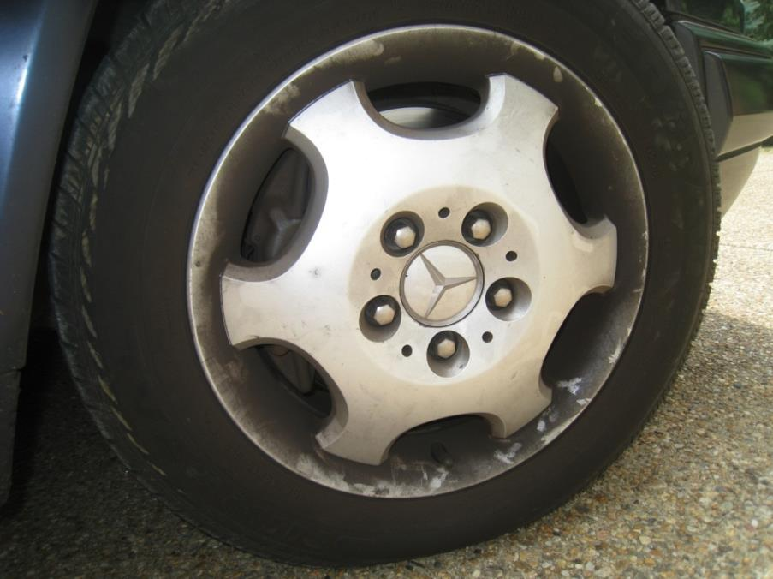
The general public is unaware of the negative impact that Brake Dust from vehicles has on our global environment.
Why is this a problem?

Slide 2
The Problem is Brake Wear Debris
(Brake Dust)
Polluting waterways and oceans, i.e. destroying coral reefs in Hawaii
Copper pollution preventing salmon from returning to their natural habitat to spawn.
OEM/Brake manufacturers/Warranty costs
State Legislatures control raw materials
Brake Dust unsightly and damaging to aluminum wheels
Dirty wheels require dangerous chemicals to keep clean

Slide 3
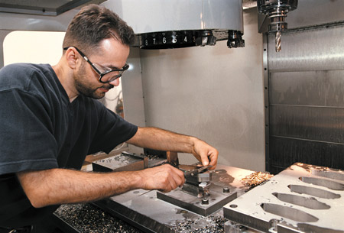
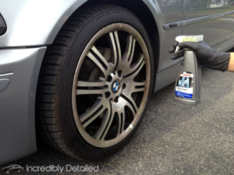
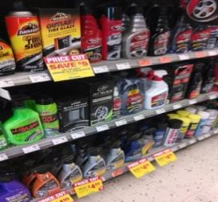

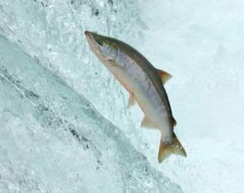
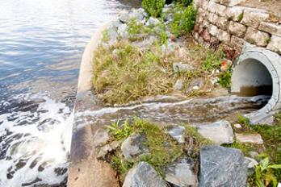
Who does this affect?
End Consumers
OEM/Brake Manufacturers/Warranty Costs
OE
Timely Cleaning
Process
Expensive Cleaning
Materials
State Legislatures
The Environment
Waterways &
Ocean Coral Reefs
Salmon

Slide 4
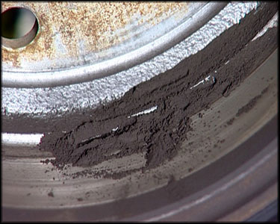
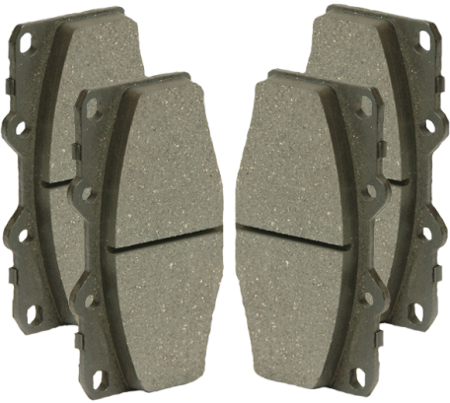
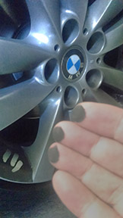
Removing this debris from the wheels is not only a difficult task, it requires toxic, harsh and acidic cleaning materials
1.2 lbs. x 250,000,000 U.S. vehicles
=
100,000,000 lbs./year released into the Environment for front brakes only
If left un-cleaned, brake dust will eventually destroy the surface of an aluminum wheel.

Slide 5
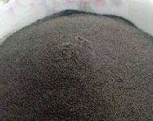
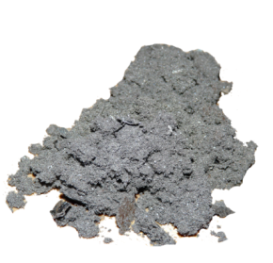
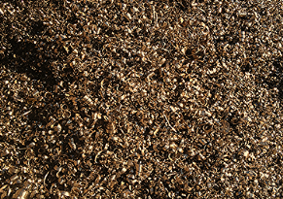
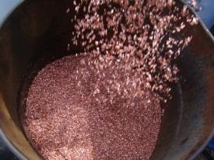
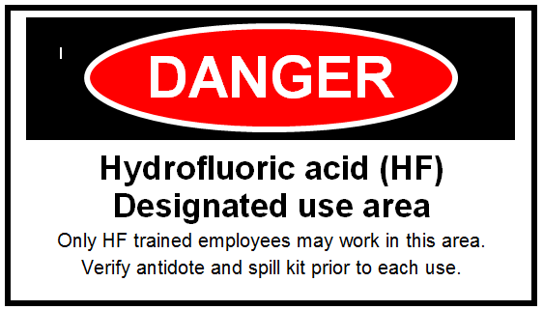
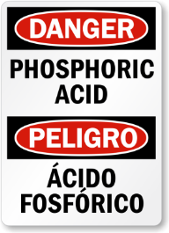
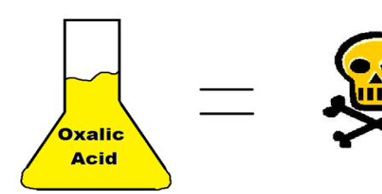
Brake wear debris contains many types of pollutants.
Iron Powder
Brass
Copper
Steel
Chips
The cleaners used to remove the debris also contain dangerous chemicals which contribute to the problem.
Hydrofluoric Acid
Phosphoric Acid
Oxalic Acid

Slide 6
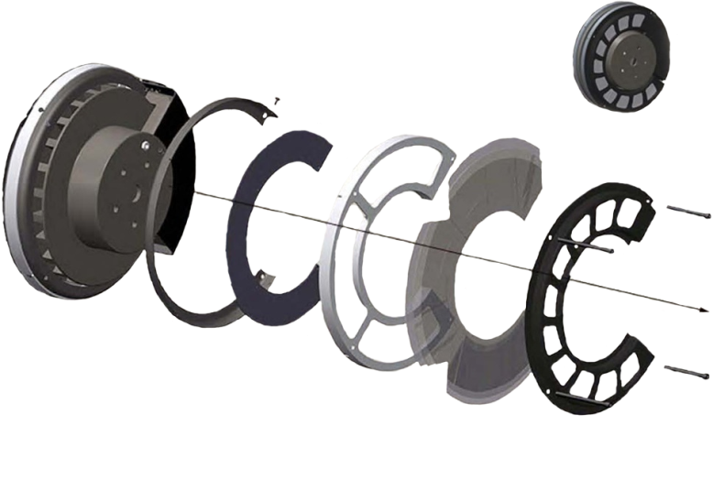
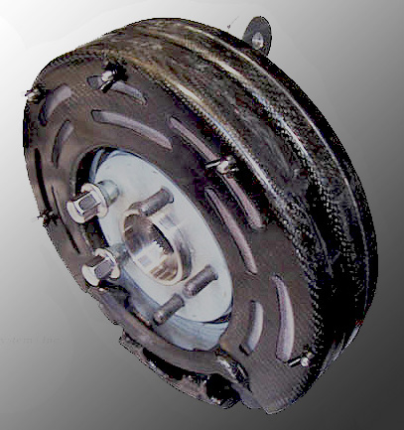
The Solution
Clean Brake Performance
CBPModule
Outer Pad side configuration assembly
Plenum
No Moving Parts
Brake Pad Waste Collection Systems

Slide 7
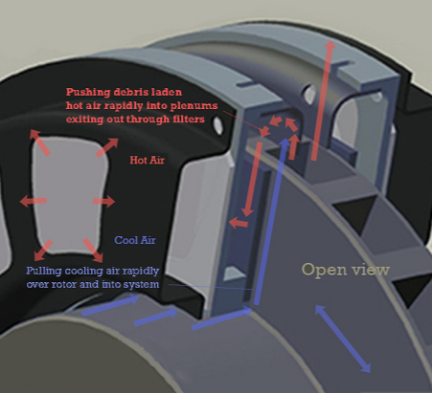
How it Works
Housing fitted on disc brake.
Cool air enters the housing which pushes debris laden hot air into the plenums from where it exits out through the filters.
Filters cleaned or exchanged during standard brake maintenance.
Tests show: The CBPModule can improve overall performance by collecting debris and cooling the brake system, resulting in extended component life.

Slide 8
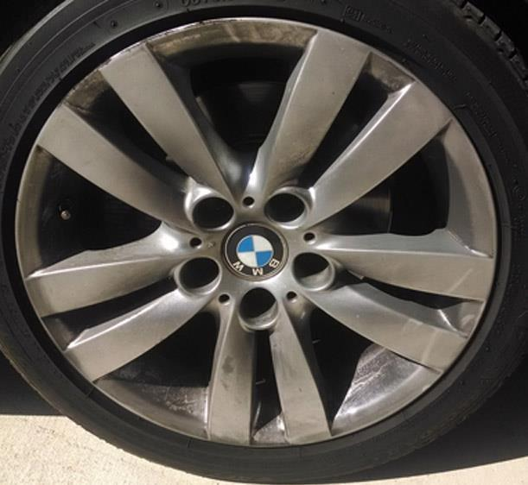
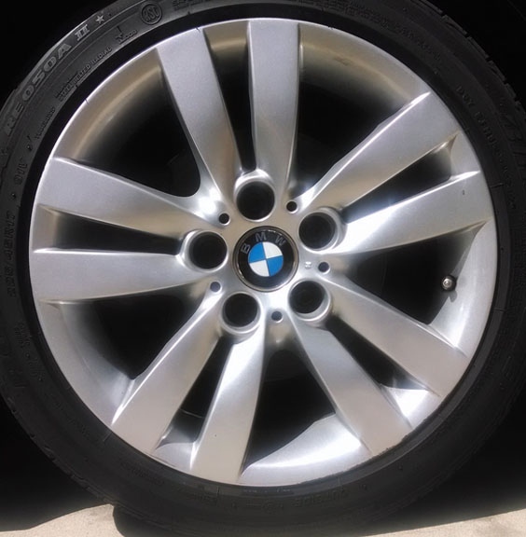
Wheel without CBPModule
Wheel with CBPModule

Slide 9

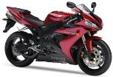
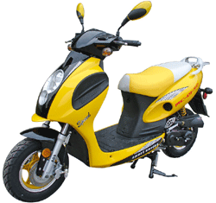




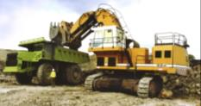


Target Markets
Applicable to all machinery using disc and/or drum brakes
Cars & Light Trucks
Motorcycles
Subways
Mopeds
Aviation
Railroads
Bicycles
Wind Turbines
Industrial Machinery
Heavy Duty Vehicles
Self Expanding Filters (SEF) also applicable to these same markets.

Slide 10
Competitive Advantages
Global patent coverage (CBPModule)
State Legislatures requires action from OEMs and suppliers
No initial practical competition
First practical, economically-feasible debris collection system
Team well-versed and respected in the automotive industry
Self Expanding Filter (SEF): Extremely large additional profit streams possible ($6.7 Billion U.S. Market)

Slide 11
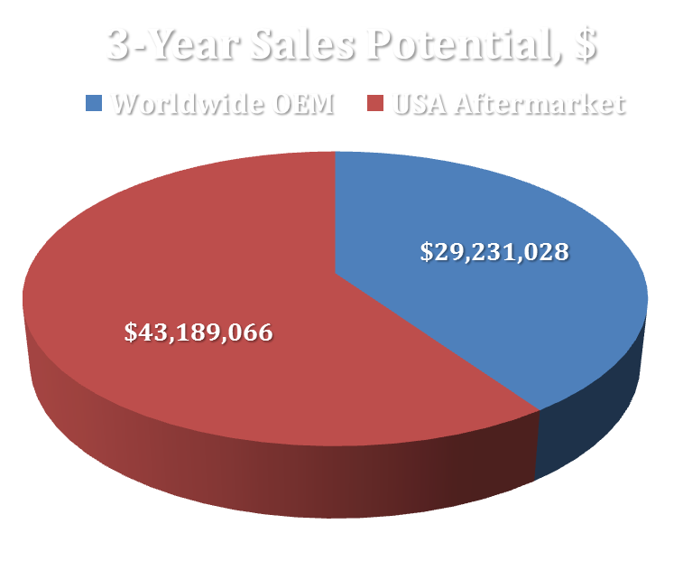
Sales Potential

Slide 12
Contact Information
If you are interested in learning more about these technologies and exciting new opportunities, please feel free to contact one of the following:
Richard Albano ralbano@brakepadwastecollection.com
Co-Founder & Secretary Treasurer
Dr. Timothy Merkel tfmerkel@brakepadwastecollection.com
Chief Technology Officer
22818 Wild Geranium Lane Moreno Valley, CA 92557 www.cleanbrakeperformance.com

Slide 13

The road to a cleaner global environment is the
CBPMODULE
Thank You!

