Slide 1
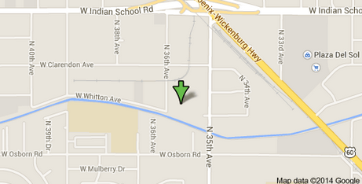
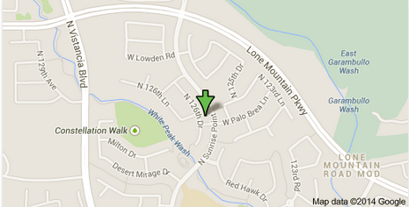
Introduction To Allstate Roofing
Phoenix Location:
3611 N 36th Avenue
Phoenix, Arizona 85019
Office: 602-484-7663
Website: http://allstateroofingaz.com/phoenix
Peoria Location:
30521 N 126th Dr
Peoria, Arizona 85383
Office: 602-620-2755
Website: http://allstateroofingaz.com/peoria
Notes:
Introduction to Allstate Roofing and their roofing contractors in Phoenix and Peoria.

Slide 2
About Us
Allstate Roofing is a family owned and operated roofing company with locations in Phoenix and Peoria. Our Arizona roofing company was started by husband and wife, Chad and Kathy Thomas in 2001. Chad was born and raised in Arizona and started working in the roofing industry with his father at the age of 15. Chad's experience and knowledge in the roofing industry is what makes Allstate Roofing the best in the business! Allstate Roofing is a roofing company you can trust and rely on!
Notes:
Learn more about Allstate Roofing and their Phoenix roofing contractors.

Slide 3
Our Roofing Services
Allstate Roofing provides commercial and residential services in the Phoenix metro area including:
Re-Roofing
New-Roofs
Roof Repair
Shingle Roofing
Tile Roofing
Foam Roofing
And More!
Notes:
Introduction to the Peoria and Phoenix Roof Repair Services by Allstate Roofing.

Slide 4
Connect With Us
https://www.facebook.com/allstateroofingaz
https://plus.google.com/u/0/+AllstateRoofingIncPeoria
https://plus.google.com/u/0/+Allstateroofingazphoenix
https://plus.google.com/u/0/+ChadThomasAllstateroofingaz
http://www.linkedin.com/company/allstate-roofing-inc
http://www.youtube.com/user/AllstateRoofingAZ
http://www.houzz.com/pro/allstateroofingaz
http://www.pinterest.com/allstateroofing
https://twitter.com/Allstate_Roofin
Notes:
Connect with Allstate Roofing on their various social media accounts!

Slide 5
Contact Us
Contact us today with any questions or to schedule your free roofing estimate!
Phoenix Location:
3611 N 36th Avenue
Phoenix, Arizona 85019
Office: 602-484-7663
Website: http://allstateroofingaz.com/phoenix
Peoria Location:
30521 N 126th Dr
Peoria, Arizona 85383
Office: 602-620-2755
Website: http://allstateroofingaz.com/peoria
Notes:
Contact Allstate Roofing for all your Phoenix & Peoria Roofing Needs Today!

