Slide 1
The effect of social media on breaking news:
A media perspective
October 2014
Notes:
JH to introduce

Slide 2
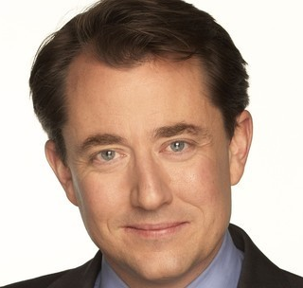
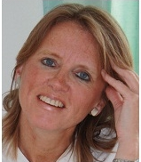
Introductions and welcome
Jonathan Hemus
Managing director, Insignia Communications
Richard Gaisford
Chief Correspondent for
Good Morning Britain, ITV
Ann Bird
Former Executive Features Editor and Health Editor on the Daily and Sunday Express
Notes:
JH to lead – will invite MB to introduce himself

Slide 3
Introductions and welcome
Jonathan Hemus
Managing director, Insignia Communications
Richard Gaisford
Chief Correspondent for
Good Morning Britain, ITV
Notes:
JH to lead – will invite MB to introduce himself

Slide 4
Introductions and welcome
Jonathan Hemus
Managing director, Insignia Communications
Ann Bird
Former Executive Features Editor and Health Editor on the Daily and Sunday Express
Notes:
JH to lead – will invite MB to introduce himself

Slide 5
Introductions and welcome
Jonathan Hemus
Managing director, Insignia Communications
Notes:
JH to lead – will invite MB to introduce himself

Slide 6
Today’s webinar
The effect of social media on traditional journalism
Implications for how the media reports breaking news
Impact on how businesses must communicate in a crisis to protect reputation
Notes:
JH to summarise agenda for webinar

Slide 7
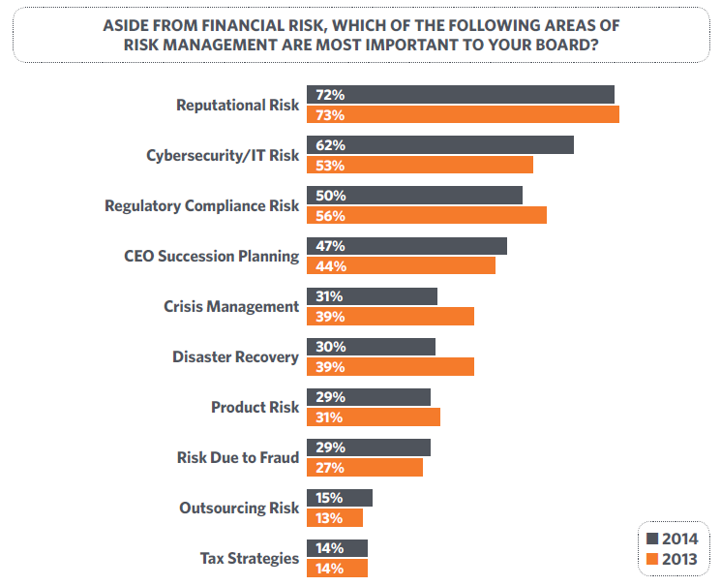
Concerns about risks confronting boards
Taken from EisnerAmper’s ‘Concerns About Risks Confronting Boards’, Fifth Annual Board of Directors Survey | 2014

Slide 8
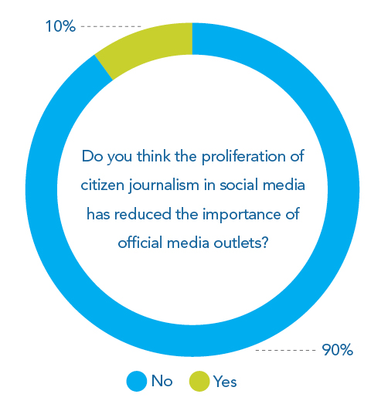
Traditional media retains significant influence

Slide 9
Traditional media retains significant influence
“Journalism is a profession like any other and needs to be practised by qualified individuals. Citizen journalism is an oxymoron, just like citizen dentistry.”
European broadcast and print journalist, Martin Roberts

Slide 10
Crisis communication implications
Identify and build relationships with key influencers ahead of a crisis
In a crisis, differentiate influential commentators from the “noise” and the extremists
Monitor key influencers to understand and shape how they are driving the crisis narrative
Pay special attention to opinion forming journalists with high credibility, influence and reach

Slide 11
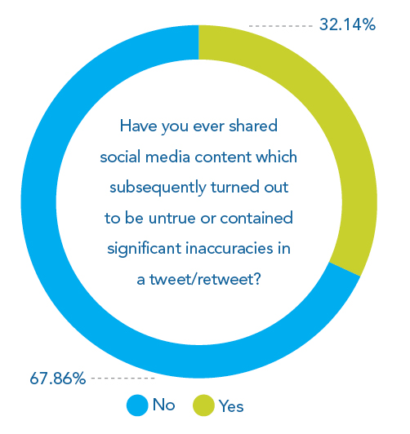
Social media is affecting accuracy and quality

Slide 12
Social media is affecting accuracy and quality
“There is a danger that our trigger happy fingers are tweeting too quickly: we need to stop and remember that it’s important to process information and give the proper perspective and context”.
US TV news presenter, Roop Raj

Slide 13
Crisis communication implications
Monitor social media closely in a crisis
Identify important inaccuracies, especially from trusted media channels and influential commentators
Connect directly with the originator to rectify the error
Communicate accurate information quickly and prolifically
Respond actively to further inaccuracies
Establish yourself as a key source of authoritative information

Slide 14
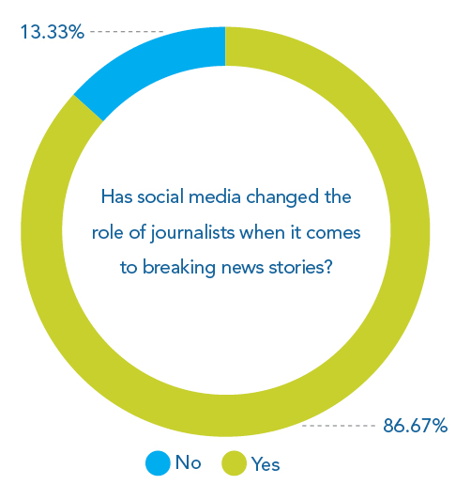
Social media has changed the role of traditional media in breaking news stories

Slide 15
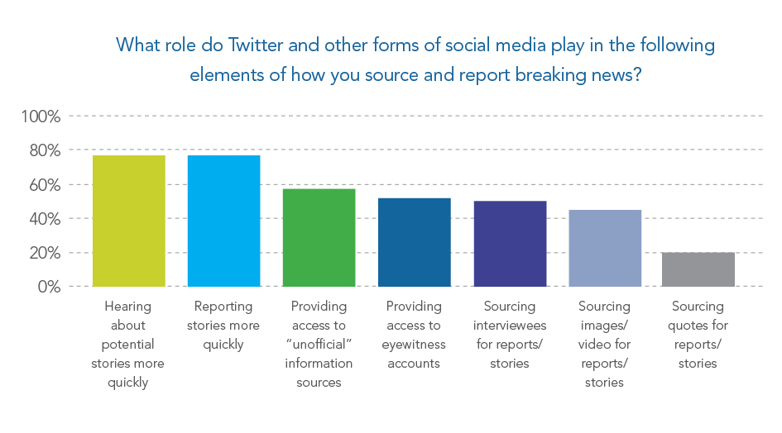
Social media has changed the role of traditional media in breaking news stories

Slide 16
Social media has changed the role of traditional media in breaking news stories
“Twitter is increasingly seen as the place to break news stories.”
UK TV correspondent

Slide 17
Social media has changed the role of traditional media in breaking news stories

Slide 18
Social media has changed the role of traditional media in breaking news stories
“Social media can be useful in bypassing official channels for information.
“I mostly use Twitter to trawl for eyewitnesses to a major event so that we can interview them ourselves. We are very wary of mentioning Tweets without checking first.
“We wouldn’t use an image or video without knowing the provenance of it. Trust is one of the BBC’s core values and we can only retain this if we verify our sources.”
BBC TV correspondent, Ben Ando

Slide 19
Social media has changed the role of traditional media in breaking news stories
“Media are increasingly seeing social media as a quicker and more direct route through to organisations compared with calling corporate communications. The difference is that those interactions are visible to everyone else.”
US TV news presenter, Roop Raj

Slide 20
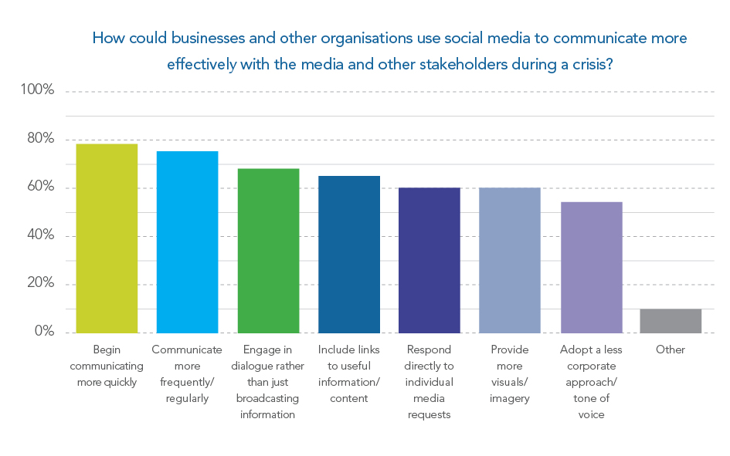
Communications implications for organisations handling a crisis

Slide 21
Crisis communications implications – preparation and planning
Comprehensive social media monitoring
Engage actively via social media channels when the going is good
Identify and build relationships with key influencers
Plan where you will host your online information hub
Integrate social media channels into your crisis communication plan
Identify and prepare human and technical resource
Create materials beforehand - images of people, products and places, maps, graphics, corporate facts and figures etc
Know how to produce new materials (e.g. YouTube message) in a crisis
REHEARSE – conventional crisis exercises and social media simulations

Slide 22
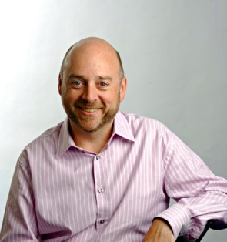
Crisis management materials and insights
To request a complimentary crisis management audit
Email: info@insigniacomms.com
Email: jonathanhemus@insigniacomms.com
Phone: +44 (0)786 832 9102
Twitter: @jhemusinsignia
Website: www.insigniacomms.com
Download our report and previous webinars here:
http://insigniacomms.com/resource/
Notes:
JH to invite and deal with questions

Slide 23
The effect of social media on breaking news:
A media perspective
October 2014
Notes:
JH to introduce

