Slide 1
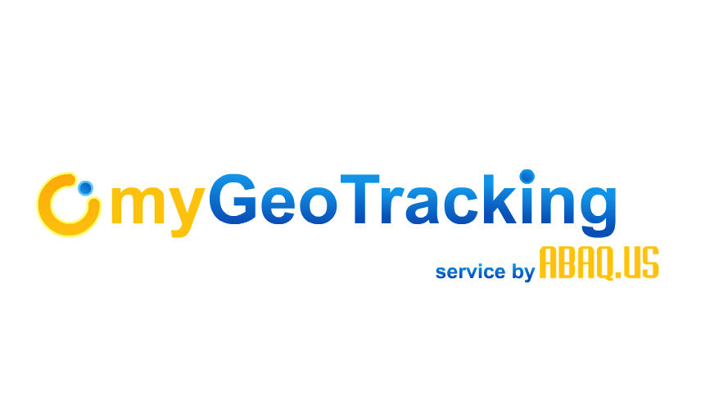
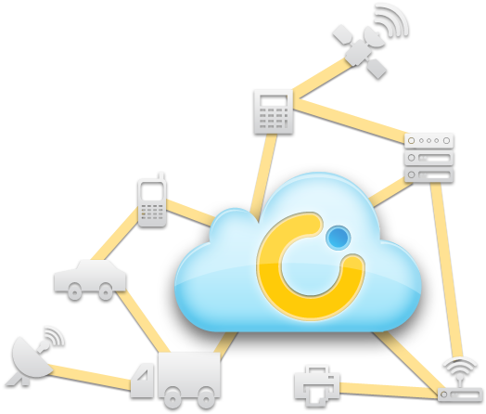
Shailendra Jain
sjain@abaqus.net
myGeoTracking for Mobile Employee Time Clocking and Optimization Solutions
Locate.Message.Manage
Shailendra Jain
sjain@abaq.us
Thursday, November 13, 14
Copyright 2013-2014 Abaqus, Inc. All Rights Reserved. Confidential.

Slide 2
myGeoTracking for Mobile Employee Time Clocking
Industry Challenge:
Improve payroll & operations management of the mobile workforce by eliminating time cards thereby cutting payroll slippage and verifying job site attendance
myGeoTracking Solution:
Easy to deploy solution where all time clocking is done automatically (eliminating manual entry for time cards) using employees phones and enabling the data to be imported into a payroll management system

Slide 3
How?
Utilizes drivers cell phone - works with normal phone or smart phone by leveraging location information from the cellular networks
Does not require any additional devices
Supports app based and non-app based solution
No entries required from employee except tapping on the "on duty" or "off duty" button on the app - how is this managed for non-app solution?
Zero-touch time clocking automatically clocks in and clocks out employee as they visit job sites in the field
Most advanced solution in the industry - supports GPS/Telematics, App based smartphones and Cloud based technology
Provides solution for compliance with DoT HoS and USPS regulations
Automatic time clocking eliminates time cards

Slide 4
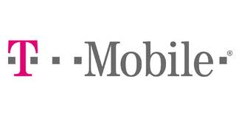
Why myGeoTracking ?
A 100 % Cloud based Location & Messaging Platform
Cover over 95% phones in the US
No Apps, No Data Plan, No Special Devices
Works on *any device* on all major carriers in the US
Fine-grain Privacy Control
Geo-Tagged Enterprise Text Messaging & IVR
USPS Service Compliant
Location-enhanced Rules Engine
Analytics & Reports
Rich Web API to integrate with Custom Backoffice Systems
Carrier Grade Scalable; Hosted on Amazon
Additional International Telco Support (e.g. Canada)
WiFi / GPS Apps for iOS and Android
Supports Telematics Devices (e.g. Calamp, Teltonika)
*Patent Pending
*Not compatible with pre-paid phone services

Slide 5
Zero Touch Time Clocking Features
Accurate time clocking lets you verify job site attendance and cut down on payroll 'slippage’
Automatically calculate billable hours with Hours-of-Service (HoS) breakdown. No more hand written time cards
Generate daily activity time and attendance reports with a single click integration into Quickbooks and other payroll systems
No training or learning curve hassles for the end-user. myGeoTracking is the only service to feature a complete 'ZERO-TOUCH' GPS time clocking solution
Works on all phones with or without an app. Supports BYOD and Contract worker scenarios

Slide 6
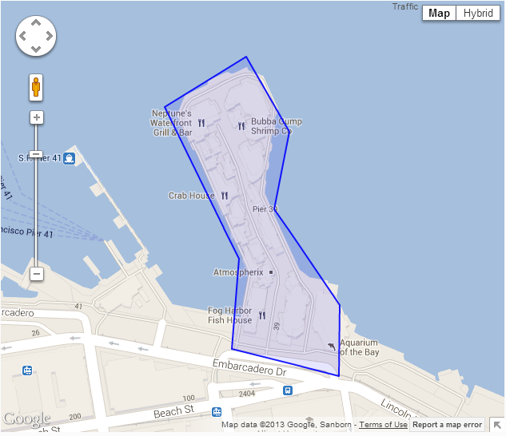
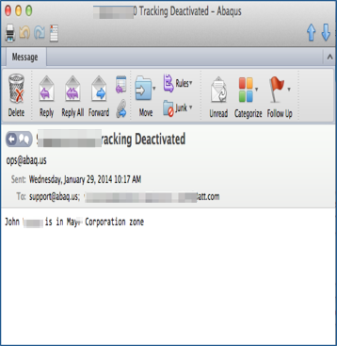
Geofencing, Location Rules & Alerts
Stop Tracking Once employee Reaches Distribution Center
Automatically clocks in when employee leaves port geozone
Automatically clocks in when employee reached field destination

Slide 7
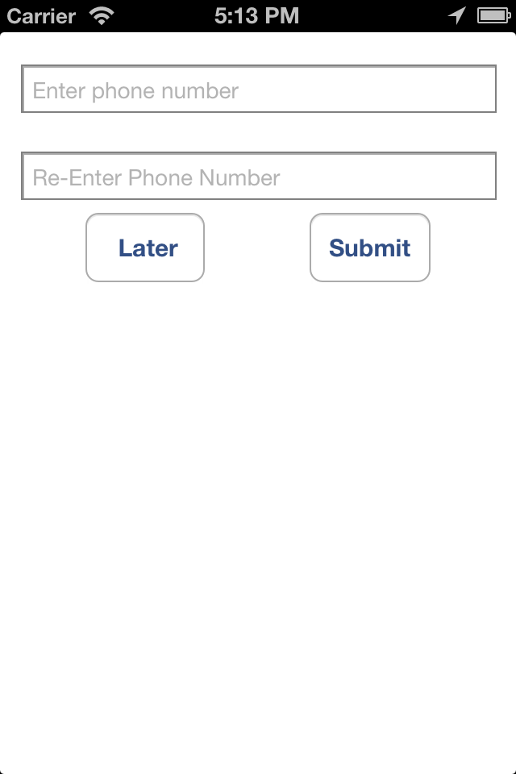
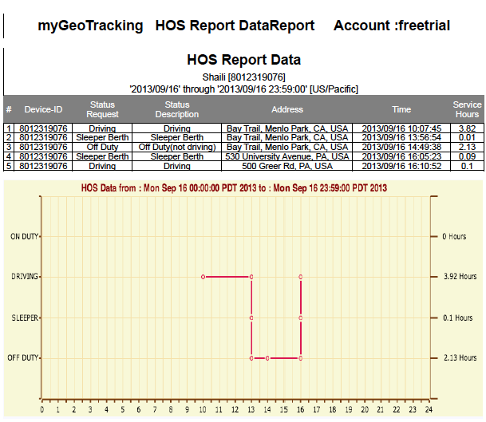
Hours of Service
Driving
On Duty
Off Duty
Sleeper
Driver taps the "on duty" button to provide permission to track them in the field
Driver taps "off duty" button to stop tracking

Slide 8
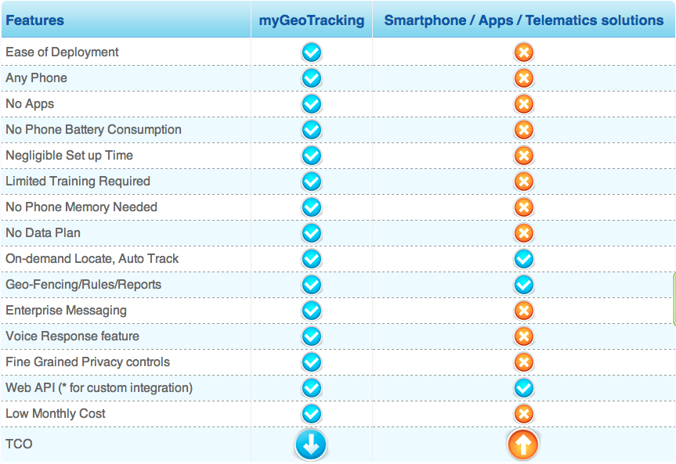
myGeoTracking Solution Advantages

Slide 9
Customer Examples
Who: McDal Corporation provides comprehensive Sales and Service for Overhead Hoist and Crane Systems. A distributor for most of the major manufacturers in the USA McDal serves the Eastern portion of PA, NJ, MD and DE.
Solution: myGeotracking's Automatic time clocking solution.
Benefit: Improved employee accountability, productivity and payroll management with significant reductions in payroll costs.
Who: Sterling Medical provides comprehensive healthcare services, including healthcare staffing, healthcare departmental operation, and healthcare clinic operation.
Solution; myGeoTracking's GPS Time clocking solution - employee punch in and punch out using an app
Benefits: Employees manually punch in and out during work shift, the systems reports punch-in location, shift duration and billable hours. Improved employee accountability and payroll management.
Who: RHW Inc has been providing expert commercial painting & wall covering services to customers based in Hollywood, Florida and its surrounding area.
Solution; myGeoTracking's zero touch time clocking solution.
Benefits: Improved employee accountability,productivity, and payroll management without any manual interaction by the crew members to clock-in & out
Copyright © 2013-2014, Abaq.us, All rights reserved

Slide 10
Summary
Zero-touch time clocking eliminates time cards completely
Improves payroll management by providing highly accurate payroll data
Frees up employees to focus on the job in the field rather than make time card entries
To Experience myGeoTracking Service,
Try our 15 day Free Trial Today.

Slide 11
Thank You
For More Information please contact
Tel +1-415-49-MYGEO
(+1-415-496-9436)
Email – info@abaqus.net
Website - www.mygeotracking.com

