Slide 1
RUC’s Retail Store Guide Book
An Overview

Slide 2

Select A Retailer
You can find the retailer of your choice by using either the Store Directory or the categories list in the Table of Contents.
You can also check Store Hours
and Holiday(s) Closed to see when
the store is open for business.

Slide 3
Store Merchandise/Services
You can see what Merchandise the store has to offer by category, and what Services are available in the store to enhance your shopping experience.
You can also check the store’s website for merchandise and available services that are specific to your area (Store Finder).

Slide 4
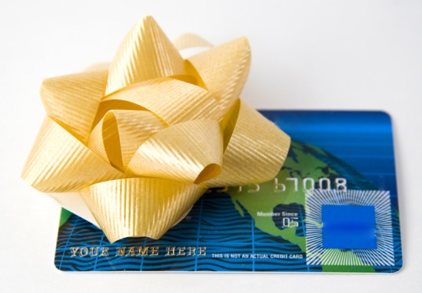
Available Cards
You can check to see if the store has Gift Cards, a Store Card, or a Store Credit Card.
Using one or a combination of these cards can help you save money, earn rewards, and enjoy benefits unique to that store.

Slide 5
Exclusive Deals
Receive Email or Mobile alerts to get exclusive deals and offers from the store before anyone else.
Visit the store’s website to sign up—it’s fast and easy!
You can also chose to stop receiving emails and mobile alerts at any time, so you have nothing to lose and everything to gain.

Slide 6

Store Flyers/Savings
See and print a weekly Store Flyer at the store website to find sales specials at your local store.
You can also print store Coupons and receive Rebates on select products when available.
Check back often to see how much
you can save!

Slide 7
Social Media/Apps
Get Connected with the store through the social media links provided to share your shopping experiences and converse with other consumers.
Have a smartphone or a tablet? Mobile Apps are listed when available so you can stay in touch, even on the go.

Slide 8

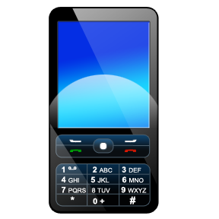
Contact Information
Store Contact Information is provided for general inquiries, customer service questions, or a specific complaint/issue that cannot be addressed by the local store.

Slide 9
Shopping Tips
Review the Shopping Trip Tips before, during, and after you shop for a smoother, stress-free shopping experience.
Payment tips are also listed to reduce confusion and provide different options when paying for your items/services at the checkout line.

Slide 10

Additional Information
You can save even more money and stay in-the-know as a consumer if you know where to look.
The Helpful Websites page has listings
for sites that can save you money
(Coupons/Rebates) and keep you
informed (Consumer Resources).

Slide 11
Stay Organized
You no longer have to worry about misplacing the number to a store or other important information connected to your shopping needs.
Notes pages are located in the back of the guide book for you to use for your records—it may come in handy when you least expect it.

Slide 12

You Are Ready
With the information and resources available in this guide book, going shopping unprepared will be a thing of the past.
Have fun and happy shopping!

