Slide 1
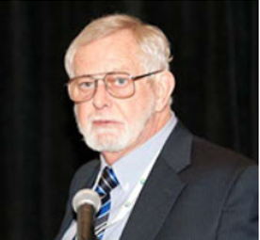
Please Join me for:
The University of Texas’s Energy Week
16th – 20th of February, 2015 in Austin, TX
Photo of Robert D. Hunt Physicist and Inventor while speaking at the UT Energy Forum in 2013
http://energyweek.utexas.edu/

Slide 3
Letter to Longhorn Energy Club regarding Ultimate’s Free Piston Engine that gained acceptance:
I was a speaker at the 2013 UT Energy Conference and look forward in continuing my collaboration with the UT Energy Forum in 2015. Ultimate Free Piston Engine is developing remarkable new Free Piston Engine technologies that offer oil and gas operators the opportunity to become convenient and cost effective net exporters of electrical power instead of exceptionally large users of electrical power, turning their power costs into significant electrical power income. The underlying pending patent application that is descriptive of the design is titled, “Multilevel Fuel, Heat Driven or Pressure Driven Gearless Free Piston Engine Liquid Pump, Gas Compressor and / or Power Generator, having Advanced Hydraulic Synchronization and Breaking” by Physicist and Inventor Robert D. Hunt. This extremely versatile and ultra-high efficiency free piston engine is useful in regard to dramatically lower operating costs, higher oil and gas production; CNG onsite production; LNG onsite production and onsite power generation, including electrical power generation and / or hydraulic power take-off for any use by which mechanical power is useful. It can be operated using any heat source, such as geothermal, solar and combustive or alternatively may be powered by any pressurized fluids.
Our presentation features novel ground-breaking development in free piston engine technology that eliminates the use of a conventional crankshaft causing high weight, substantial friction and excessive vector angle losses approaching forty-percent (48%) mechanical efficiency losses when calculated as a single piston, thereby creating typical combustion engines with an average efficiency of near 25%. Thereby all of the heat energy is transmitted by my innovative Hunt Free Piston Engine to power with no vector angle losses whatsoever as it always maintains an optimum 90 degree vector angle for maximum energy transfer.
The high mechanical efficiency of the design that was third party validated is a current world’s record efficiency for a positive displacement engine standing at 94%. Current piston engines only have 25% combined mechanical and thermal efficiency on average. Completed engineering shows estimated combined efficiencies approaching 70% for the new prototypes currently being manufactured, which we anticipate will create a new world’s record combined efficiency as the current record is held by a lesser developed Caterpillar free piston engine design at 59%. I look forward to seeing all of you again during this year's 2015 UT Energy Forum
By: Robert D. Hunt
Physicist and Inventor

Slide 4
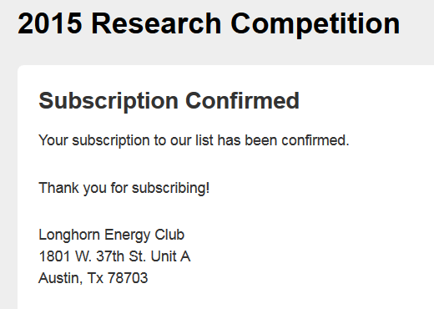
Ultimate Free Piston Engine was Accepted in the Longhorn Energy Club’s Oil and Gas Technology Research Competition at the University of Texas in Austin and will be going for over $100,000 in prize money and will be viewed by alumni, who include ExxonMobil Corporation CEO Rex Tillerson, Dell founder and CEO Michael Dell, and Southwest Airlines's CEO Gary C. Kelly; and Red McCombs . The contest is great exposure for the Free Piston Engine that is in association with the UT Energy Conference that I was a speaker at in 2003 and is one of the biggest energy events of the year as UT is the major energy research arm of the State of Texas, which by far leads the U.S. in Energy Production and is world renown.
http://energyweek.utexas.edu/
Ultimate Free Piston Engine will be Exhibiting at the 2015 UT Energy Forum during the entire week of 16 – 20 February with the actual Energy Competition Presentation on February 18th

Slide 5
Ultimate Free Piston Engine’s Presentation is Scheduled on the Agenda to the Left at 14:50 to 15:15 in the Oil and Gas Division after Lunch in the Alumni Center – Main Hall at 12:30 to 14:00 going for $15,000 First Place Division and $5,000 Second Place Division Awards

Slide 6
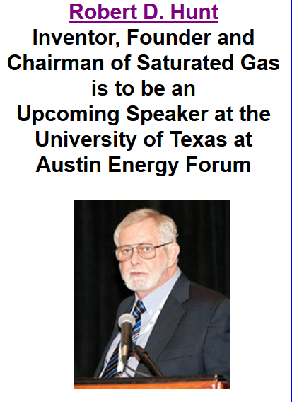
http://en.wikipedia.org/wiki/University_of_Texas_at_Austin (See Alumni)
Physicist and Inventor, Robert D. Hunt who is the Managing Director of Ultimate Free Piston Engine was a Speaker at UT’s Energy Forum in 2013, which featured his methane extraction from brine process that he developed for Saturated Gas.
http://saturatedgas.com/

Slide 7
