Slide 1
XiMAD Portfolio and Traffic Presentation

Slide 2
XiMAD Portfolio
Founded in 2009 and based in San Francisco, CA
In 2010 established as California S-Corporation
Managed by industry experts with over 10 years of experience in telecom and mobile
Employs more than 200 people with 4 R&D offices in Russia and Belarus
Core Businesses:
Mobile Applications Development and Publishing
Social Networks Applications Development
eBook Publishing Solution
In-House Mobile Ad Traffic Mediation
Financial Overview:
Profitable since 2010
Current Revenue with 30% net profit margin

Slide 3
XiMAD Portfolio
Competitive advantages
Expertise and established product development, publishing and monetization process
Cost-effective distribution of engineering, creative, and business management resources throughout Eastern Europe
Technology know-how, re-usable code-base and intellectual property
Unique and sophisticated Ad Traffic Optimization Platform
Direct relationship with most major app-stores
Integrated Cross-Promotion across own and partners properties
Sources of Revenue
Direct sales via app stores and IAP: 30%
Advertisement: 70%

Slide 4
XiMAD Apps Portfolio
Over 80 product titles ported on 8 major native mobile platforms
Totals to over 600 stand alone apps in over 50 native and independent app-stores
Products categories: Games, Social, Utilities, References & eBooks
Apps are distributed in 200+ countries (though most of downloads US, CA, UK, AU)
Apps are distributed through 50+ app stores
Multiple placements in “Featured Sections” in all major app stores
Winner of 5+ contests by operators and OEMs
Prizes in 5+ contests by operators and OEMs
Direct partnerships with Microsoft and RIM

Slide 5
XiMAD Apps Portfolio
XiMAD Apps feature set
Cross-promotion
Rate it
Ad module
Analytics
Push notifications
Scoreboard
Share (FB, Twitter …)
IAP

Slide 6
XiMAD Apps Portfolio

Slide 7
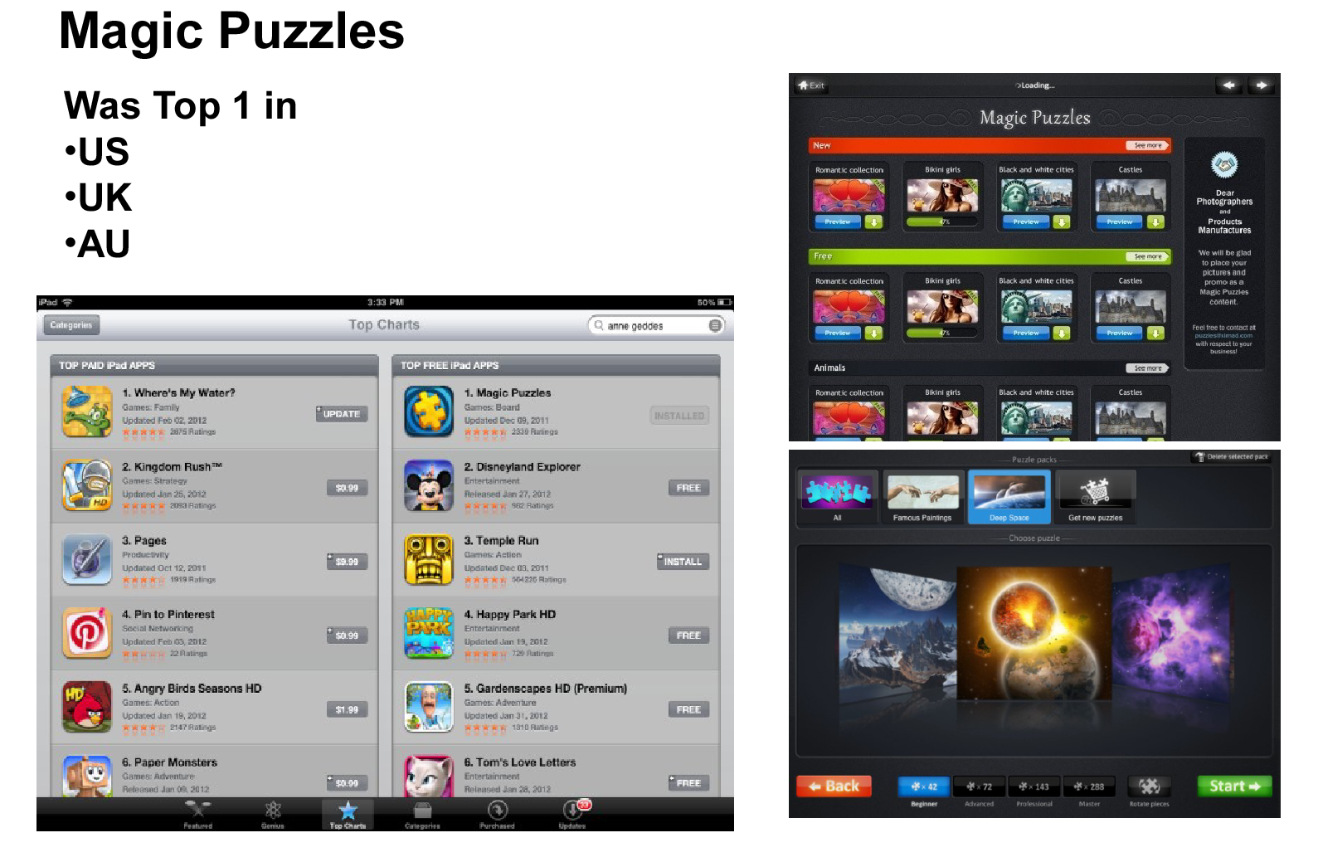
XiMAD Top App

Slide 8
XiMAD Top Apps
Magic Jigsaw Puzzles
Bubble Birds
Fruit Quest
Muffin Quest
Color Quest

Slide 9
XiMAD In-House Traffic Optimization Tool
95% Fill Rates by querying multiple ad-networks with no network latency
eCPM Traffic Optimization
Supports in-house ads for unfilled requests
Supports custom campaigns
Ad targeting
Real-time performance reports
CPM/CPC/CPA campaigns support

Slide 10
XiMAD Traffic Portfolio
Average monthly impressions:
2010 – 50 M/M
2011 – 230 M/M
2012 – 276 M/M
2013 – 395 M/M
2014 – 1005 M/M*
*December 2014 – 1,54 B impressions

Slide 11
XiMAD Traffic Breakdown
Top Geo Location:
iOS - (US 40%,UK 12%, CA 10%) Android - (US 50%, UK 25%, CA+DE 10%)
Amazon - (US 80% , UK 10%, DE 5%) Win8 (desktop) – (US 40%, DE 10%, FR 10%)

Slide 12
XiMAD Traffic Breakdown
Platform Breakdown:
iOS - (78,2%) Android - (4,3%)
Amazon - (7,3%) Win8 (desktop) - (5%)
Others - (5,2%)

Slide 13
Ad Size Traffic Breakdown
iOS - (728x90, 320x50, interstitials*, video)
Android - (728x90, 320x50, interstitials*, video)
Amazon - (728x90, interstitials*, video)
Win8 (desktop) - (728x90, 160x600, interstitials*, video)
Others - (320x50)
*all interstitial banners within device screen dimensions

Slide 14
XiMAD Top Partners
iOS - (InMobi, Smaato, Mmedia, Applovin, Chartboost)
Android - (Amazon, Smaato, Tapit, Applovin, Chartboost)
Amazon - (Amazon, Smaato, Tapit, Chartboost)
Win8 (desktop) - (Pubcenter, Adduplex)

Slide 15
THANK YOU!

