Slide 1
The Robotics Inventors Club ‘THE WORLD’S YOUNGEST ROBOT STARTUP’
Created by
Infamous Robotics LLC
Sponsored by

Slide 2
Who we are

Slide 3
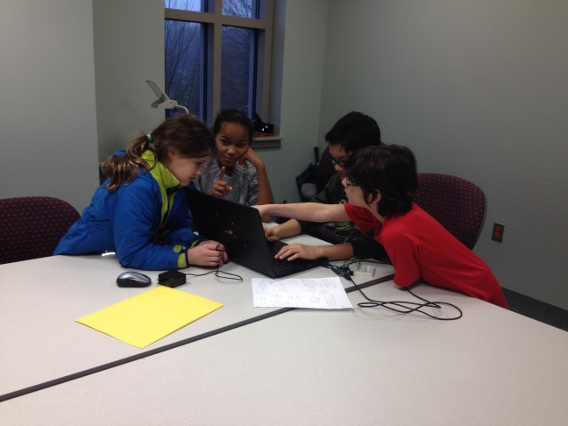
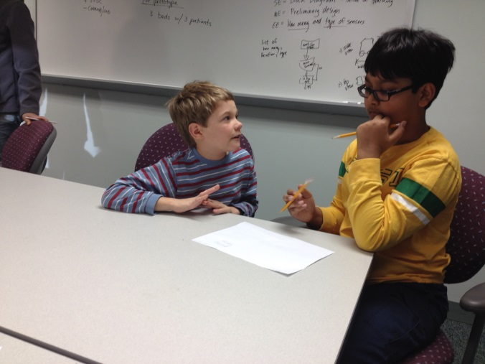
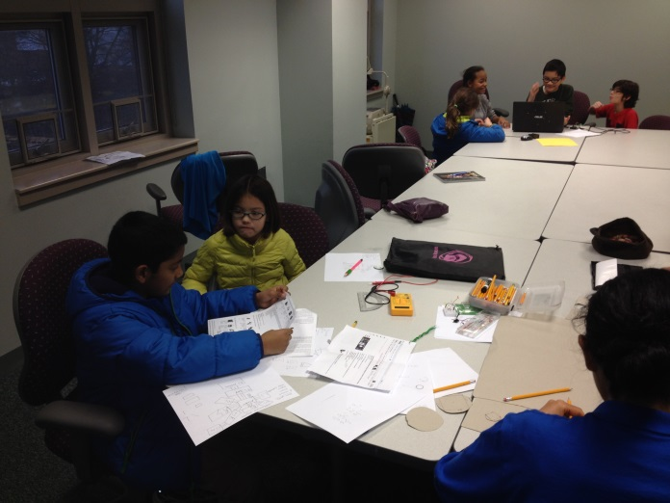
Who we are
There are three teams in the Robotics Inventors Club

Slide 4
What is the problem

Slide 5
What is our Solution A.N.A.

Slide 6
How our Solution works

Slide 7
Future Enhancement

Slide 8
Video
See our prototype in action
Come see us live during National Robotics Week on April 3rd inside the Smithsonian National Air and Space Museum in D.C.

Slide 9
Questions
For more information about the Robotics Inventors Club, visit
www.InfamousRobotics.com
Twitter: @InfamousRobotic
Email: Anthony@InfamousRobotics.com
Thank you to our sponsors

