Slide 1
visitbasis
Introduction and System Overview

Slide 2
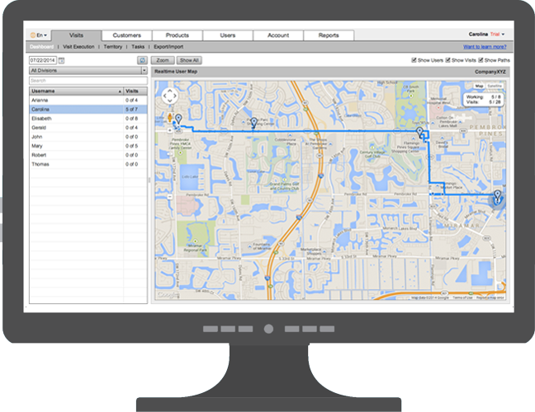
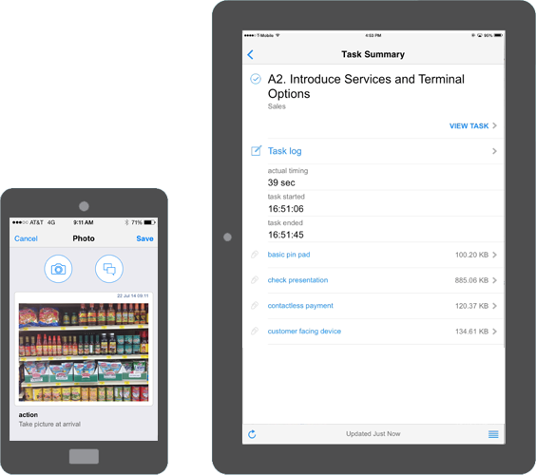
Introduction
About VisitBasis
VisitBasis Retail Execution is a cloud-based complete mobile data collection solution designed to build, schedule and monitor field team activities in real time.
Main Structure
Browser-based Office App
Android/iOS Mobile App
Cloud Storage
• Manage • Assign
• Plan • Schedule
• Monitor • Report
• Perform visits and tasks

Slide 3
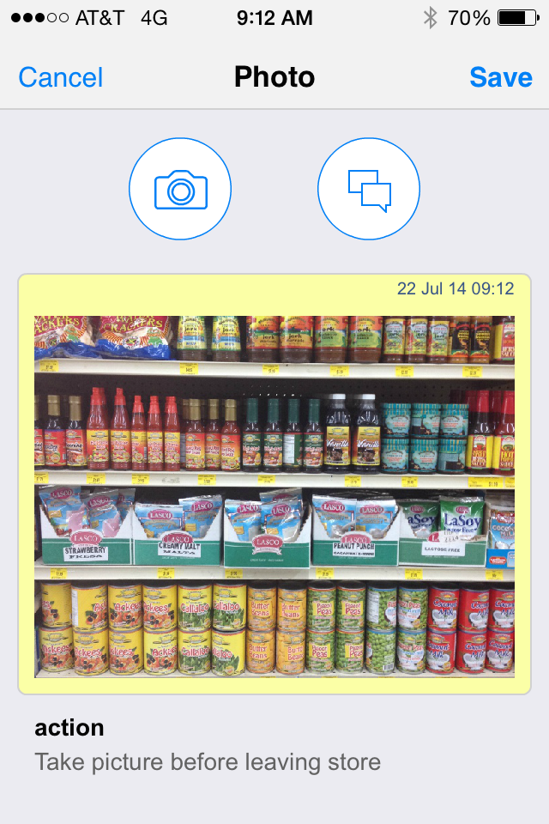
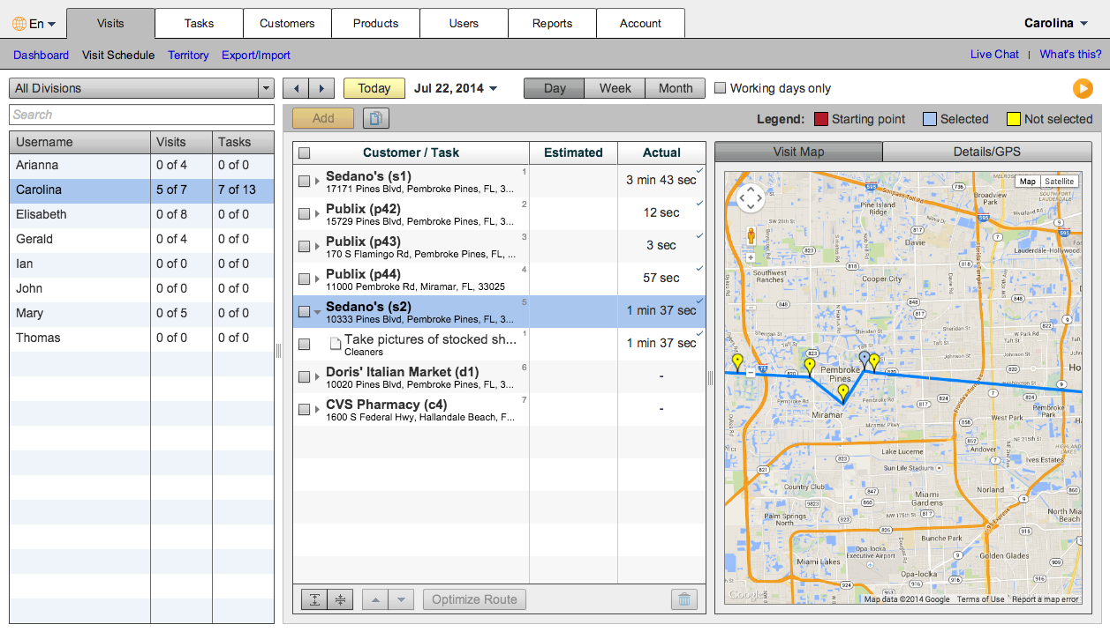
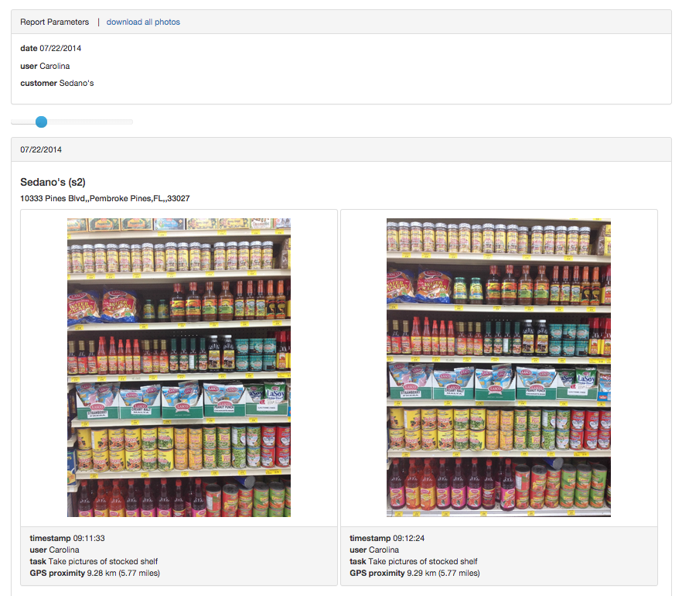
Uses
Industries and Applications
Merchandising and Field Marketing
CPG and FMCG
Outside Sales
Mystery Shopping
Retail Audits and Inspections
Surveys
POS Asset Management
Training
Other in-store activities:
Product demonstrations
Sampling, etc.

Slide 4
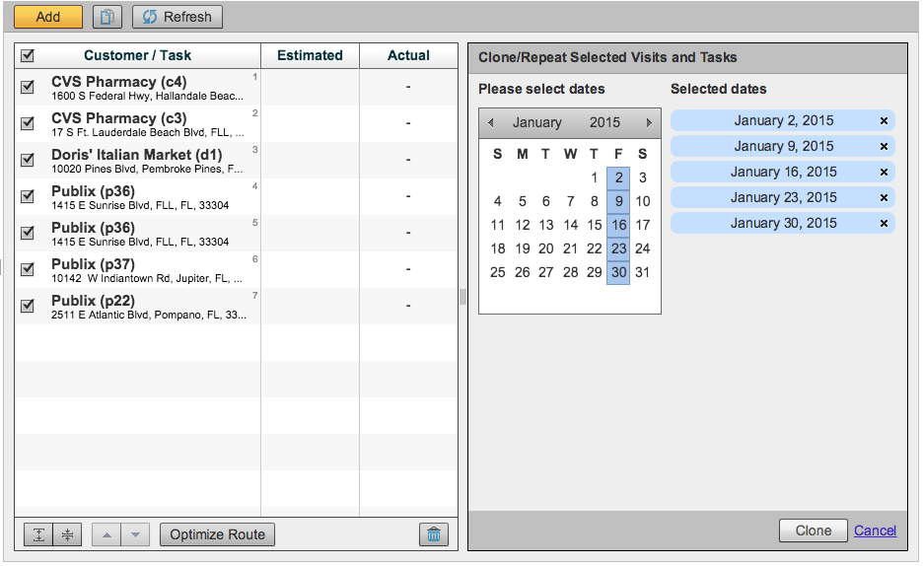
Uses
How Does it Work
Set-Up: Office creates users, customers, products, task templates, and assigns territories.
Typical Everyday Workflow
4. Supervisors can then create and share detailed user and/or customer reports.
1. Office plans visits and schedules them for mobile reps, including any recurring visits.
3. At the office, supervisors are able to see where mobile reps are, and which activities are being performed.
2. On their mobile devices, reps follow the visits scheduled for the day and perform the tasks requested by the office.

Slide 5
System Overview
VisitBasis Office
Manage
Customers – full CRM capabilities
Products – electronic catalog
Users – multi-division and multi-team
Assign territories
Easy to use mapping
Plan visits
Advanced task template building with multiple action formats: text, numbers, selection, photo, signature
Schedule visits and tasks
Includes efficient bulk scheduling tool and route optimization
Monitor
Track user activities live on the map with timestamp and details on GPS locations
Report
Advanced tools allow to extract data in many forms

Slide 6
System Overview
VisitBasis Mobile App
Android and iOS
Users can install and use app in as many devices necessary, and at the same time
Online and offline mobile data capturing
Users can work offline and then synchronize once a connection is established
Information on customers, products and visits is readily available
On-the-go scheduling and planning, as well as route optimization
VisitBasis is a Google Cloud implementation, so you can count on the best service availability even if your company is multinational and runs in different countries and time zones.
Cloud Environment

Slide 7
Contact info
www.visitbasis.com
blog.visitbasis.com
Live Chat
sales@visitbasis.com
Toll Free: +1 (800) 497-6293
Phone: +1 (954) 505-2059

