Slide 1
What is Visible Builder?
How does it work & what do I get for my monthly investment?

Slide 2
We Create, Maintain & Manage your Companies Social Platforms (Up to 10) Such as: Porch, LinkedIn, Twitter, City Search, Facebook, Merchant Circle, Insider Pages, Zillow and Manta or others that make sense! MONTHLY
Reputation monitoring
Claiming of your Online profiles
Harvest Client Testimonials- We will get you REVEIWS on SOCIAL!

Slide 3
No TIME Wasting Meetings
You get a monthly link to fill-in
When you have time send it in. We will take it from there!
If you don’t have time that month to fill it out, DON’T WORRY we will still post GREAT LOCAL features!

Slide 4
Effective HOMETOWN FEELING Posts and Updates. 2 Per Week! on
a post for Archadeck of Columbus

Slide 5
Harvesting Reviews from your Promotors Monthly!

Slide 6
Monitor what people are saying about YOUR COMPANY!
We will let you know if we see anything online and give you direction on how to Handle it! The post on this page was addressed within 24 hours and reversed to a positive response!
You need to know this is being said!

Slide 7
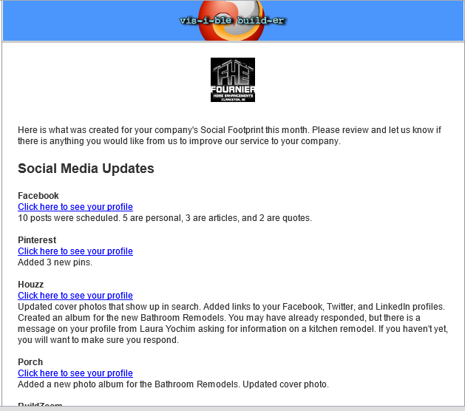
Emailed Reports- Monthly
An email that will tell you all that was done for Your Companies Online Visibility for the month. If you do not feel that all that is being done is WORTH the cost you are paying you can cancel the service anytime. There are NO CONTRACTS. Why? Because we believe that we offer the best service for the Home Services Industry!
You will want to STAY with us!

Slide 8
How Much?
$ 350.00 per month for 9 Months
(1st month is at this rate)
$ 50.00 per months for 3 Months
Same service during this time (Lower cash flow months)
If you own a 2nd Brand it is billed @
$ 350.00 per month for 7 Months
(1st month is at this rate)
$ 50.00 per months for 5 Months
Same service during this time (Lower cash flow months)
And YES you can still cancel at anytime even after the $50 months! We are that Confident that you will see the VALUE of this service and the RESULTS!

Slide 9
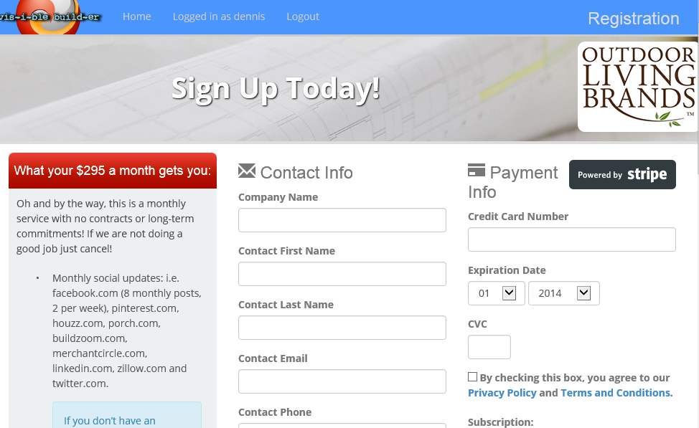
Let’s Get Started!
When you register in January 2015 the first Payment is $350.00 then the months of February and March of 2015 will be $50.00. Then April through November will be @ the $350.00 and returning to $50.00 in December 2015
For those with Multiple Brands the $50 Months for the 2nd Brand will be Feb., March, April, Nov. &Dec. 2015
Remember there are NO CONTRACTS so you can stop service anytime. But you won’t because IT WORKS!
https://members.visiblebuilder.com/registration/OLB

Slide 10
Still Have Questions?
Contact Me! Dennis@VisibleBuilder.com

