Slide 2
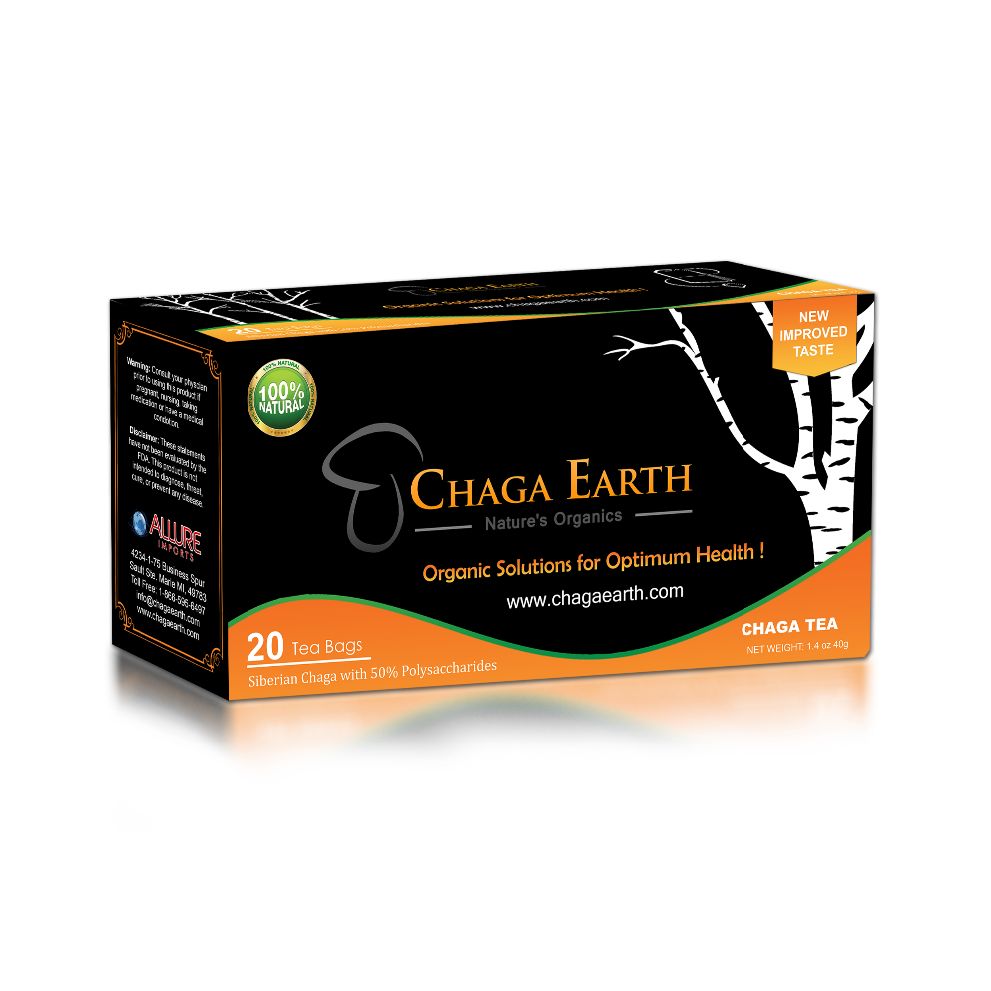
SIBERIAN CHAGA (Tea bags)
Siberian Chaga is the latest in a line of health products offered by Allured Imports, Inc.
Siberian Chaga is a premium tea blended from the mushroom that grows wild on the Birch trees of Russian forests. Only the finest of these morels are naturally harvested and are then ground finely to be used as a tea mixture that offers outstanding health benefits.
CALL NOW: 866 595 6497

Slide 3
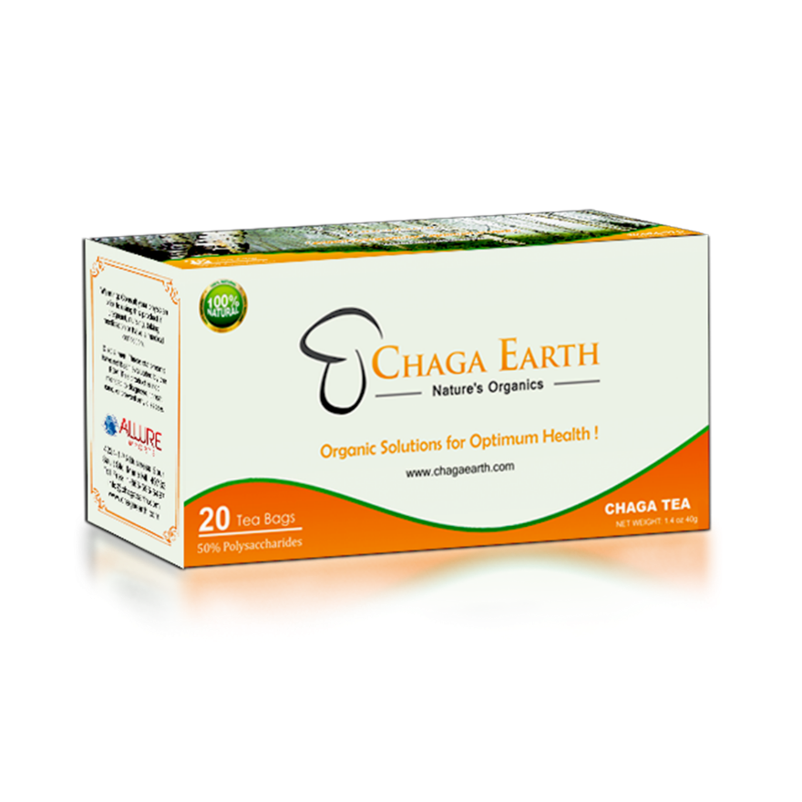
CHAGA GOLD (Tea bags)
Chaga Gold is a tea sold by Allure Imports, Inc. and made from its namesake mushroom that has been found to be one of the most powerful superfoods in the world. The benefits of this potent morel include enhancement of the human immune system, tumor inhibitor, and anti-inflammatory.
Not only is Chaga Gold good for you, it tastes good too, pleasing the palate with a unique, rich flavor that is certain to please any tea-drinker. It is simply a great substitute for your morning coffee, with a unique brewed aroma that will perk up your senses.
CALL NOW: 866 595 6497

Slide 4
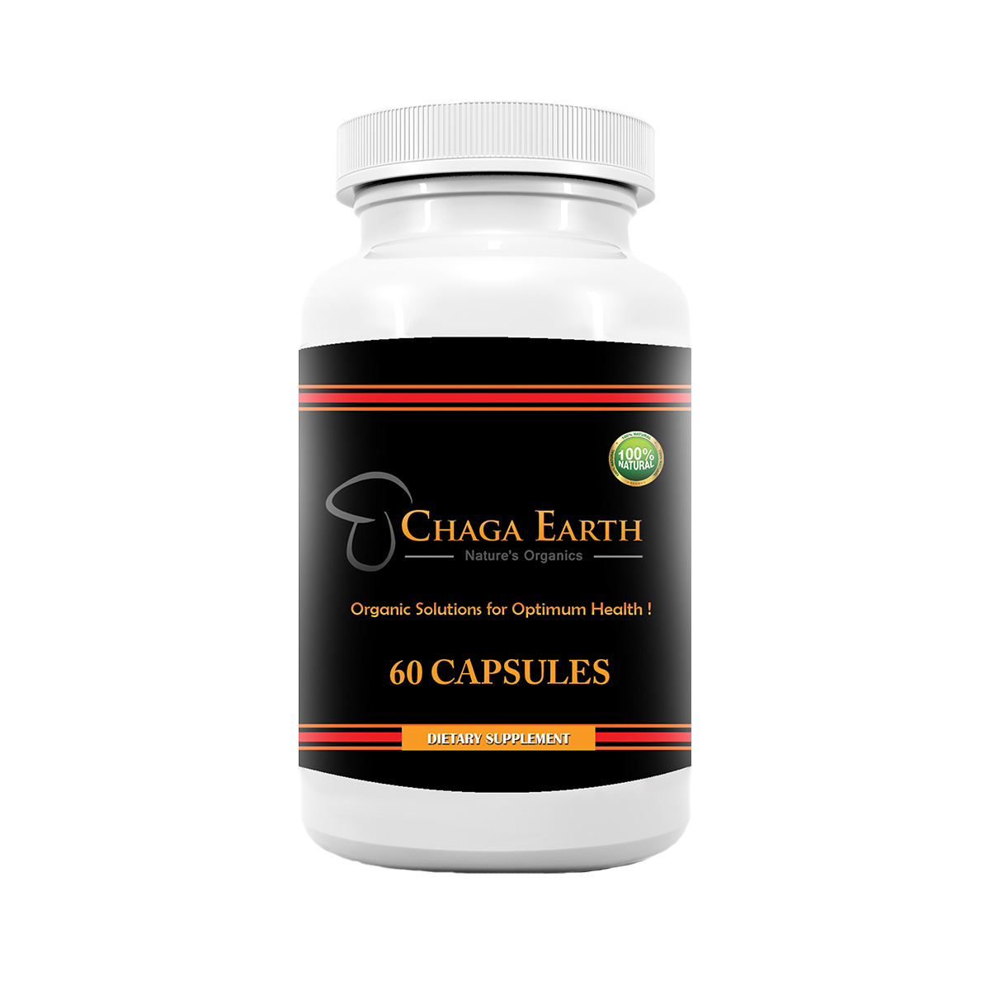
CHAGA SUPPLEMENT (CAPSULES)
Allure Imports, Inc. has added Chaga Supplements to its line of products, a simple and effective way to enjoy the benefits of Chaga when you’re too busy to take the time to brew it in a cup of tea. Chaga is a morel that grows wild on trees above the 45th parallel; and it is prized by laymen and experts alike for its health advantages.
Chaga is a powerful but unique herbal substance that incorporates a wide range of medicinal powers including everything from working as an anti-aging biologic to infusing restorative properties to human body systems all the way to the cellular structure.
CALL NOW: 866 595 6497

Slide 5
CONTACT US
ADDRESS:
42341-75 Business Spur, Sault Ste. Marie Ml, 49783
TOLL FREE:
1-866-595-6497
EMAIL:
info@allureimports.com
KINDLY VISIT OUR WEB - SITES FOR PRODUCT DETAILS:
www.goodlifeondemand.com www.fullthrottleondemand.com www.facedoctor.ca www.chagaearth.com

