Slide 1
Azoteq IQS231 SAR Controller
The World Leader in Capacitive Proximity Sensing

Slide 2
Azoteq Proximity SAR solutions
Designed for SAR compliance
Failsafe firmware & hardware
Algorithms to ensures long-term stability
SOT23, MSOP10, DFN10 packages
Configuration via OTP, input straps, I2C
Low power consumption
IQS229 – 1 channel
IQS263 – 3 channels

Slide 3
IQS231
Optimized for SAR applications
Human movement detection - distinguish between humans and inanimate objects
Minimal external components
Standalone and I²C modes
OTP or I2C configuration
Optional external threshold adjustment
Self and Projected capacitive sensing
Low power modes: 100Hz, 30Hz, 8Hz, 4Hz sample rates
1.75V to 3.6V Supply voltage
Replacement solution for the IQS128
6 pin TSOT23-6

Slide 4
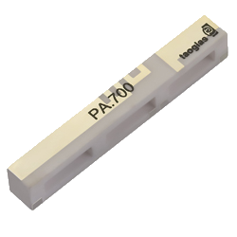
Special features
Human movement detect
Dedicated movement channel
Can detect small human movements
Quick release
Detect human interaction
Hand-held power on detection
Failsafe operation with heartbeat
Safety critical applications
Synchronization with RF transmit/receive
Utilize 3G/4G antenna as electrode

Slide 5
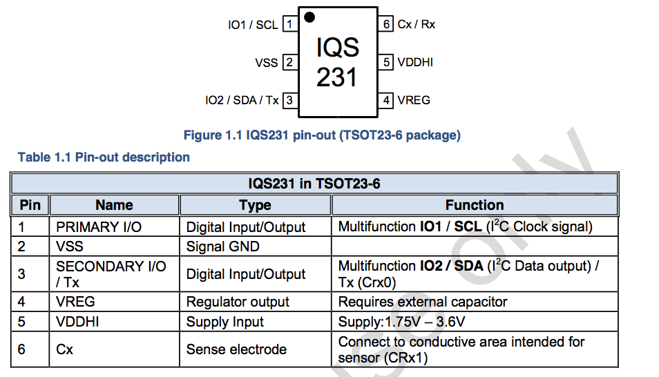
Pinout

Slide 6
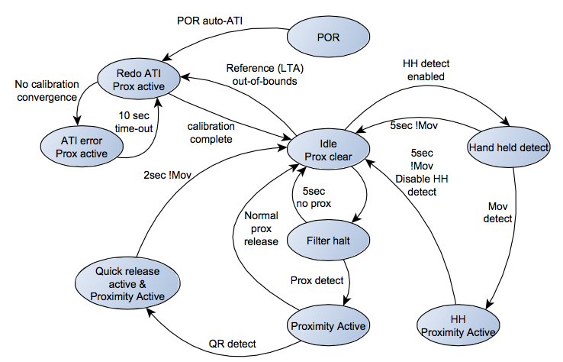
Proximity detection – movement disabled

Slide 7
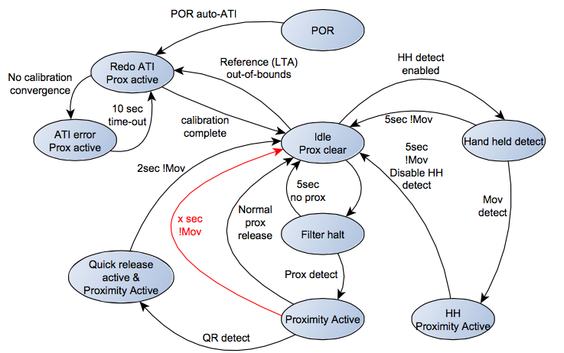
Proximity detection – movement enabled

Slide 8
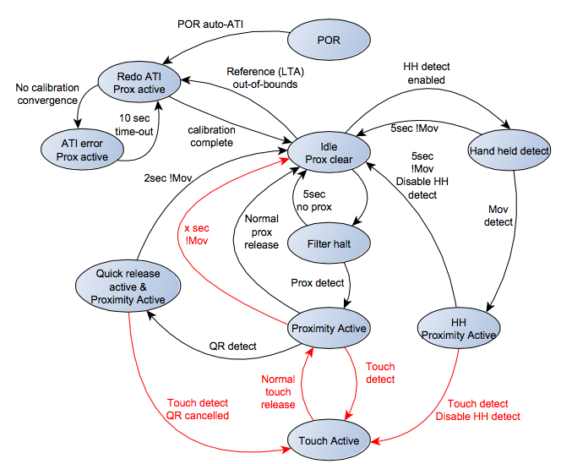
Proximity & touch detection – movement enabled

Slide 9
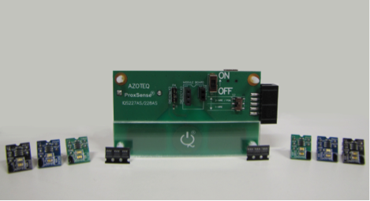
IQS231 – Evaluation Kit
Modular design: Mainboard with modules allow rapid prototyping
Reference design for IQS231 with user proximity & touch detection ability
LEDs indicate proximity and touch
Modes of operation:
Standalone mode: Battery or USB powered with LED indicators for proximity or touch
I²C Mode: Graphical user interface to view controller data. (Requires CT210 or DS100)
In-circuit OTP programmer (requires CT210)

Slide 10
Additional resources

Slide 11
SAR design resources
IQS229, 231, 263 Datasheets available on Azoteq website
Application notes to meet SAR specifications
AZD073 | SAR Qualification with Azoteq Movement Based Sensors | IQS229 | Download
AZD081 | Capacitive sensing techniques to meet SAR requirements | IQS128, 253 | Download
AZD080 | A Guide to Prolonged Detection using Capacitive Proximity Sensors | IQS127, 128, 229 | Download

Slide 12
IQS229 – In production
Azoteq movement detection technology
Designed for SAR test specification compliance
Automatic Tuning (ATI)
Internal Capacitor Implementation (ICI)
Supply voltage: 1.8V to 3.6V
External strap options for quick configuration
Streaming data option
Advanced on-chip digital signal processing
Ultra Low Power (30uA)
Robust UI for long term stability
Separate activation and movement outputs
3x3mm DFN10 package

Slide 13
IQS263 – In Production
Up to 80Hz report rate
On chip Movement Detection algorithm
SAR compliance in mobile devices according to the IEC 62209-2 ed1.0 standard and the FCC standard (KDB 616217 – D04 SAR for laptop and tablets v01)
Long proximity range
Automatic drift compensation
Fast I2C Interface
Event mode or Streaming modes
Hibernation mode
Low Power, suitable for battery applications
Supply voltage: 1.8V to 3.6V
<3μA Active sensing in LP mode
<100μA full running current up to 40Hz report rate
MSOP10 package

Slide 14
IQS231 SAR Sensor Controller

