Slide 1
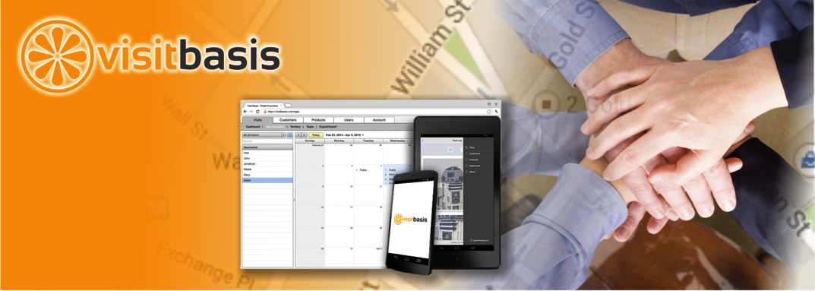
Visitbasis
Android & iOS Mobile App for Field Data Collection.
VisitBasis Retail Execution is a cloud-based enterprise data collection SaaS software for managing, scheduling, and monitoring field team activities in real-time. Ideal for merchandising, service audits, secret shopping, field sales and promotions.
Автоматизация работы тайных покупателей с приложением VisitBasis для Android и iOS.

Slide 2
visitbasis
If you want to boost your sales, maximize sales productivity and business intelligence at the same time, just use the right tools for sales effectiveness! The VisitBasis Mobile App for Field Data Collection helps sales managers and field teams by offering a set of tools to enhance sales productivity.
Field reps visit multiple stores every day to help consumer packaged goods companies to ensure the product is properly priced and merchandised. Field sales automation allows companies to tighten collaboration between field reps and points of sales and to achieve the best results at the store shelf.
VisitBasis offers Mobile App for Field Data Collection for managing, scheduling, and monitoring field reps' activities in real-time. The VisitBasis Mobile App for Field Data Collection gives field reps easy access to all merchandising and sales data and tools required to perform in-store activities and allows them to collect critical information for store performance analysis. The office supervisors can track all the field activities in real time using VisitBasis web-based dashboards and reports.
Mobile App for Field Data Collection works both on Android and iOS smartphones and tablets and is the ultimate tool for field representatives, merchandising, retail audits, mystery shopping, promotions.

Slide 3
visitbasis
The VisitBasis Mobile App is a cloud-based enterprise data collection SaaS software designed to automate sales process, improve your sales effectiveness, manage sales teams
Mobile App for Field Data Collection allows you to optimize field rep scheduling, planning and tracking. Manage territories among your field reps, schedule and plan visits, optimize field rep routes so they spend more time on the actual visits than travelling. GPS technology helps tracking all field activities live on the map. The office managers can easily access field reps timesheets.
With VisitBasis Orders and Returns your field sales reps are able to easily reorder items that are out-of-stock and automatically place these orders as soon as a connection is established. The app automatically tracks every activity the rep performs. Run your planogram checks, promotion and price check, competition surveys, product display photo reports, shelf spacing and product face counting tasks to ensure compliance with your retail execution plans.
You can start sales automation completely free after you create an account at www.visitbasis.com. Free download from Google Play and App Store for any number of field representatives.

Slide 4
visitbasis
Maximize the Efficiency and Effectiveness of Your Field Team Automation Process
WITH VISITBASIS MOBILE APP FOR FIELD DATA COLLECTION, YOU CAN GET:
Real-time Dashboard and Reporting
VisitBasis generates several types of real-time reports with info on user, customer, visit, task, order, timing and location information
Live GPS Tracking and Mapping
All user activity is GPS and time stamped. Collect customer's signature, timestamp and geolocation to get immediate audit confirmation and/or to comply with regulations
CRM and Territory Management
Robust system and user-friendly Rich Internet Application office interface with multi-team support - build as many outside sales teams as needed
Advanced Map Tools
With tools like "Route Optimization" it is easy to make time for an extra appointment a day
Integration
Export and import all your business information from/to VisitBasis (google docs integration, custom reports)
High Performance Level, Globally
Since VisitBasis is a Google Cloud implementation, you can count on the best service availability even if your company is multinational and runs in different countries and time zones

Slide 5
visitbasis
The Advantages of VisitBasis: Easy, Zero-Cost Setup and Cost-Effectiveness for Your Business.
ONLY PAY FOR WHAT YOU USE – NOTHING MORE
Pay-as-you-go charging – no licenses, no subscriptions. With Pay-as-you-go, you will only be obligated to pay $0.20 per executed visit, which means you only pay for visits in which your field representatives actually completed a task; whether it is setting a route for an outside sales rep, or a sales rep placing an order for a customer during a store visit. If you only log into the app to view data or information and there are no actions being implemented – there won’t be a charge. With the Pay-As-You-Go system, you only pay for what you use - never paying for holidays, weekends, and avoiding account issues due to user turnover.
Bring your own device (BYOD): your field reps can bring their own devices as VisitBasis Mobile App for Field Data Collection can run on any smartphone or tablet and looks and feels exactly the same. There is no limit on the number of devices each employee can use at any given time. BYOD solutions has proven to be remarkably effective, because most individuals already own their own mobile devices, whether it be – an iPhone, iPad, Android smartphone or any of these that allows outside sales representatives to accomplish their daily tasks right from their mobile devices.

Slide 6
Visitbasis tech, llc
Start your sales automation with VisitBasis, powered by Google Cloud, and you’ll see how easy it can be.
www.visitbasis.com Phone: +1 (954) 505-2059 Email: sales@visitbasis.com Twitter: @visitbasis
Facebook: https://www.facebook.com/visitbasis
Blogger: http://blog.visitbasis.com/

