Slide 1
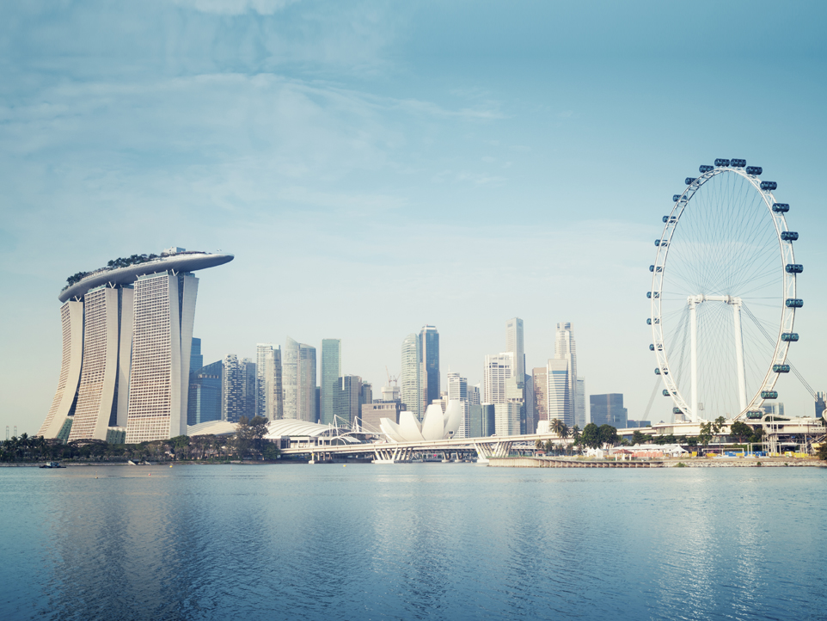
Incorporation Of Private Limited
Company In Singapore
A Brief Guide

Slide 2
Most of the companies in Singapore are incorporated as private limited companies. According to the Singapore Companies Act, such companies need to add “Private Limited”, “Pte Ltd” or “Ltd” as a suffix to their company name. Additionally, the private limited company is a separate legal entity in Singapore, which is also considered as an independent business structure from its owners.
Accounting and Corporate Regulatory Authority of Singapore or ACRA is the governing body looking after Singapore company incorporation and company registration process in Singapore.
We at SBS Consulting will help you in all steps of company incorporation and ensure your company is incorporated as quickly as possible if every document and every prerequisite is properly managed.

Slide 3
In the Singaporean corporate environment, a private limited company is the business entity with separate legal identity apart from its shareholders. By all means such companies incorporated in Singapore are recognized as taxable entities and are taxed as per the local corporate tax code. In addition to that, the company can be sued and can sue in its own name leaving behind the liability of shareholders and directors.

Slide 4
Requirements To
Incorporate a
Private Limited Company In Singapore

Slide 5
1. COMPANY NAME
Most of the companies in Singapore are incorporated as private limited companies. According to the Singapore Companies Act, such companies need to add “Private Limited”, “Pte Ltd” or “Ltd” as a suffix to their company name. Additionally, the private limited company is a separate legal entity in Singapore, which is also considered as an independent business structure from its owners.
Accounting and Corporate Regulatory Authority of Singapore or ACRA is the governing body looking after company incorporation and company registration process in Singapore.

Slide 6
2. ISSUED SHARE CAPITAL
According to the Singapore Companies Act and as per the statutes of Singapore company incorporation minimum paid-up capital (share capital) required to incorporate a private limited company in Singapore is 1 Singapore Dollar or S$1.
This initial share capital is entitled tot be increased at any time after the company is incorporated. For Singapore companies, there is no any concept such as Authorized Capital making it further easier to do and incorporate a business in Singapore.

Slide 7
3. OWNERSHIP OF THE COMPANY
The issued share capital has to be held or owned by at least one individual or by one or many corporate entities.
There are no restrictions on how much share capital can be withheld or owned by a single entity. Additionally, there are no restrictions or limitations o the amount of share capital held by foreign individuals or by the foreign companies.
This might be the reason more and more foreign companies are interested to set up business in Singapore by incorporating a subsidiary company as a private limited business entity.

Slide 8
4. DIRECTORS
In order to meet the statutory obligations of the Singapore Company Act, it is mandatory to appoint an Omni director. As of now, there are no restrictions on foreign individuals to serve as a director of a company incorporated in Singapore. If the concerned company is interested to appoint a foreign individual as the director of of the company; then, this Omni director will serve as a nominee director until the foreign director receives the Employment Pass.
The appointed director must be above 18 years of age and an ordinary Singapore resident. Therefore, it would be better of the newly incorporated company appoints two directors. One, an ordinary resident of Singapore and the other one with foreign nationality.

Slide 9
5. COMPANY SECRETARY
Pass. According to Section 171 of the Singapore Companies Act, it is necessary to appoint a qualified company secretary within first six months of company incorporation.
In no way, a sole director or a sole shareholder is allowed to act or take over the responsibilities of a company secretary.
The appointed company secretary is required to be a natural person, ordinarily resident of Singapore and has to have required education and experience to act as a secretary.

Slide 10
6. APPOINTING AN AUDITOR
Unless exempt from audit requirements (As per the Section 205A of the Companies Act.), private limited companies incorporated in Singapore will have to appoint an auditor within three months after company incorporation.
An exempt company is one having less than 20 individual shareholders or the company is not having any corporate shareholders. In addition to that, a company is also exempted from audit requirements, if the annual turnover of the company is less than S$5 million.
For additional information on exempt companies you may refer this link http://www.sbsgroup.com.sg/incorporation/exempt-private-limited-company-explained/

Slide 11
7. REGISTERED OFFICE ADDRESS
It is Necessary for every individual and for every individual and for every foreign company to have registered Singapore address ready at the time of Singapore company incorporation.
Please ensure that the registered address has to be the physical address in Singapore.
P O Box addresses are not and will not be accepted by ACRA to register a business in Singapore.

Slide 12
8. ACCOUNTING COMPLIANCE
Every company must audit and file its accounts on an annual basis.
Although dormant and exempt private limited companies having turnover less than S$5 million per annum are exempted from the auditing obligation, it is expected, that these companies should maintain proper accounting records and file their unaudited accounting records on a yearly basis.
According to the Section 205A, Singapore Companies Act (Cap.50) an EPC (Exempt Private Company) is the one wherein shares are not withheld either directly or indirectly by an corporate entity or the company having less than 20 shareholders.

Slide 13
9. ANNUAL GENERAL MEETING
Every Singapore incorporated company must organize its annual general meeting once in a calendar year. Tabling the financial statement for shareholder’s approval is must at the time of the AGM.
It is mandatory to conduct the first annual general meeting within 18 months of company incorporation or six months before the end of the subsequent financial year, whichever is the earlier and annually thereafter.
Private companies by passing unanimous shareholder’s resolution in the general meeting can dispense this requirement.

Slide 14
10.TAXATION
Singapore private limited companies have immense opportunities to participate in different tax exemption and business incentive schemes. Corporate tax in Singapore starts from 0% and is capped at 17%.
First S$100,000 of taxable income is exempt from taxes and effective tax rate is 5.6% on the profits earned up to S$ 300,000, henceforth the tax rate becomes flat 17%.
Singapore does not impose any capital gain taxes or dividend taxes on companies incorporated in Singapore.
The Singaporean taxation regime offers some splendid benefits to the Singapore businesses and this might be the reason, entrepreneurs and investors from all over the world and interested to set up new business in Singapore.

Slide 15
Are You Ready To Register a
Private Limited Company
In Singapore?

Slide 16
SBS Consulting has acquired excellent expertise in helping domestic and international clients to set up a private limited company in Singapore. If all the necessary documents are in place and if everything is prepared, SBS Consulting will register your business with ACRA within few hours.
To Understand More About Our Company Incorporation Promo Packages Visit
http://www.sbsgroup.com.sg/incorporation-promo-package/
To Understand More About Our Incorporation Package and Fees Visit
http://www.sbsgroup.com.sg/incorporate-a-singapore-company/

Slide 17
Contact Us:
SBS Consulting Pte Ltd 35-B Hongkong Street, Singapore – 059674
Tel: +65 6536 0036 Email: info@sbsgroup.com.sg Website: http://www.sbsgroup.com.sg/

Slide 18
Thank You !

